Slide 1
Psychological Aspect of Skin Disease
Dr. Rr. Tesaviani Kusumastiwi Sp.KJ

Slide 2
Learning Objective
Interaction of skin and psyche
Neurobiological factors
Acute and Chronic Stress Response to Skin
Psychodermatology disease

Slide 3
INTERACTION OF SKIN AND PSHYCE

Slide 4
SKIN AND PSYCHE RELATIONSHIP

Slide 5
Classification
stress → skin: skin disorders which are caused by mental disease (delusional parasitosis, body dysmorphic disorder)
skin → stress: psychosocial stress/disorder (reactive depression, adjustment disorder, anxiety disorder) is the result of a skin disease
stress ↔ skin: genuine interrelation between psychosocial stress and somatic aspects at the beginning and/or over the course of chronic skin diseases (such as atopic dermatitis, psoriasis, urticaria, acne)

Slide 6
Psiko
Sosial
Bio
KONSEP BIOPSIKOSOSIAL DALAM KESEHATAN
Understanding this interrelation is critically relevant, not only to ensure a good quality of life of affected patients but also for consistent therapeutic success.

Slide 7
NEUROBIOLOGICAL FACTOR

Slide 8
SKIN AND PSYCHE RELATIONSHIP

Slide 9
Stress Response System

Slide 10
Psychodermatology
The immune system always co‐reacts when stress mediators are released
Receptors for stress mediators can be found on every cutaneous and skin‐infiltrating cell of the immune system
This includes the protagonists of innate immunity such as mast cells, Langerhans cells, neutrophils, and eosinophils, as well as the protagonists of specific adaptive immunity such as B and T cells

Slide 11
HPA(Hipotalamus Pituitary Adrenal) Axis
Stress → Hipotalamus → CRH → Pituitari anterior → ACTH → Adrenal Gland → immune system

Slide 12
The Sympathetic Axis in Stress Response System
SIMPATIS
HPA AXIS

Slide 13
Acute and Chronic Stress
Adaptive responses to acute stress have to be distinguished from the events that occur under chronic stress :
As it is too energy‐consuming → collateral damage.
Release of cortisol is reduced, instead, baseline secretion is increased.
If a chronically stressed organism encounters acute stressors, cortisol levels do not rise as much as otherwise under acute conditions, nor do they decrease as much afterwards.
At the same time, the coupling of the SA and the HPA is lost.

Slide 16
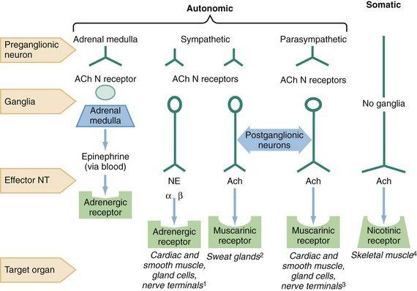
The cholinergic Axis in Stress Response System
The cholinergic axis (CA) with the mediator acetylcholine and its nicotinic and muscarinic receptors regulates → anti inflammatory

Slide 17
CA hypothesis in psychodermatology
Recently, the hypothesis of the anti‐inflammatory CA has attracted a lot of attention.
Indeed, acetylcholine is able to suppress the release of TNF‐alpha from different cells of the immune system.
There is evidence that the CA affects the barrier function of the skin under stress conditions, by stimulate expression of nAChR in neuronal ACh

Slide 19
NNA (Neuropeptida, Neurotropine)
The existence of another stress axis was proposed which includes neuropeptides (Substansi P, calcitonin gene‐related peptide [CGRP])
SP modifies the stress response by inhibiting the HPA; locally, by increasing sensory perception and pruritus.
CGRP : vasodilatation + hair growth inhibitory effect
Neurotrophins (nerve growth factor [NGF] → degranulation mast cell
Brain‐derived neurotrophic factor [BDNF]) as mediators → increase Th2 response → production IgE, reduce th1 response

Slide 20
NEUROPEPTIDE, NEUROTROPINE AND BDNF
Stress‐induced SP release from nerve fibers sensitizes mast cells for further stimuli.
Under the influence of SP, mast cell degranulation is significantly more pronounced in response to immunological triggers such as IgE → histamine
Furthermore, neuropeptides very individually and specifically stimulate the release of individual cytokines from mast cells and activates endothelial cells, with subsequent T‐cell infiltration of the skin

Slide 21
PSYCHODERMATOLOGY DISEASE

Slide 22
Delusional Parasiter
* Yakin di kulitnya ada parasit (waham)
* Timbul rasa bersalah dan ketakutan
* Masuk dalam gangguan jiwa berat (Psikotik) sering bersama dengan Skizofrenia ataupun gangguan akibat penyalahgunaan zat (kokain/alkohol)
→ Intervensi Psikiatrik

Slide 23
Dermatitis Artifisialis
* Dibuat oleh penderita misal dengan zat kimia secara fisik atau mekanik
* Pada pasien psikotik atau kepribadian borderline
* Di daerah yang mudah dijangkau penderita
Berbeda dengan malingering (imbalan perhatian, uang dll)

Slide 24
Ekskoriasi Neurotic
Menggaruk dengan repetitif dan kompulsif
Mengakui UKK dari hasil garukan sendiri
Muka, lengan atas, punggung → ekskoriasi dengan krusta hemoragik atau supuratif atau sikatriks karena digaruk oleh penderita. Gatal +, infeksi sekunder +
Gangguan impulsivitas atau compulsivitas

Slide 25
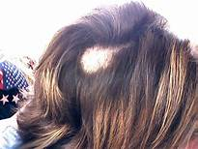
Trikotilomania
* Menarik (mencabut) rambut dalam satu area
Merasakan kepuasan setelah mencabut rambut
Meningkat saat situasi stress/cemas

Slide 26
Body Dismorphic Disorder
Adanya perhatian dan fokus yang berlebihan terhadap defek yang diasumsikan ada pada penampilan fisik, walaupun sebenarnya penampilan tampak sepenuhnya normal.
Keluhan mengenai penampilan penderita biasanya berpusat pada 3 area yaitu wajah, kepala, dan kelamin.

Slide 27
Kelainan sekunder akibat penyakit kulit (Skin to Stress)
CEMAS DAN DEPRESI
ALOPECIAREATA
VITILIGO

Slide 28
SKIN ←-→ STRESS
Pruritus
Psoriasis
Acne

Slide 29
Pruritus
* Kausa : Eksogen dan endogen
* Pruritus primer : tanpa ada penyakit dermatologik bisa lokalisata atau generalisata
* Psikogenik stimulasi pada itch center.
Interaksi stress dengan cell mast → pelepasan histamin

Slide 30
Psoriasis
Multifactorial
Proliferasi epidermal keratinocyt
Sensory nerves release neuropeptides (neurotensin, somatostatin, substance P and NGF) which activate the proliferation of keratinocytes.
Cholinergic fibres produce acetylcholine and the vasoactive intestinal peptide (VIP) → vasodilatation.
Stress hormone inhibit keratinocyte migration, and epineprin activate keratinocyte beta adrenergic reseptor (impaired cell motility and wound reepithelization

Slide 31
ACNE
Acne and seborrhoeic dermatitis may be caused by a neurogenic stimulation of sebaceous secretion.
Sensory nerves release neuropeptides (neurotensin, somatostatin, substance P, NGF, hormone melanocyte, and PPAR-γ) stimulant-α and the peptide derived from the propiomelanocortina, all of which stimulate sebaceous gland sebocytes, increasing secretion.
The activated sebocytes also secrete cytokines (IL1-α IL-6, TNF-α, INF-γ and PPAR-γ) that produce inflammation

Slide 32
mind

