Slide 1
PREVENTIVE adhesive RESTORATION
PAR
Drg. Alfini Octavia, Sp.KGA

Slide 2
pengertian
Restorasi PAR (Preventive Adhesive Resin):
Restorasi yang menggunakan bahan-bahan adhesive , termasuk
didalamnya Preventive Resin Restoration

Slide 3
Teknik mendiagnosa karies
1. Pemeriksaan Visual
2.Translumination
3.Laser fluorosence
4.Radiograph

Slide 5
Prevention for caries
INTERVESI AWAL:
Menyeimbangkan lingkungan rongga mulut : bacterial test, antimicrobial (chlorhexidine, iodine, xylitol),saliva, diet intervention
Pembersihan plaque : brushing, flossing
Remineralisasi: fluoride dentrificis, profesional fluoride aplication, Casein phosphopeptide-amorphous calcium phosphate (CCP-ACP)
Fluoridated filling material : Glass Ionomer Cement, Resin based sealant

Slide 6
Bahan-bahan PAR
1. Glass Ionomer cement
2. Resin

Slide 7
restorasi adhesive dengan Glass ionomer cement (GIC)
Kemampuan berikatan dengan struktur gigi secara kimia
Ikatan kimia→ kombinasi dari struktur Ca /Strontium phosphate/polyalkenoic acid yang ada dipermukaan emaol/dentin dan permukaan bahan yang telah setting
Ikatan dengan komponen organik→ikatan hidrogen dengan grup karboksil pada poliacid dengan molekul kolagen pada dentin
Melepaskan fluoride

Slide 8
…dengan struktur gigi…
Conditioning: meningkatkan dasa adhesi gigi
Bahan conditionong : citric acid,hidrogen periksid,10% poliakrilic acid
Tujuannya menghilangkan smear layer
Mekanisme: Menurunkan energi dipermukaan gigi
Meningkatkan kelembaban di permukaan gigi
Meningkatkan adhesi dari semen ke permukaan gigi

Slide 9
Kelebihan dan kelemahan GIC
Kelebihan:
Anti kariogenik
Translusen
Biokompatibel
Melekat secara kimia dengan struktur gigi
Sifat fisik yang stabil
Mudah dimanipulasi
Kelemahan:
Water in dan water out
Compressive strength rendah
Resistensi terhadap abrasi rendah
Estetil lebih rendah daripada komposit/resin

Slide 10
Secondary caries is responsible for greater than 50% of all restorations that are replaced (Mjor, 1997).
Considerable fluoride release occurs during the glass ionomer cement setting reaction and continues at very low levels for years (Arends et al., 1995). The released fluoride is readily up- taken by the cavosurface tooth margins of the restorative material (Hicks et al., 2003).
Resistance to secondary caries at the cavosurface margins and adjacent smooth surfaces to the glass ionomer cement restorative material has been demonstrated (Donly et al., 1999a, b).
Fluoride at the restoration surface and rerelease the fluoride, the restorative material acting as a fluoride reservoir.
Advantage of using glass ionomer cement restorations in children who are of moderate caries risk for the prevention of secondary caries.

Slide 11
PREVENTIVE RESIN RESTORATION (SEALED COMPOSITE RESIN RESTORATION)
PRR adalah suatu alternatif prosedur untuk merestorasi gigi tetap muda yang membutuhkan preparasi minimal untuk membuang karies di oklusal maupun di fissure yang berbatasan

Slide 12
PREVENTIVE RESIN RESTORATION (SEALED COMPOSITE RESIN RESTORATION)
Henderson and Setcos described the sequence of the preventive resin restoration that is particularly applicable for young patients with recently erupted teeth and minimally carious pits.

Slide 13
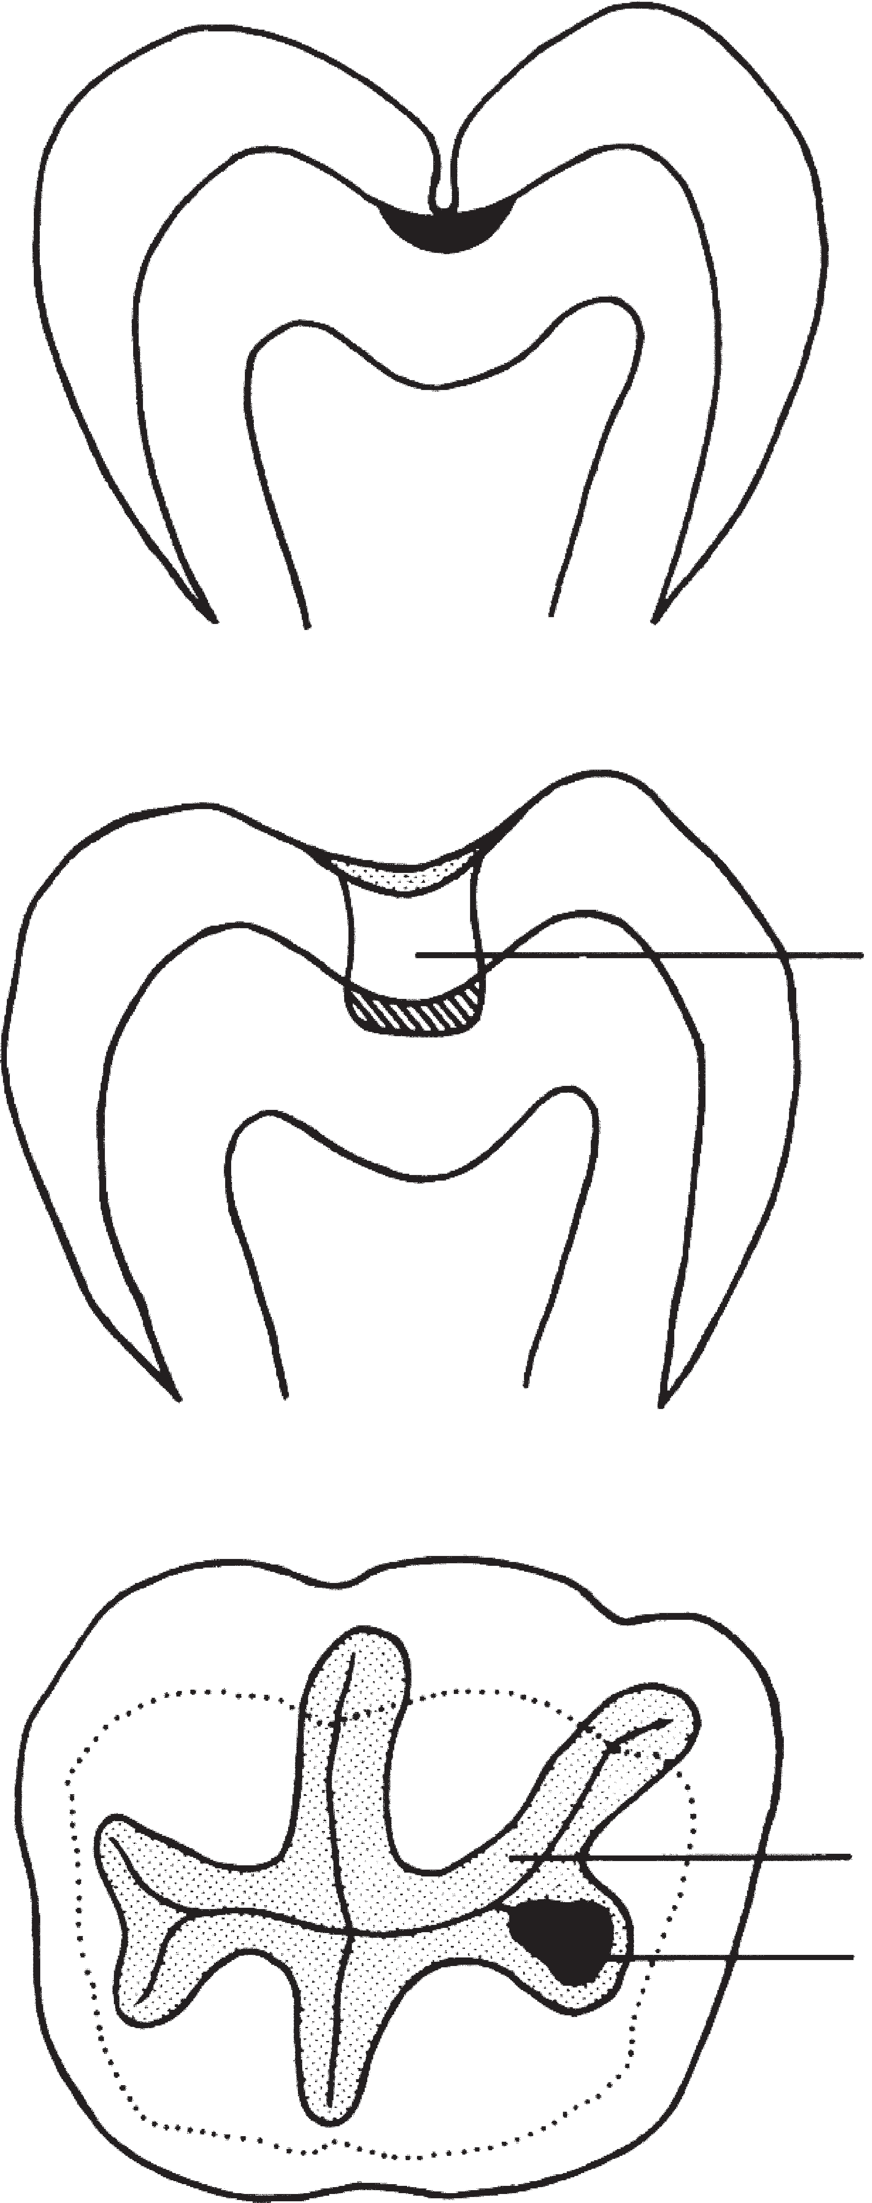
Permukaan oklusal sering memiliki karies kecil. Untuk mengatasi keausan bahan tambal karena gaya kunyah yang besar, peletakan bahan tambal biasanya lebih luas dari kariesnya.

Slide 14
TYPES OF PRR
Based on the extent and depth of the carious lesions:
a) Type A - Suspicious pits and fissures where caries removal
is limited to enamel.
b) Type B - Incipient lesion in dentin that is small and confined
c) Type C - Characterized by the need for greater exploratory
preparation in dentin

Slide 15
TYPE A RESTORATION.
PLACEMENT TECHNIQUE TYPE A RESTORATION 1)CLEAN THE SURFACE
2)ISOLATION
3)REMOVE DECALCIFIED PITS AND FISSURE
4)PLACE ACID – ETCHED GEL – 20 TO 60 SEC
5)WASH AND DRY
6)APPLY THE SEALANT
7)POLYMERISE WITH VISIBLE LIGHT – 20 SEC
8)ADJUST THE OCCLUSION, IF NEEDED

Slide 16
TYPE B RESTORATION
PLACEMENT TECHNIQUE
Removal caries with a high speed no.330 bur, followed by a slow speed no.1/2 Round bur.
2. After caries removal Ca(OH)2 liner is placed .
Acid etching Acid etching gel is applied over the entire occlusal surface for 20 to
60 sec , then washed 20 Sec and dried 10 sec.
3. Bonding agent application The walls of the preparation are coated with bonding
agent which act as an intermediate Resin layer.
4. Composite resin application Filled composite resin is injected into the
preparation and placed.
5. Resin condensed and smoothened by plastic or Teflon instrument.
The composite resin is condensed and smoothed with a plastic or teflon
Instrument.
6. Sealant application. Filled sealant material is Applied over the entire Occlusal
surface.
7. Polymerization All layers are simultaneously Polymerized with visible light
Produced by the Polymerization unit.
8. Occlusal adjustment The occlusion is adjusted, Where required, with finishing
burs.

Slide 17
TYPE C RESTORATION.
PLACEMENT TECHNIQUE
1.Repeat all steps listed for type B
2.Type C is larger and deeper add additional polymerization time (30 sec).
3. In most cases local anesthesia will also be required.

Slide 18
EVIDENCE:
Walker and associates :preventive resin restorations placed in patients 6 to 18 years of age and observed for up to 6.5 years.Of the 5185 restorations, 83% did not require further intervention. Those requiring intervention included 37% that needed sealant alone and 21% that required treatment because of the development of an interproximal lesion.
Houpt and associates :complete retention of 54% of their preventive resin resto- rations, partial loss of sealant in 25%, and complete loss of sealant in 20% after 9 years. Caries occurred in 25% of the teeth that had sealant loss, and 88% of the restored surfaces remained caries-free 9 years after treatment.

Slide 19
CONCLUSION
Loss of the restoration and subsequent replacement proves to be less invasive than that for conventional restoration like amalgam.
PRECAUTIONS Early loss of PRR similar to pit and fissure sealants due to insufficient etching so, it is very important to maintain excellent isolation from moisture contaion
ADVANTAGES Minimal cavity preparation is required thus prevents unnecessary removal of healthy tooth structure for retention. Seals caries halting the destruction of tooth. Eg: teeth with pit and fissure

Slide 20
THANK YOU!

