Slide 1
Neisseria gonorrhoeae
muhammad kurniawan

Slide 2
Gonorrhea : Neisseria gonorrhoeae
Termasuk dlm famili Neisseriaceae
Morfologi
Coccus Gram Θ (0.6 x 1.0 μm)
→ sering ‘diplococcus’ (seperti biji kopi)
Tak mempunyai flagela
Tak berspora
Mempunyai pili (strain virulen)

Slide 3
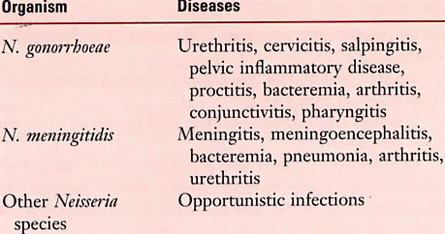
Neisseria Associated Diseases
(ophthalmia neonatorum)

Slide 4
Epidemiology of Gonorrhea
Sexually-transmitted disease
Found only in humans
Asymptomatic carriage is major reservoir
Lack of protective immunity and therefore reinfection, partly due to antigenic diversity of strains
Higher risk of disseminated disease in patients with complement deficiencies

Slide 5
Differences Between Men & Women with Gonorrhea
In MEN
Urethritis; Epididymitis
Most infections among men are acute and symptomatic with purulent discharge & dysuria (painful urination) after 2-5 day incubation period
The two bacterial agents primarily responsible for urethritis among men are N. gonorrhoeae and Chlamydia trachomatis

Slide 6
Differences Between Men & Women with Gonorrhea
In WOMEN
Cervicitis; Vaginitis; Pelvic Inflammatory Disease (PID); Disseminated Gonococcal Infection (DGI)
Women often asymptomatic or have atypical indications; Often untreated until PID complications develop
Pelvic Inflammatory Disease (PID)
May also be asymptomatic, but difficult diagnosis accounts for many false negatives
Can cause scarring of fallopian tubes leading to infertility or ectopic pregnancy

Slide 7
Females | Males
50% risk of infection after single exposure | 20% risk of infection after single exposure
Asymptomatic infections frequently not diagnosed | Most initially symptomatic (95% acute)
Major reservoir is asymptomatic carriage in females | Major reservoir is asymptomatic carriage in females
Genital infection include cervix (cervicitis), but vagina, urethra, rectum can be colonized | Genital infection generally restricted to urethra (urethritis) with purulent discharge and dysuria
Ascending infections in 10-20% including salpingitis, tubo-ovarian abscesses, pelvic inflammatory disease (PID) , can lead to sterility | Rare complications may include epididymitis, prostatitis, and periurethral abscesses
Disseminated infections more common, including septicemia, infection of skin and joints (1-3%) | Disseminated infections are very rare
Can infect infant at delivery (conjunctivitis, opthalmia neonatorum) | More common in homosexual men
Gonorrhea

Slide 8
Fisiologi
Sifat biokimia & ciri kultur :
- aerob
- oksidase +, katalase +,
sangat peka terhadap lingkungan merugikan :
drying, chilling, pH, sinar matahari
Kultur : pada 3-10% CO2
medium selektif : Thayer Martin Agar
(Chocolate Agar + Vancomycin, Colistin, Nystatin)
Identifikasi :
metabolisme glukosa : +
metabolisme maltosa, sukrosa, laktosa : -

Slide 9
Struktur Antigen
Ag pilus
Protein pada outer membrane
Lipo oligosakarida pada outer membrane
Determinan Patogenesis
Pili : faktor virulensi
Komponen pada outer membrane
Peptidoglycan
Ig A protease (hanya pada Neisseria pathogen)

Slide 10
Patogenesis
Infeksi berawal pada epitel kolumnar urethra, saluran periurethral
dan kelenjar kelamin → kuman melekat pada permukaan sel (dengan
pili) → penetrasi ke subepitel (hari III) → respon peradangan oleh
PMN (obstruksi oleh eksudat)
Penyebaran sering terjadi lewat pembuluh limfe, dapat pula lewat pembuluh darah
Resistensi
Non spesifik (wanita : Δ hormon & Δ pH genital ~ siklus haid;
pria : Δ pH, osmolaritas, kadar urea dari urin )
Spesifik ( sistem imun humoral terutama Ig A & Ig G,
Complement)

Slide 11
Pemeriksaan Laboratorik
Bahan Pemeriksaan
Nanah/sekret diambil dari uretra, servix, prostat, mukosa tenggorok, kadang-kadang cairan synovia
Pemeriksaan Mikroskopik
Spesimen yang diambil dibuat preparat oles dan dilakukan pengecatan gram. Gambaran mikroskopik dari Neisseria gonorrhoe adalah pada proses akut tampak diplokokkus gram negatif intraseluler dalam sel-sel darah putih dengan pengecatan gram
Pemeriksaan makroskopik (Kultur/penanaman)
Sekret diambil dari uretra (pada laki-laki) dan cervix (pada wanita) kemudian digores pada media Thayer Martin (media selektif yang diperkaya) dan diinkubasi dalam atmosfer yang mengandung CO2 5% (metode lilin padam) pada 35⁰ – 37⁰ C selama 48 jam. Untuk menghindari kontaminasi, media diberi antimikroba.

Slide 12
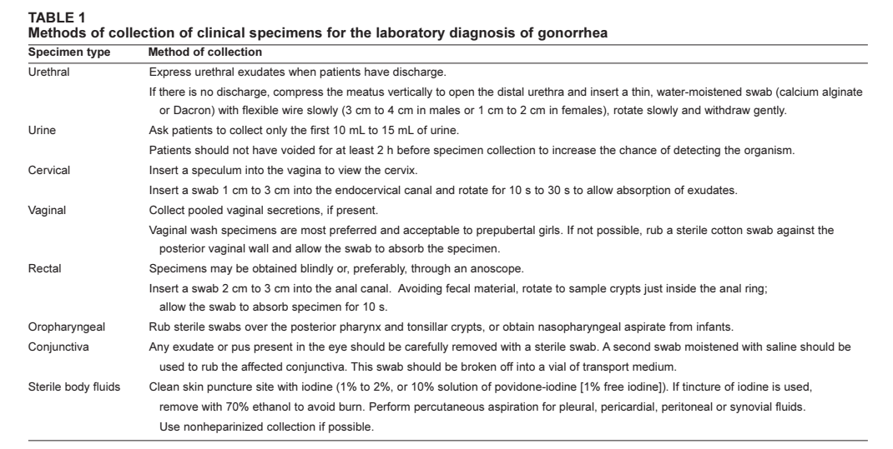
SPESIMEN

Slide 13
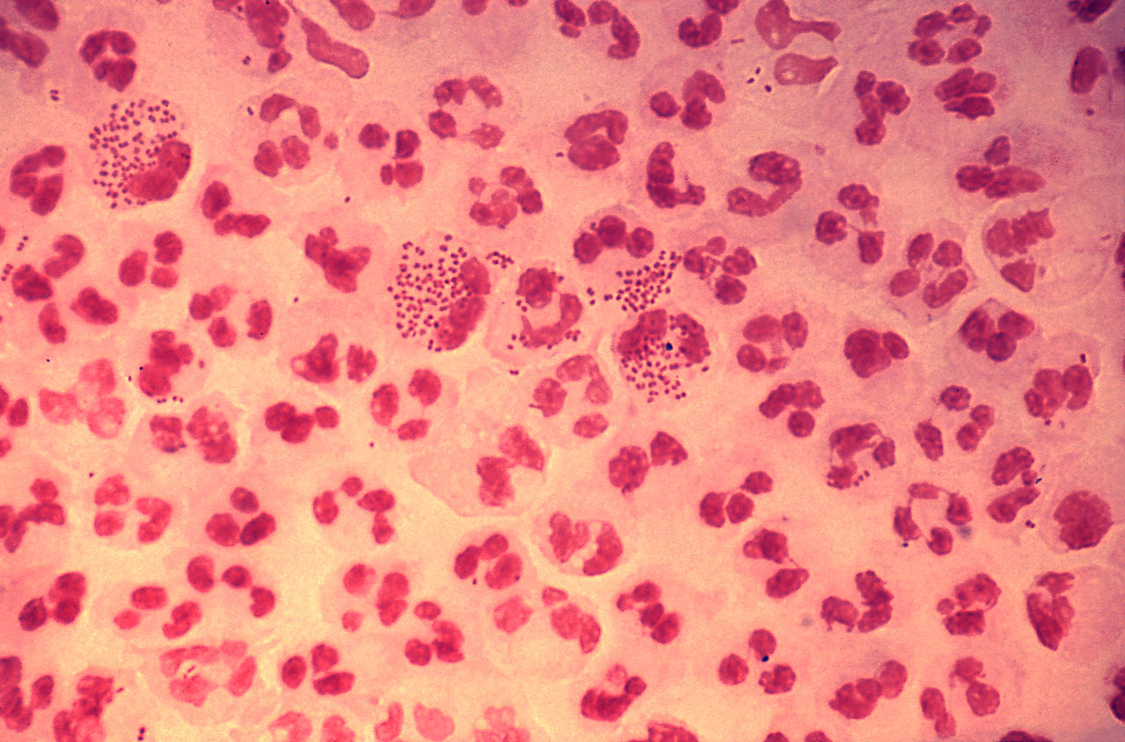
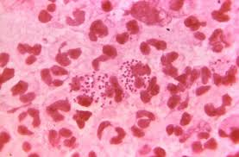
Diplococcus gram negatif
Diplokokkus gram negative
Biji kopi/ginjal berhadapan (bagian tengah rata/cekung)
Non motil,non spora
ø 0,8 mm

Slide 14
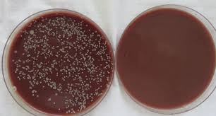
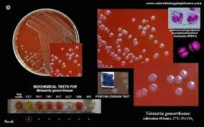
neisseria gonorrhoeae thayer martin agar
Koloni pada Media Thayer Martin:
Ciri makroskopis Neisseriae go : Koloni mukoid, cembung, mengkilat, menonjol, tidak mempunyai pigmen, transparan, non hemolitik, oksidase (+), obligat aerob, memfermentasi KH (Glukosa) dan tumbuh pada CO2 (5 – 10%).

Slide 15
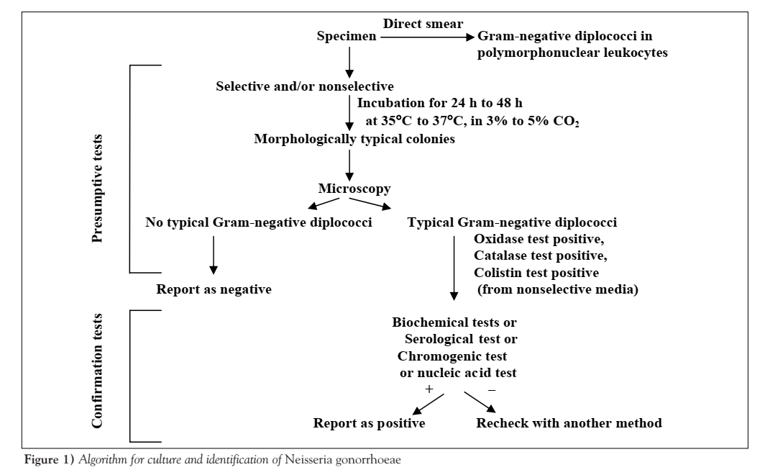
ALGORITHM CULTURE AND IDENTIFICATION

Slide 16
Tugas mahasiswa
Pengamatan
Diskusi kasus (buat kasus scenario untuk diskusi)

