Slide 1
Praktikum Neuro-Muskulo skeletal FKIK UMY 2020
Lipoma, neurofibroma, osteoma,osteomyelitis, Fibrous dysplasia, Osteosarcoma, Synovial sarcoma, Giant cell Tumor, Giant cell Tumor of tendon sheath. Chondroma

Slide 2
Kasus :Benjolan dibawah kulit Lengan kiri, sebesar duku, mudah digerakan. Pada operasi didapatkan tumor benigna di dalam sub-cutis.
Lipoma
Definition / general
Benign tumor composed of mature white adipocytes with uniform nuclei resembling normal white fat
Most common mesenchymal and soft tissue tumor (100x more common than liposarcoma)
Epidemiology
Most common soft tissue tumor - 16% of all mesenchymal neoplasms
Adults, age 40+
No gender or ethnic preference
Rare in children
Associated with obesity
Multiple lipomas: 5%, more common in women, often familial, associated with neurofibromatosis, multiple endocrine neoplasia syndromes, Bannayan syndrome (macrocephaly, hemangiomas and lipomas, Wikipedia)
Sites
Usually trunk, back, shoulder, neck, proximal extremities
Rare on hands, feet, face, lower leg, retroperitoneum
Usually subcutaneous (liposarcomas are usually deep seated)
Unusual sites include oral cavity, pancreas, breast, intestines
Clinical features
Relatively static growth after initial growth period
Does not regress even with starvation
Becomes hard after application of ice

Slide 3
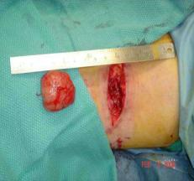
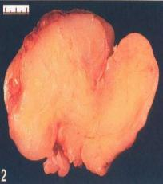
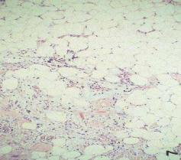
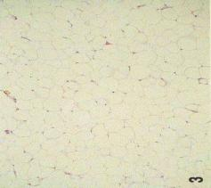
LIPOMA tumor jinak asal jaringan mesoderm yang terdiri atas jaringan lemak
tumor benigna di dalam sub-cutis. Penampang berwarna kuning
jaringan lemak dengan sel-sel lemak seperti pada jaringan lemak normal.

Slide 4
Definition / general Neurofibroma
Benign peripheral nerve sheath tumor with classic identifiable features including the presence of a neuronal component comprising transformed Schwann cells and a nonneoplastic fibrous component that includes fibroblasts
Sites
Localized neurofibromas are superficial and evenly disturbed over the body surface
Diffuse neurofibromas are usually in the head and neck region (Int J Trichology 2010;2:60)
Plexiform neurofibromas are localized to a major nerve trunk
Etiology
Neurofibromas are caused by a biallelic inactivation of the tumor suppressor gene neurofibromatosis type 1 which is located on 17q11.2
Non myelinating p75+ Schwann cell progenitors are the candidate cell for neurofibromatosis type 1 loss in plexiform neurofibroma (Cancer Cell 2008;13:117)
Dermal neurofibromas may have a non Schwannian precursor of a neural stem cell / progenitor

Slide 5
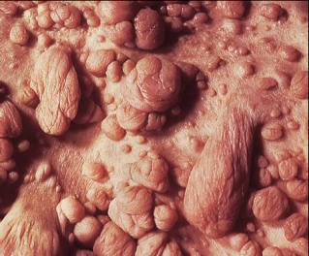
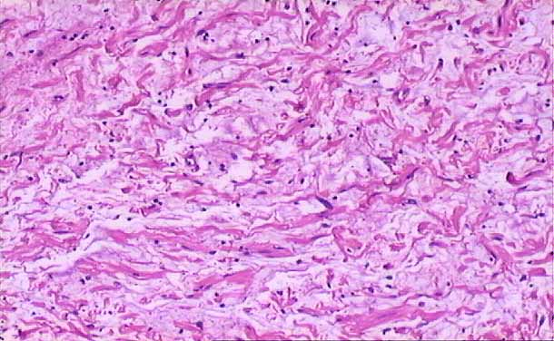
Neurofibroma
Klinis
Mikroskopis
http://cai.md.chula.ac.th/chulapatho/chulapatho/systemic/soft_tissue/mneufibml

Slide 6
Definition / general Schwannoma
Benign nerve sheath tumor arising from differentiated Schwann cells
Terminology
Also known as neurilemoma and neurinoma
Epidemiology
All ages can be affected
Most commonly 20 - 50 years old
M = F
90% are sporadic, 3% with neurofibromatosis type 2, 2% with schwannomatosis, 5% with meningiomatosis with or without neurofibromatosis type 2
Sites
More frequently on the limbs with a predilection to the upper limbs, followed by the head and neck area, including the oral cavity, orbit and salivary glands
Deeply seated tumors are mainly in the posterior mediastinum and retroperitoneum
Other areas include posterior spinal roots, bone, gastrointestinal tract, pancreas, liver, thyroid, adrenal glands and lymph nodes
Rare sites include penis and vulva (Urol Ann 2017;9:301, World J Surg Oncol 2015;13:139)
Pathophysiology
May occur spontaneously
Can occur in familial tumor syndromes such as neurofibromatosis type 2 (NF2), schwannomatosis or Carney complex (StatPearls: Carney Complex [Accessed 13 August 2018])
Loss of function of the tumor suppressor gene merlin (schwannomin)
Direct genetic change involving the NF2 gene on chromosome 22 or secondarily to merlin inactivation
Can occur in NF2 and spontaneous schwannomas
Can cause other neoplasms including meningioma, mesothelioma, glioma multiforme and carcinomas of breast, colorectum, kidney (clear cell type), liver, prostate and skin
Clinical features
Pain and neurological symptoms are uncommon unless the tumor is large
Tumor waxes and wanes in size, which may be related to the amount of cystic degeneration it contains (J Lab Physicians 2013;5:60)

Slide 7
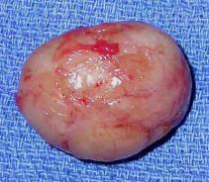
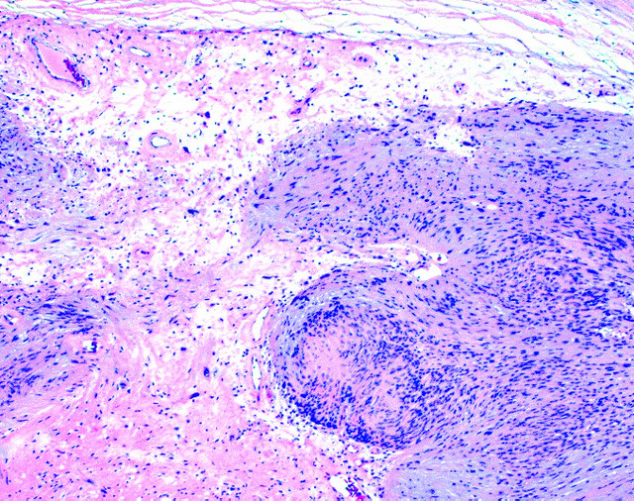
Schwannoma
Makroskopis
mikroskopis
http://www.columbianeurosurgery.org/wp-content/2009/11/schwannoma_4_lg.jpg

Slide 8
Definition / general Osteoma
Benign bone forming tumor composed of compact or mature trabecular bone limited almost exclusively to craniofacial bones, especially paranasal sinuses (Arch Pathol Lab Med 2009;133:1587)
Terminology
Ivory exostosis, sino orbital osteoma, sino nasal osteoma
Epidemiology
Adults and children, mean age 37 years
Men outnumber women, 3:2
Sites
Paranasal sinuses (frontal sinus most common), orbit, nasal cavity, jaw bones, cranial vault
Etiology
Unknown
Clinical features
Paranasal sinus tumors associated with pain, headache, facial distortion, proptosis, visual changes, mucocele, sinusitis, CSF leakage, pneumatocele, meningitis, and cerebral abscess
Associated with Gardner syndrome

Slide 9
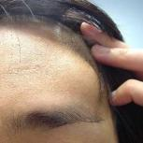
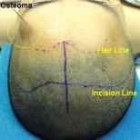
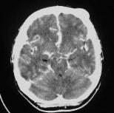
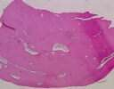
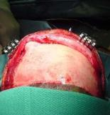
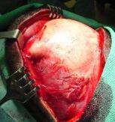
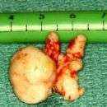
Osteoma
Klinis
Mikroskopis

Slide 10
Definition / general Osteosarcoma
A malignant tumor in which the cells synthesize bone The most common primary malignant solid tumor of Clinical features
Painful enlarging mass lesion is common
Pathologic fracture in a minority of cases (5 - 10%)
Laboratory
Alkaline phosphatase levels often increased; increased levels associated with metastasis, decreased overall survival and decreased disease free survival (Cancer Med 2017;6:1311)
Radiology description
Invasive, destructive intraosseous mass (mixed lytic and blastic)
Cortical permeation and soft tissue invasion common
Mineralization (often, most prominent centrally)
Periosteal reactions:
Sunburst pattern
Codman triangle: tumor permeates cortex and lifts up periosteum, then bone is deposited in periosteum creating a triangle
Parosteal osteosarcoma:
Mass attached to cortex: usually has a broad base, wraps around bone
Extends into soft tissue
Cortical destruction and medullary invasion in 25%
Heavily calcified (periphery is less mineralized)
Low grade central osteosarcoma: focal aggressive features (cortical disruption, soft tissue extension)
May have well defined margins and appear radiographically benign
Periosteal osteosarcoma: cortically based “soft tissue mass” (most dense around cortex)
Cortical thickening
Extrinsic cortical scalloping
Periosteal reaction perpendicular to cortex (sunburst or Codman triangle)
Bone and cartilage components
Soft tissue component with areas of mineralization
High grade surface osteosarcoma: mass on surface of bone (broad attachment)
Destructive invasion (cortex, soft tissue)
Periphery of lesion has periosteal bone deposition

Slide 11
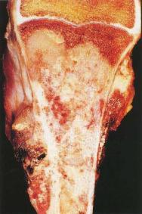
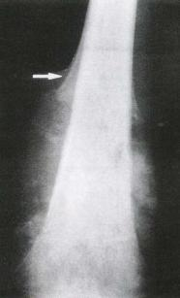
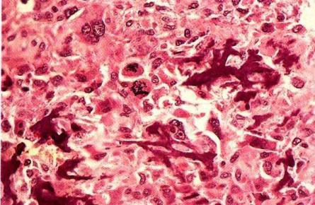
Osteosarcoma
Makroskopis Radiologis
Mikroskopis

Slide 12
Definition / general Giant cell tumor dari Tulang
Benign but locally aggressive primary bone neoplasm composed of mononuclear round to spindle cells with numerous evenly dispersed osteoclast-like giant cells
Not the same tumor as giant cell lesion of the small bones
Malignancy in giant cell tumor is rare (< 2% of cases) and is more common at older ages (30 - 50 years)
Rarely associated with Paget disease of bone (Skeletal Radiol 2007;36:973)
May occur in setting of focal dermal hypoplasia (Goltz syndrome) (Genet Couns 2014;25:445)
Epidemiology
Accounts for ~5% of primary bone tumors
Ages 20 - 45 (10% of cases between age 15 - 20)
Rare if immature skeleton (Sarcoma 2016;2016:3079835)
Sites
Usually occurs in the epiphysis and adjacent metaphysis of long bones (distal femur, proximal tibia, distal radius, proximal humerus)
Other bones (proximal sacrum, vertebrae, skull base) may be involved, and any bone may be affected
> 95% are unifocal
Uncommon in hands / feet (more likely to be giant cell lesion of the small bones), jaw (more likely to be central giant cell granuloma)

Slide 13
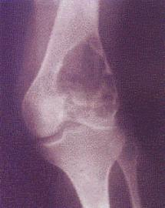
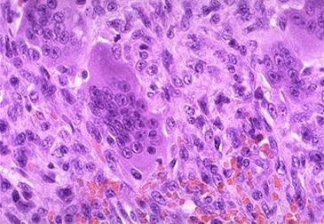
Giant cell tumor dari Tulang
Radiologis
Mikroskopis

Slide 14
Definition / general Giant cell tumor of tendon Sheath
Benign, well circumscribed proliferation of mononuclear cells admixed with variable proportions of osteoclast-like giant cells, foamy histiocytes, siderophages and inflammatory cells
Essential features
Composed of variable proportions of mononuclear cells, osteoclast-like giant cells, foamy histiocytes and hemosiderin laden histiocytes
Well circumscribed and lobulated, usually in close association with a tendon
Second most common tumor of the hand (after ganglion cyst)
Epidemiology
Fourth or fifth decade of life most frequent
F>M (2:1) (Orthop Traumatol Surg Res 2017;103:S91)
Sites
Predominantly occurs on the digits (85%) (Orthop Traumatol Surg Res 2017;103:S91)
Other locations have been reported, such as wrist, ankle, knee, hip, elbow
Intra-articular localized tenosynovial giant cell tumors are most frequent in the knee

Slide 15
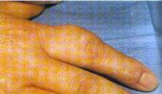
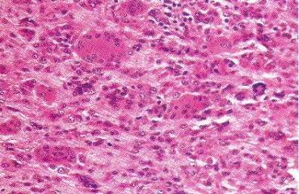
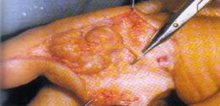
Giant cell tumor of tendon sheath
Klinis, durante operatif
Mikroskopis

Slide 16
Ganglion. Definition / general
Common tumor-like lesion arising from soft tissue, caused by mucoid degeneration of joint capsule, tendon or tendon sheath
Small cyst-like mass (no epithelial lining) near joint capsule or tendon sheath
Common site is wrist, also hand and foot, rarely in intratendinous region
May cause pain, weakness, bone changes, partial disability of joint
May be due to injury or overuse of joint
May be multilocular
Fluid is similar to synovial fluid
Gross description
Usually does not communicate with joint space; rarely is intraosseus (medial malleolus of tibia)
Microscopic (histologic) description
Dense fibrous tissue, with no synovial or epithelial lining; inflammation may be associated with cyst rupture
Cystic space lined by histiocytes and granulation tissue with moderate acute and chronic inflammation of cyst wall

Slide 17
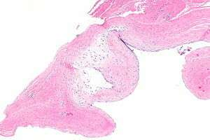
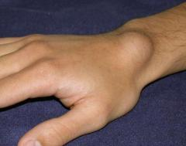
Ganglion
Klinis
Mikroskopis
jaringan ikat dengan pseudokista berisi massa amorf miksoid. Stroma jaringan ikat dengan fokus-fokus pseudokista ( ‘multiloculated’ )

Slide 18
Definition / general Osteomyelitis
While the original derivation emphasizes involvement of marrow, common medical literature extends the definition to an inflammation process of the entire bone including cortex and periosteum, recognizing that the pathological process is rarely confined to the medullary portion
Osteomyelitis has been used to encompass a wide variety of pathoses / etiologies, such as traumatic injuries, radiation, and certain chemical substances, but the term is mostly often used to describe infection of the bone

Slide 19
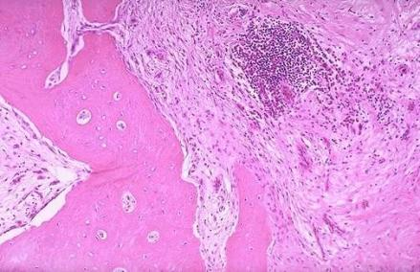
Osteomyelitis
Mikroskopis
sel inflamasi termasuk neutrofil, limfosit dan sel plasma, fibrosis, dan nekrosis tulang

Slide 20
Synovial sarcoma
Synovial sarcoma is a rare type of cancer that tends to arise near large joints, particularly the knee, in young adults. Despite its name, it typically doesn't affect the interior of joints, where synovial tissue and fluid are located.
The first sign of trouble is usually a deep-seated lump that may be tender or painful. Synovial sarcoma generally grows slowly. While these tumors can occur in young children, they generally develop in people between the ages of 15 and 40.
While synovial sarcoma can occur almost anywhere in the body, the most common locations are in the legs, arms and throat.

Slide 21
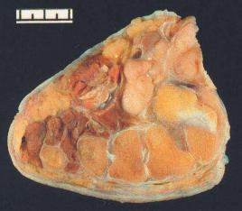
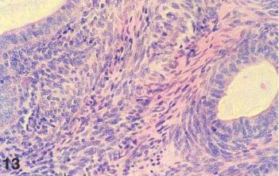
Synovial sarcoma

Slide 22
Definition / general Fibrous dysplasia
Called craniofacial form of fibrous dysplasia if confined to jaw
Monostotic, polyostotic or associated with McCune-Albright syndrome
May be congenital or hereditary (but differs from cherubism)
Starts in childhood, usually diagnosed by age 20 years
McCune-Albright syndrome
Due to somatic mutation of c-fos oncogene that causes activation of cAMP pathway
Polyostotic fibrous dysplasia, cafe au lait skin pigmentation (large, dark lesions with serpiginous ["coast of Maine"] borders in chest, neck, back), almost exclusively in women
Also endocrine abnormalities (precocious puberty, hyperthyroidism, pituitary adenomas that secrete growth hormone primary adrenal hyperplasia)
Symptoms
Unilateral painless swelling of mandible or maxilla in men / women ages 25 - 35 years
No treatment since growth is self limited and responsive to pubertal hormonal changes
Surgical recontouring performed if facial deformity, although may regrow in 25%
Radiology description
Ill defined margins
Diffusely radiopaque with ground glass image
Microscopic (histologic) description
Uniformly distributed C shaped or Chinese figure-like trabeculae of woven / immature bone within proliferating fibroblastic and vascularized stroma
Usually no osteoblastic rimming and no / rare osteoclasts

Slide 23
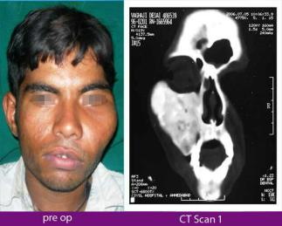
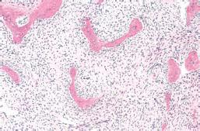
Fibrous Dysplasia
Klinis Radiologis
Mikroskopis

Slide 24
Definition / general Chondroma
Benign cartilaginous tumor
Either enchondroma (arise from diaphyseal medullary cavity), subperiosteal/juxtacortical chondroma or soft tissue chondroma
Cytofluorometric DNA ploidy analysis may be useful in distinguishing these tumors from chondrosarcomas (Mod Pathol 1999;12:863)
Clinical features
Juxtacortical (periosteal) chondroma
Rare
Usually 3 cm or less
Surface of long bone or small bones of hand / feet
Usually teens to twenties, more common in males
Sites: metaphysis or shaft of tubular bones; may arise in zones lacking periosteum such as the femoral neck
Am J Surg Pathol 1985;9:666
Radiology description
Periosteal: well defined, 2 - 4 cm, sharply scallops outer cortex of underlying bone

Slide 25
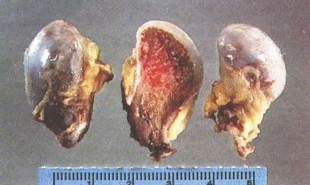
Chondroma
Makroskopis
Mikroskopis
Kondrosit diantara matriks hialin

