Slide 1
TEXTUS CONNECTIVUS
HISTOLOGY LABORATORY DEPT.
MEDICAL & HEALTH SCIENCE FACULTY
MUHAMMADIYAH YOGYAKARTA UNIVERSITY

Slide 2
TEXTUS CONNECTIVUS MUCOSUS (GELATINOSUS)
SUBSTANSIA INTERCELLULARIS
HOMOGEN DENGAN FIBRA COLLAGENOSA

Slide 3
TEXTUS CONNECTIVUS MUCOSUS (GELATINOSUS)
FIBRA COLLAGENOSA (HALUS, TERPUTUS -PUTUS)
FIBROBLAST BERBENTUK CELULLA STELATA

Slide 4
TEXTUS CONNECTIVUS AREOLARIS

Slide 5
TEXTUS CONNECTIVUS ELASTICUS

Slide 6
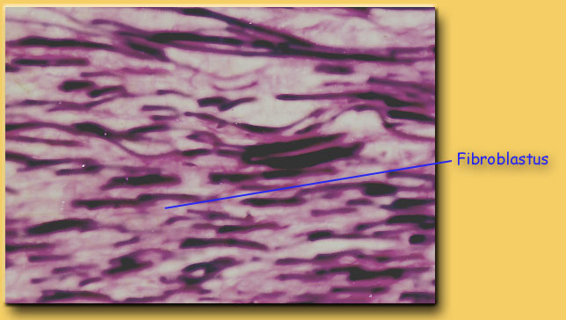
TEXTUS CONNECTIVUS ELASTICUS

Slide 7
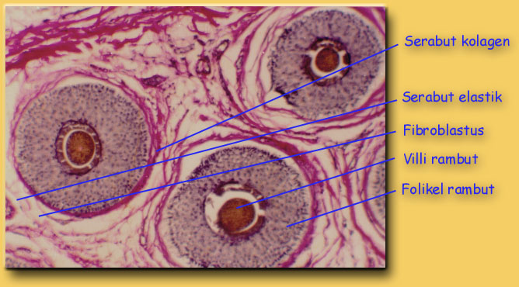
TEXTUS CONNECTIVUS COLLAGENOSUS COMPACTUS IRREGULARIS

Slide 8
TEXTUS CONNECTIVUS COLLAGENOSUS COMPACTUS IRREGULARIS

Slide 9
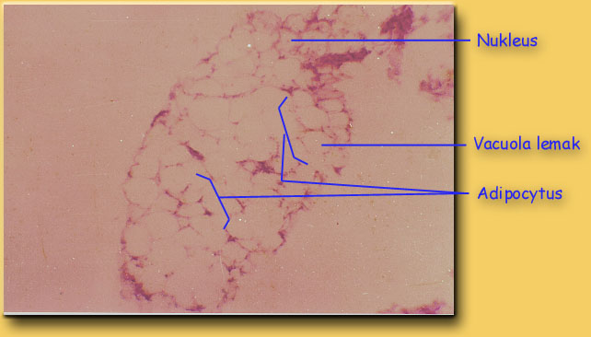
TEXTUS CONNECTIVUS ADIPOSUS (HEMATOXILIN EOSIN)

Slide 10
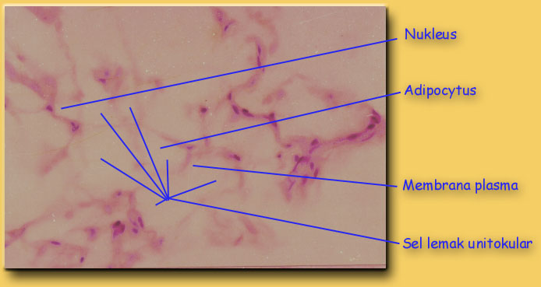
TEXTUS CONNECTIVUS ADIPOSUS (HEMATOXILIN EOSIN)

Slide 11
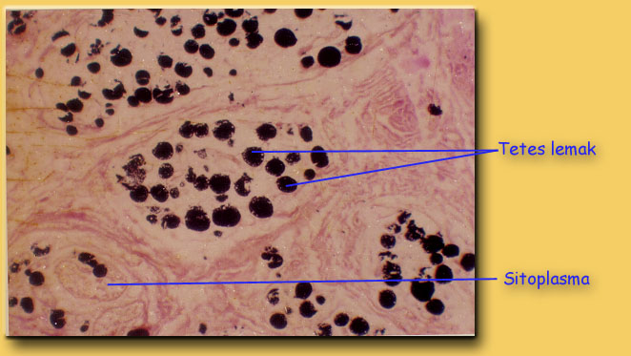
TEXTUS CONNECTIVUS ADIPOSUS (OSMIUM TETRAOKSIDA)

Slide 12
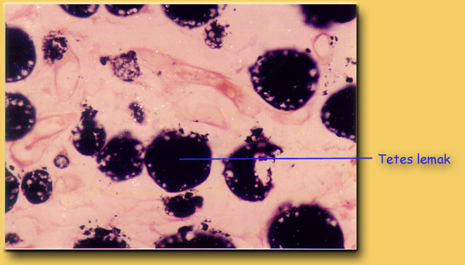
TEXTUS CONNECTIVUS ADIPOSUS (OSMIUM TETRAOKSIDA)

