Slide 1
asthma bronchiale drugs
Wiwik Kusumawati

Slide 2
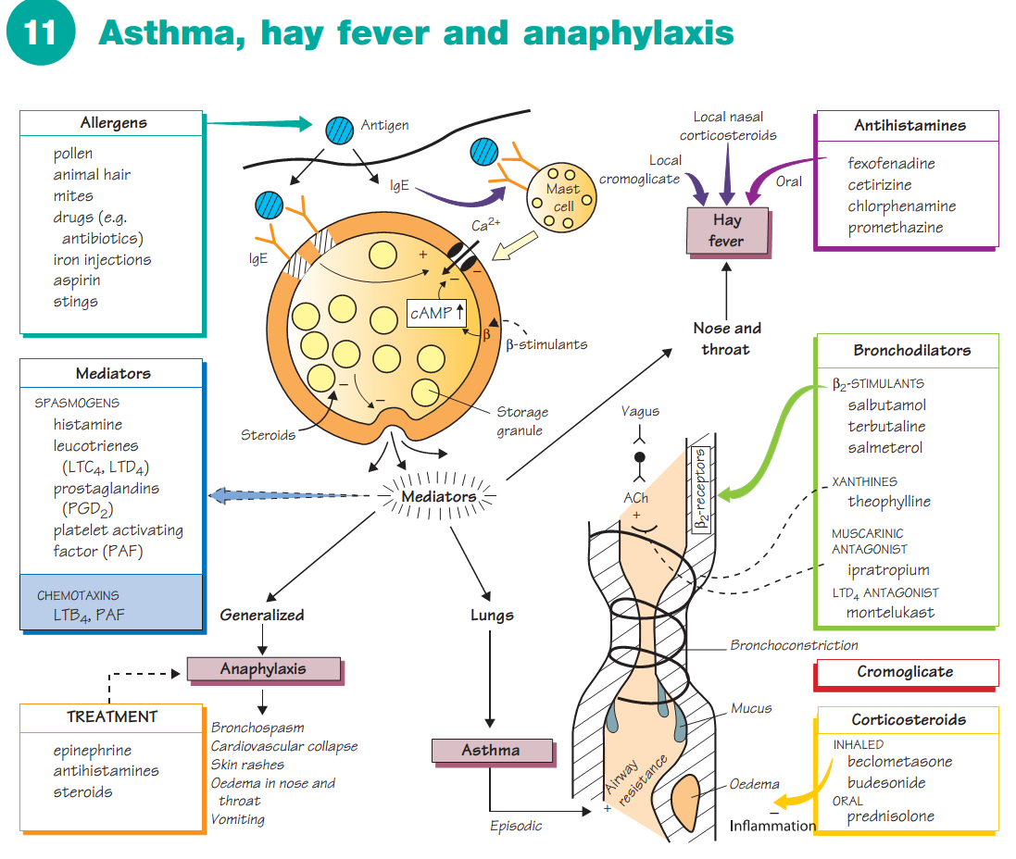

Slide 3
INTRODUCTION
Asthma, hay fever and anaphylaxis (green shaded boxes) are caused by the same basic processes: IgE antibody attaches to mast cells (topleft) and, on renewed exposure to the same antigen ( ), degranulationof the mast cells occurs with the production and release of mediators (middle left).
If the release of mediators is localized, hay fever (top right) or asthma (bottom right) result, but a massive general release causes anaphylaxis, which is a rare but life-threatening reaction to beestings and penicillin or other drugs.
Antigens that can trigger these reactions are called allergens (top left)

Slide 4
Bronchial asthma
is an inflammatory disease in which the calibre of the airways is chronically narrowed by oedema and is unstable.
During an attack the patient suffers from wheezing and difficulty in breathing as a result of bronchospasm, mucosal oedema and mucus formation (bottom right).
Eventually the chronic inflammation causes irreversible changes to the airways (bottom right).
When the acute attack has an allergic basis, the term extrinsic asthma is often used.
When there is no obvious allergic basis for the disease, it is called intrinsic asthma

Slide 5
Classification of asthma
In mild to moderate asthma, the first-line drugs are short-acting β2-adrenoceptor agonists (β2-stimulants, middle right) inhaled from pressurized containers when required. If β-agonists are required more than once a day, then regular administration of inhaled steroid is added (bottom right).
In more severe asthma, short-acting β-agonists and inhaled steroids are retained with the addition of a regular inhaled long-acting β−stimulant (e.g. salmeterol). If necessary, a high-dose inhaled steroid is tried with salmeterol, together with oral sustained release theophylline, or a modified release oral β2-agonist, or a leukotriene receptor antagonist (e.g. montelukast, which reduces the bronchoconstrictor and inflammatory effects of leucotriene D4 [LTD4]).
Some patients are controlled only by oral steroids (usually prednisolone, Chapter 33).
Acute severe attacks of asthma (status asthmaticus) that are not controlled by the patient’s usual drugs are potentially fatal and mustbe dealt with as an emergency, requiring hospital admission

Slide 6
Hay fever is most commonly caused by allergy to grass pollen. Antihistamines control some symptoms and nasal corticosteroids are very effective. Cromoglicate eyedrops may be a valuable adjunct in allergic conjunctivitis.
IgE is the major class of reaginic antibody. In allergic patients, specific antibody levels may be increased to 100 times greater than normal. Binding of the Fc portion of the antibody to receptors on mast cells, followed by cross-linking of adjacent molecules by antigen, triggers degranulation by a mechanism involving Ca2+ influx.
Mast cells contain the body stores of histamine and occur in almost all tissues. Within the mast cells, histamine is bound with heparin in cytoplasmic granules. Histamine release normally involves an influx of Ca2+ ions and, because the permeability of the cell membrane to Ca2+ ions is reduced when intracellular cyclic adenosine monophosphate (cAMP) levels are raised, drugs that stimulate cAMP synthesis (β2-adrenoceptor agonists) may reduce histamine release.

Slide 7
MEDIATORS
The initial phase of an asthma attack is brought about mainly by spasm of the bronchial smooth muscle caused by the release of spasmogens (middle left) from mast cells. In many asthmatics, a second delayed phase results from the release of chemotaxins (centre left, shaded) that attract inflammatory cells, especially eosinophils.
These inflammatory processes cause vasodilatation, oedema, mucus secretion and bronchospasm and are at first reversible. However, permanent damage to the bronchial epithelium and smooth muscle hypertrophy eventually lead to irreversible airway obstruction.
This damage seems to be caused mainly by substances released from the eosinophil granules (especially eosinophil major basic protein and granule peroxidase).

Slide 8
BRONCHODILATORS
β-Adrenoceptor stimulants
The airway smooth muscle has few adrenergic nerve fibres but many β2-receptors, stimulation of which causes bronchodilatation. Activation of β2-adrenoceptors relaxes smooth muscle by increasing intracellular cAMP, which activates a protein kinase (see Nitrates, Chapter 16).
This inhibits muscle contraction by phosphorylating and inhibiting myosin-light-chain kinase. β2-Agonists such as salbutamol are usually given by inhalation. They are not specific, but β1-effects (cardiac stimulation) are not usually seen at doses that cause bronchodilatation. Adverse effects include fine tremor, nervous tension and tachycardia, but these are not usually troublesome when the drug is given by inhalation.
Oral administration is usually restricted to children and other patients who cannot use an aerosol preparation. Salmeterol is much longer lasting than salbutamol. In contrast to short-acting β2-agonists, regular treatment with ininhaled salmeterol has beneficial effects in asthmatics.
Ipratropium is a muscarinic antagonist and a moderately effective bronchodilator, presumably because it reduces reflex vagal bronchoconstriction that results from histamine stimulation of sensory (irritant) receptors in the airways. Ipratropium given by inhalation rarely causes atropine-like side-effects.

Slide 9
BRONCHODILATORS
Xanthines
Theophylline may benefit children who cannot use inhalants, and adults with predominantly nocturnal symptoms. Theophylline often causes adverse effects, even oral sustained-release theophylline preparations that are effective for up to 12 h. Even when plasma concentrations are in the therapeutic range (10–20 mg L−1), nausea, headache, insomnia and abdominal discomfort are common.
Above 25 mg L−1, toxic effects include serious arrhythmias and convulsions that may be fatal. It is not known how theophylline causes bronchodilatation in asthmatics.
Theophylline inhibits phosphodiesterase and increases cellular cAMP levels. The concentration of theophylline that inhibits most phosphodiesterases is higher than the therapeutic range, but there is some evidence that a subtype of the enzyme (perhaps type 4 isoform) in airway smooth muscle is more sensitive to the drug.
Bronchodilators are also used in the treatment of chronic obstructivepulmonary disease (COPD).

Slide 10
ANTIHISTAMINES
Antagonists that block H1-histamine receptors are used in the treatment of allergic conditions such as hay fever, urticaria, drug sensitivity rashes, pruritus, and insect bites and stings. They are not effective in asthma. Older antihistamine drugs (e.g. chlorphenamine, alimemazine, promethazine) hav antimuscarinic actions and pass theblood–brain barrier, commonly causing drowsiness and psychomotor impairment.
Newer agents (e.g. loratadine, cetirizine, fexofenadine) do not have atropine-like actions and, because they do not cross the blood–brain barrier to any extent, they cause much less drowsiness

Slide 11
Cromoglicate
Cromoglicate is a prophylactic drug and is of no value in acute attacks. It has anti-inflammatory actions in some patients but it is not possible to predict which patients will benefit and it is usually less effective than prophylaxis with corticosteroid inhalation. Cromoglicate must be given regularly and it may be several weeks before beneficial effects are apparent. The mechanism of action of cromoglicate is unclear. Itmay act by decreasing the sensitivity of bronchial sensory nerves,abolishing local reflexes that stimulate inflammation.
Corticosteroids
Steroids effectively increase the airway calibre in asthma by reducing bronchial inflammatory reactions (e.g. oedema and mucus hypersecretion)and by modifying allergic reactions. Oral administration of steroids is associated with many serious adverse effects (Chapter 33), but, except for high doses, these can be avoided in asthma by aerosol administration of the drugs (e.g. beclometasone). Inhaled steroids are usually effective in 3–7 days, but oral steroids may be necessary in some patients where all other therapy fails. Steroid nasal sprays (e.g.beclometasone, budesonide) are very effective in hay fever and are especially useful in patients with nasal congestion that is not affectedby antihistamines.

Slide 12
Acute severe asthma
Oxygen (40–60%) is given together with nebulized or intravenous β2-agonists (e.g. salbutamol). Then intravenous hydrocortisone or oral prednisolone is given. Nebulized ipratropium may also be used if required. If these drugs do not produce a response, an intravenous infusion of aminophylline may help, but there is little evidence that it does. Artificial ventilation may be required.

