Slide 1
MITOSIS
HISTOLOGY LABORATORY DEPARTMENT MEDICAL & HEALTH SCIENCE FACULTY MUHAMMADIYAH YOGYAKARTA UNIVERSITY

Slide 2
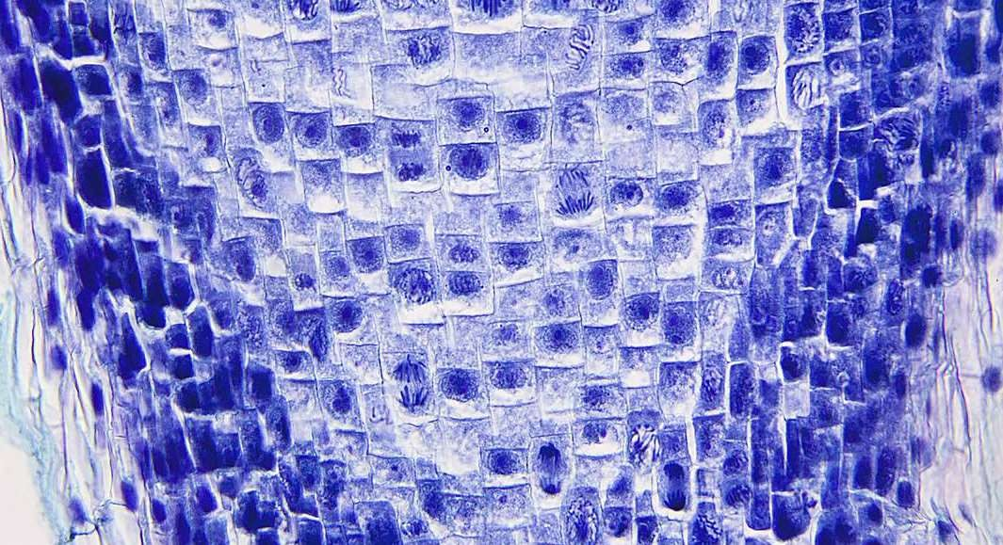

Slide 3
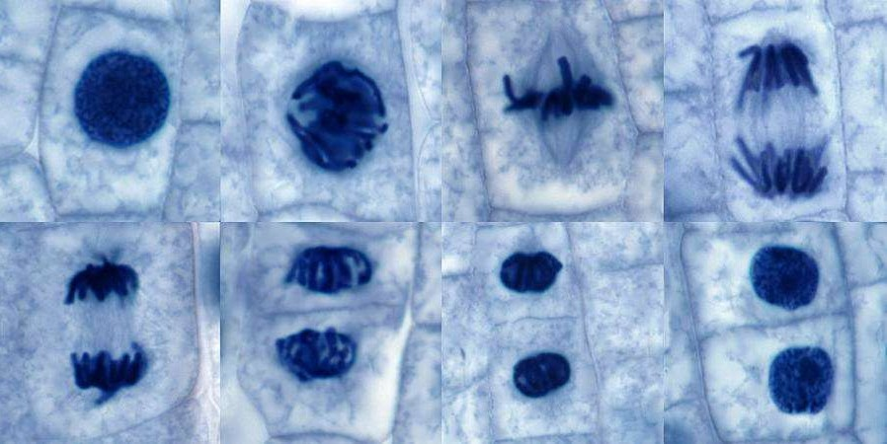

Slide 4
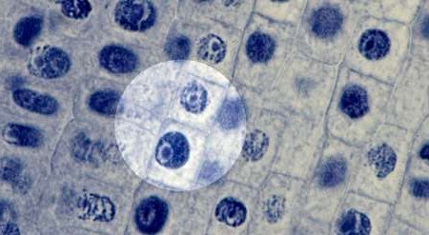
INTERPHASE

Slide 5
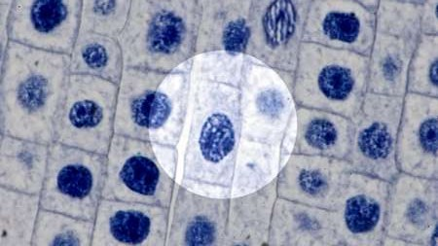
PROPHASE

Slide 6
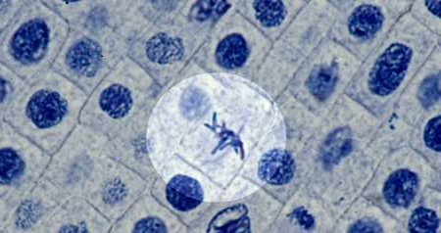
METAPHASE

Slide 7
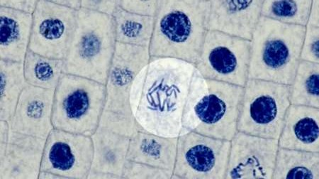
ANAPHASE

Slide 8
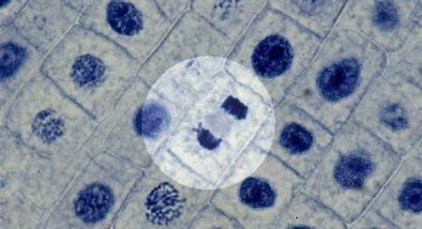
LATE ANAPHASE

Slide 9
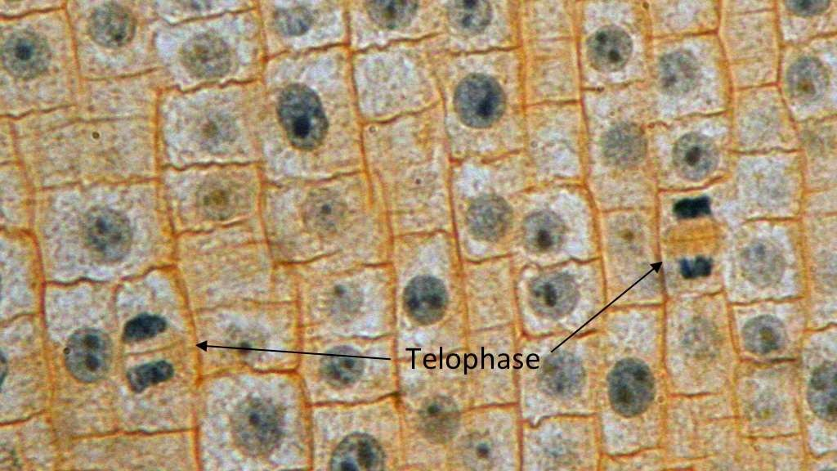
TELOPHASE

