Slide 1
CARTILAGE
HISTOLOGY LABORATORY DEPARTMENT
MEDICAL & HEALTH SCIENCE FACULTY
MUHAMADIYAH YOGYAKARTA UNIVERSITY

Slide 2
MAIN COMPONENTS
PERICONDRIUM
CHONDROCYUS
LACUNA
MATRIX TERRITORIAL
MATRIX INTERTERRITORIAL

Slide 3
EMBRYONALE CARTILAGE

Slide 4
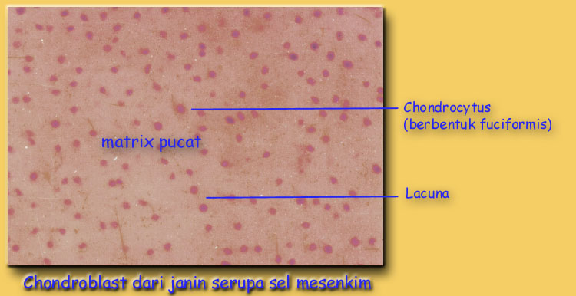
EMBRYONALE CARTILAGE

Slide 5
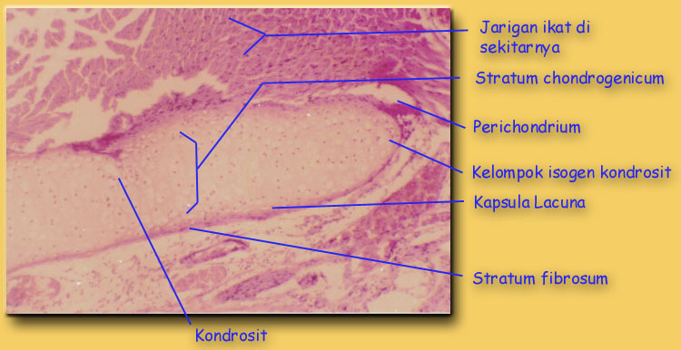
HYALINE CARTILAGE

Slide 6
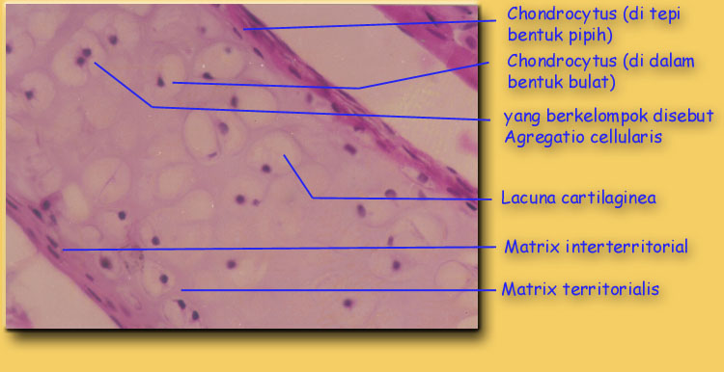
HYALINE CARTILAGE

Slide 7
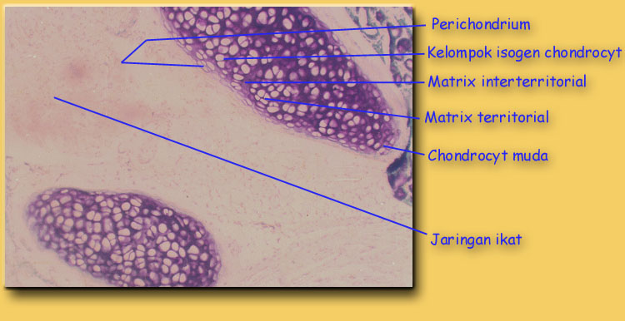
HYALINE CARTILAGE

Slide 8
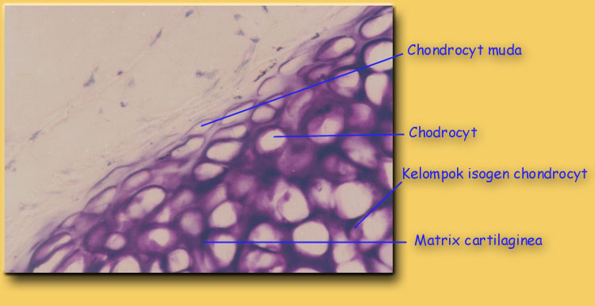
HYALINE CARTILAGE

Slide 9
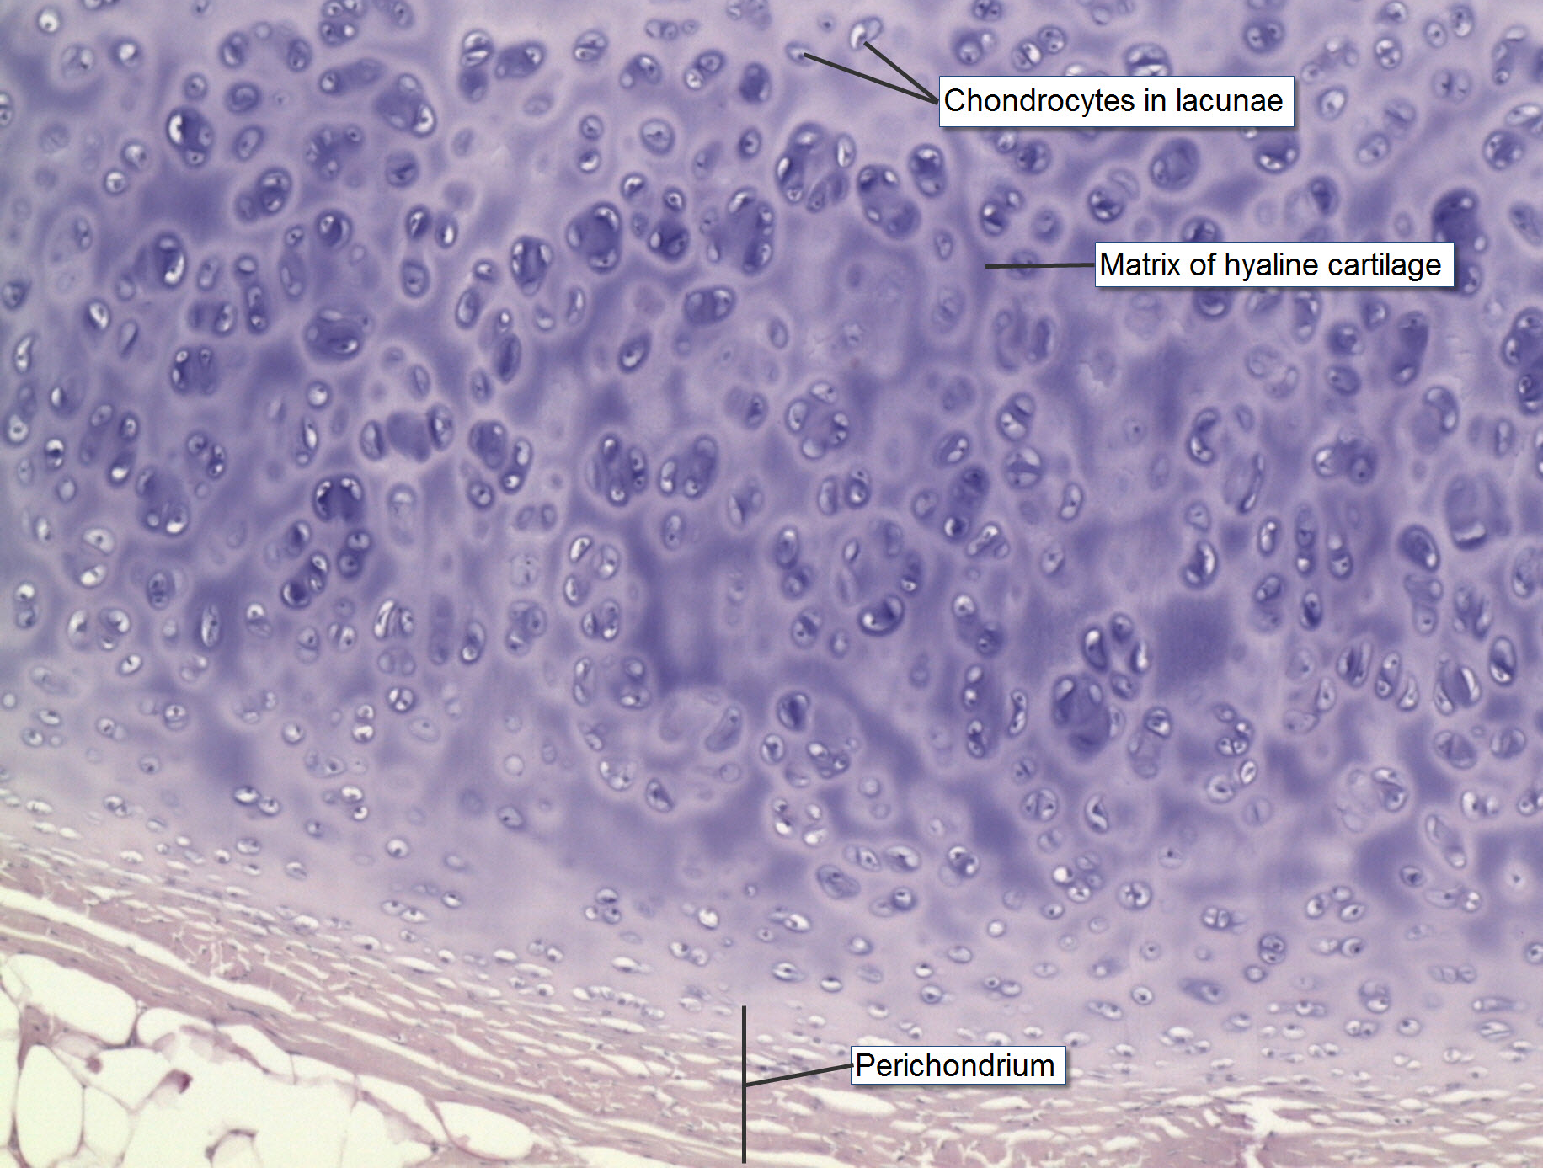
HYALINE CARTILAGE

Slide 10
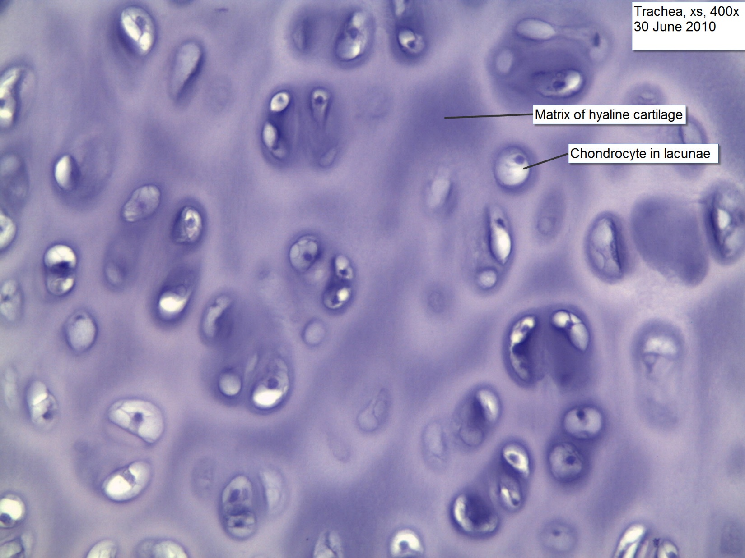
HYALINE CARTILAGE

Slide 11
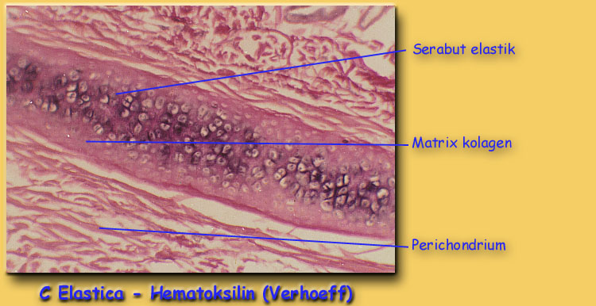
ELASTIC CARTILAGE

Slide 12
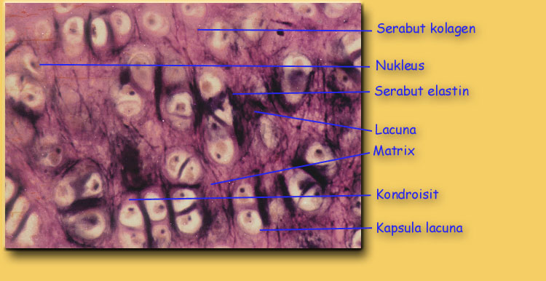
ELASTIC CARTILAGE

Slide 13
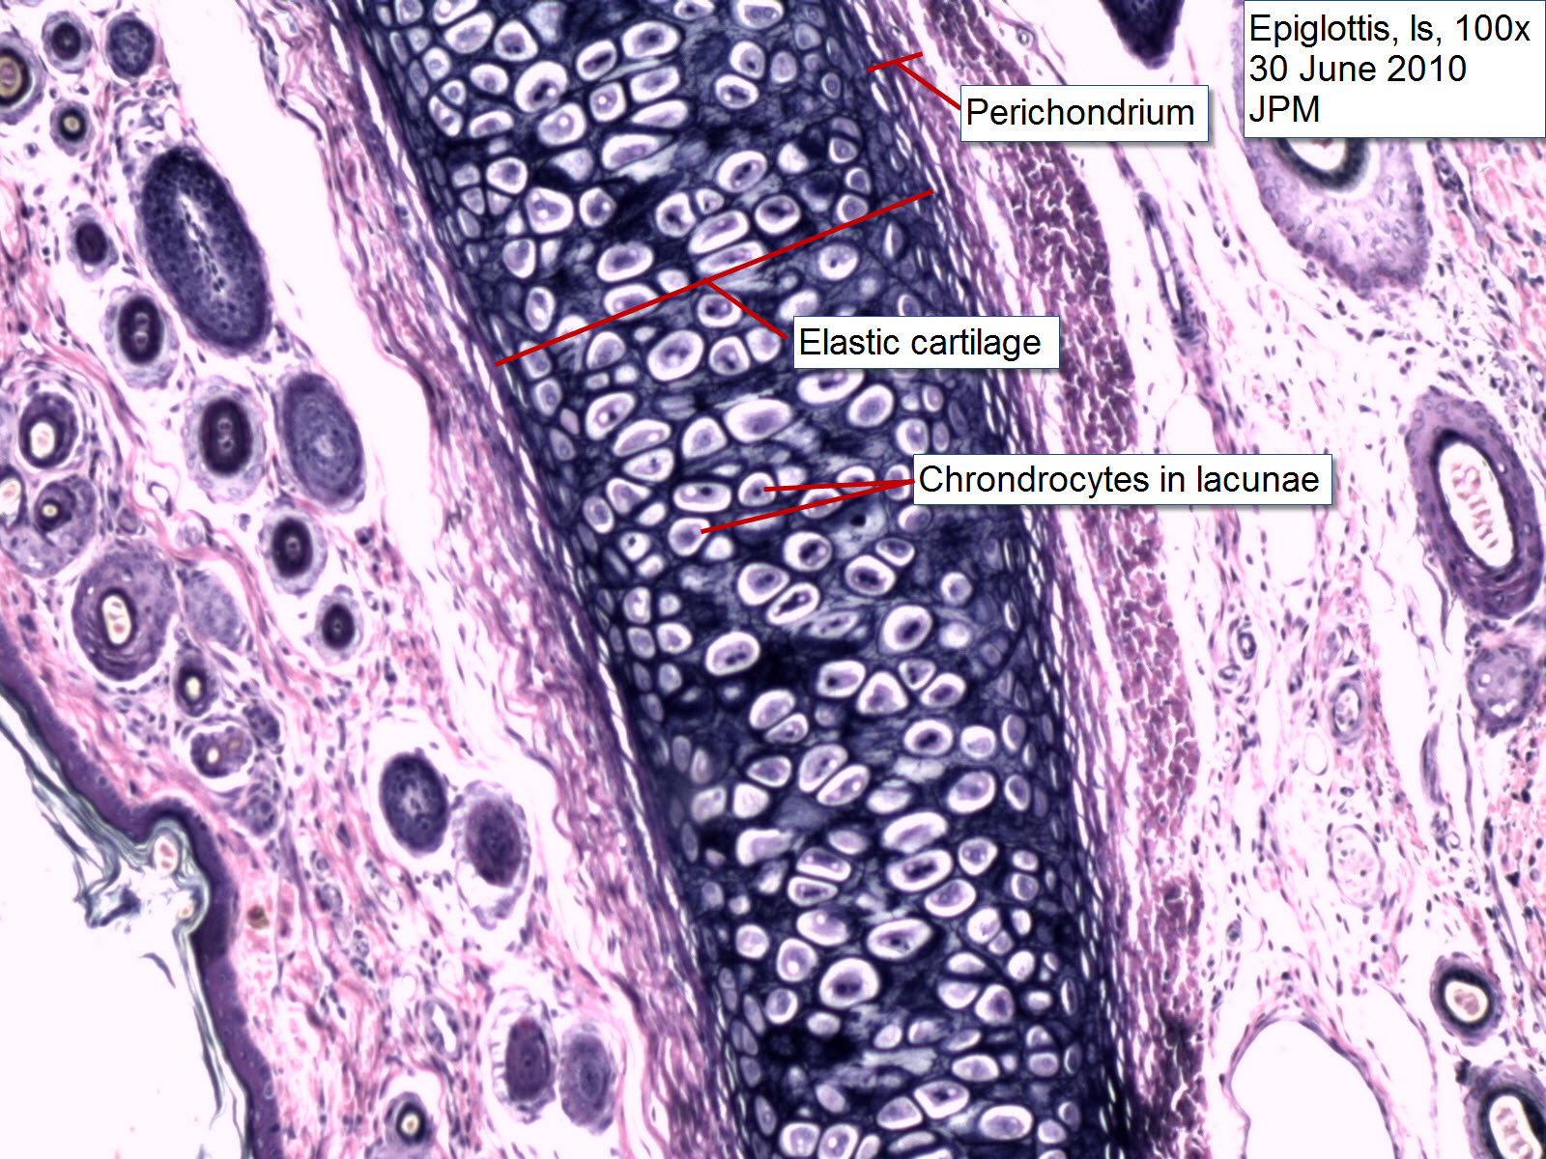
ELASTIC
CARTILAGE

Slide 14
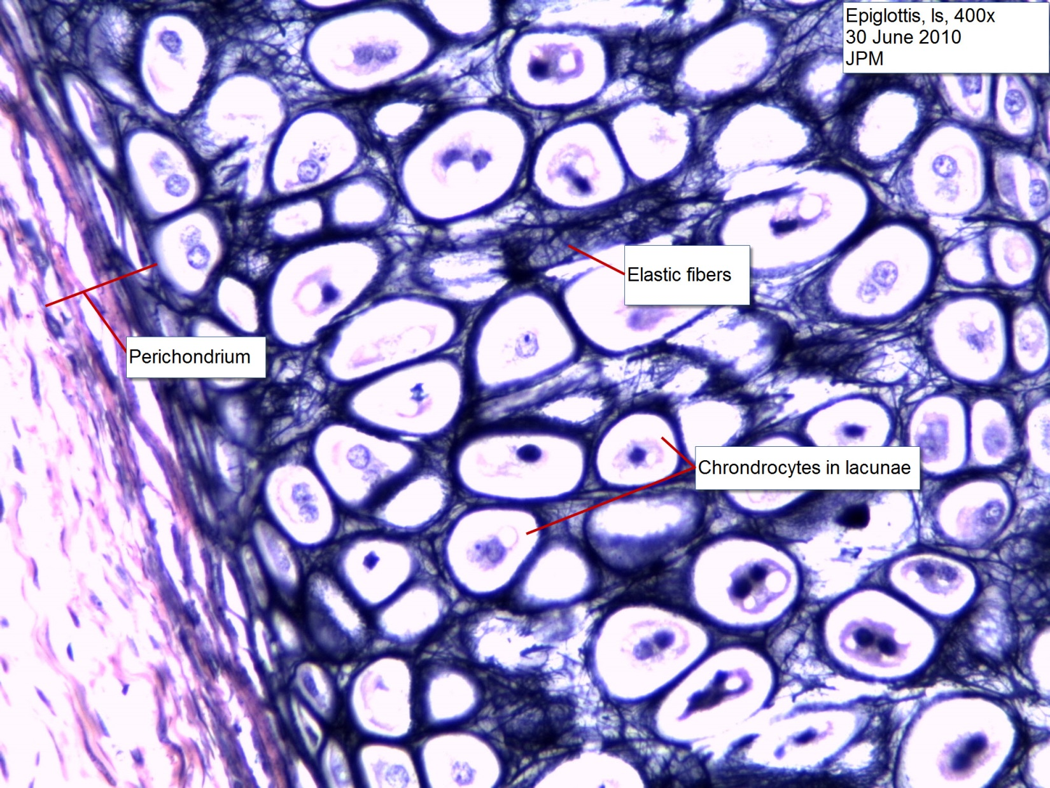
ELASTIC
CARTILAGE

Slide 15
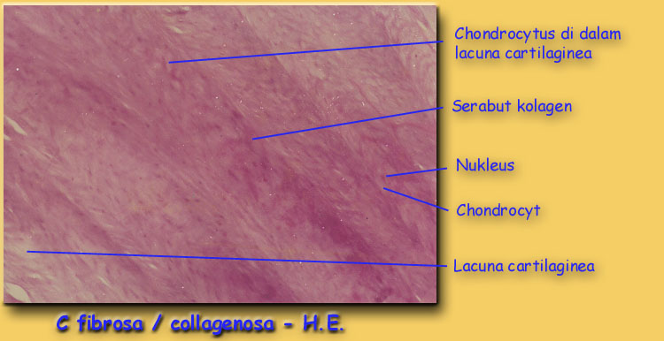
FIBROUS/COLLAGEN CARTILAGE

Slide 16
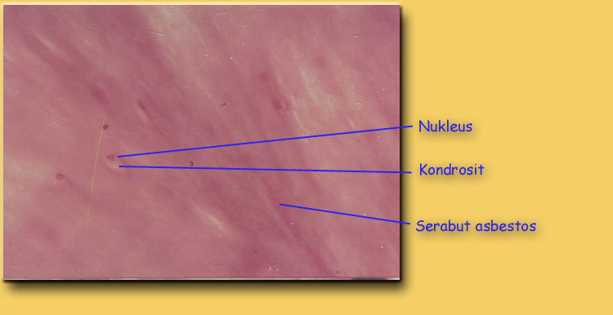
FIBROUS/COLLAGEN CARTILAGE

Slide 17
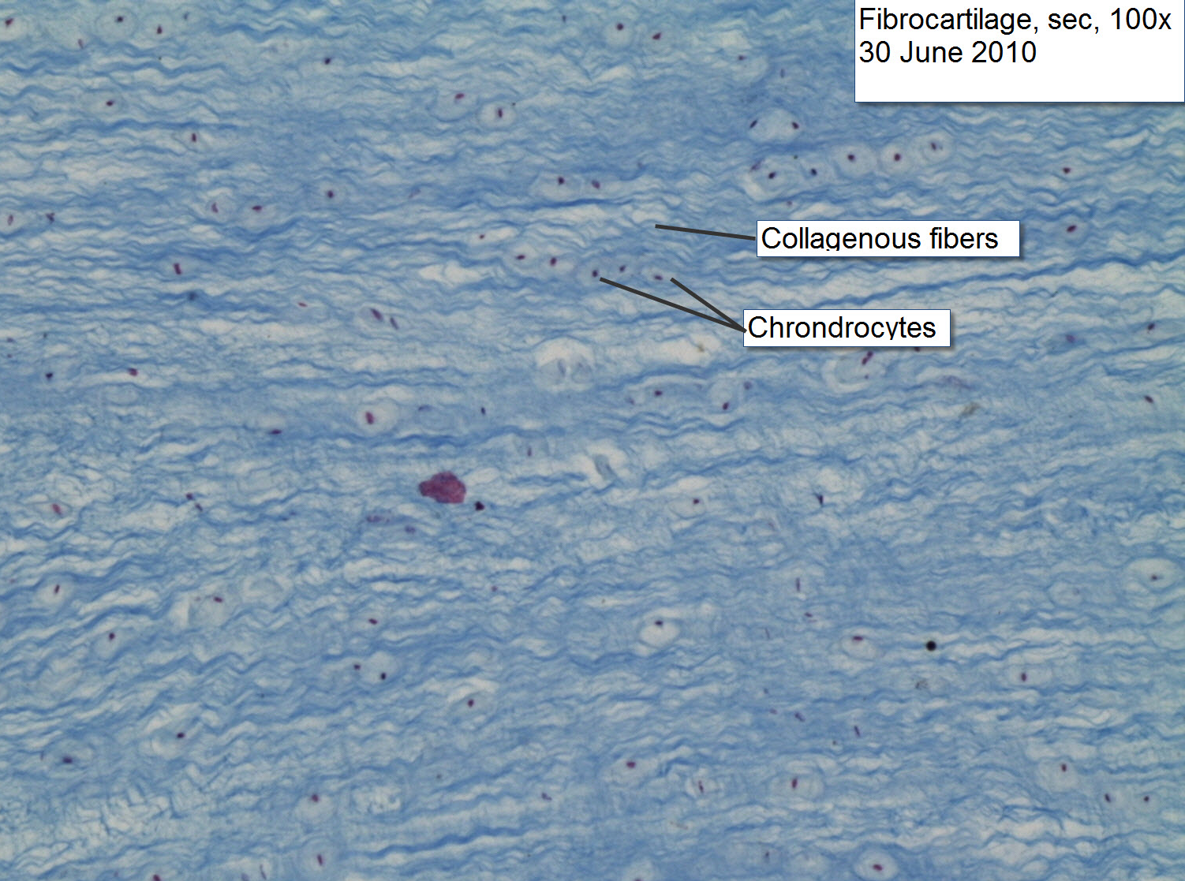
FIBROUS
CARTILAGE

Slide 18
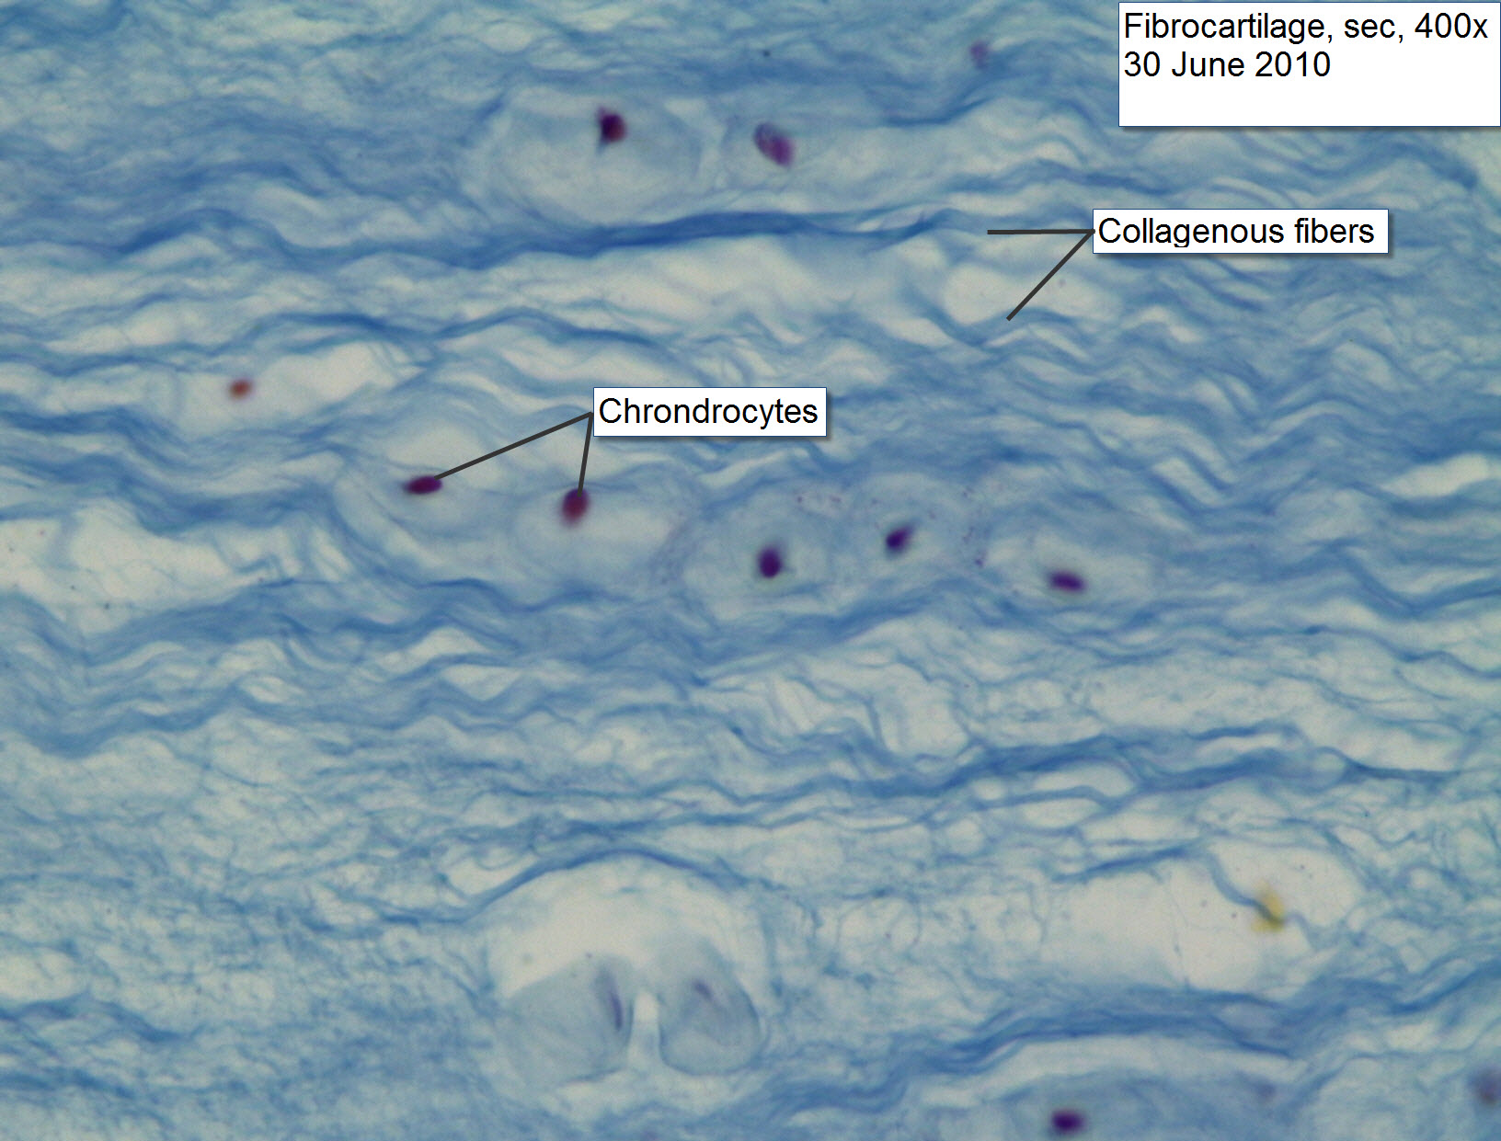
FIBROUS
CARTILAGE

Slide 19
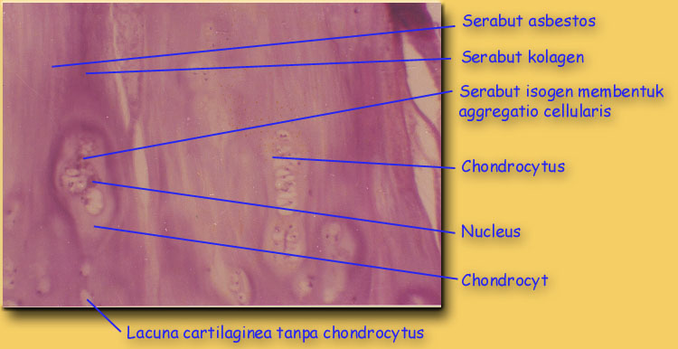
CARTILAGO CUM FIBRAE ASBESTOSEAE

Slide 20
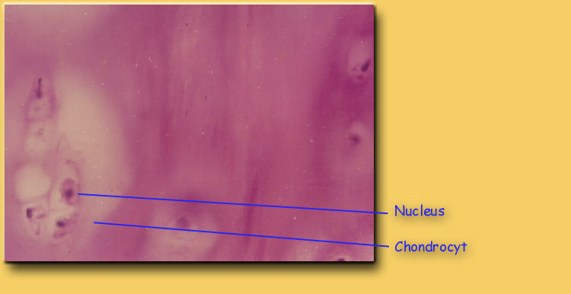
CARTILAGO CUM FIBRAE ASBESTOSEAE

