Slide 1
MUSCLE
HISTOLOGY LABORATORY DEPARTMENT
MEDICAL & HEALTH SCIENCE FACULTY
MUHAMMADIYAH YOGYAKARTA UNIVERSITY

Slide 2
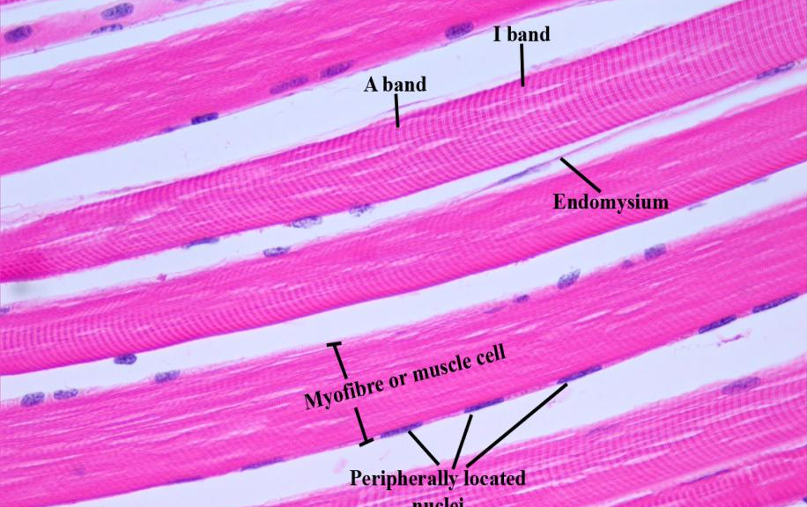
SKELETAL MUSCLE (LONGITUDINAL CROSS-SECTION)
(LOW MAGNIFICATION)

Slide 3
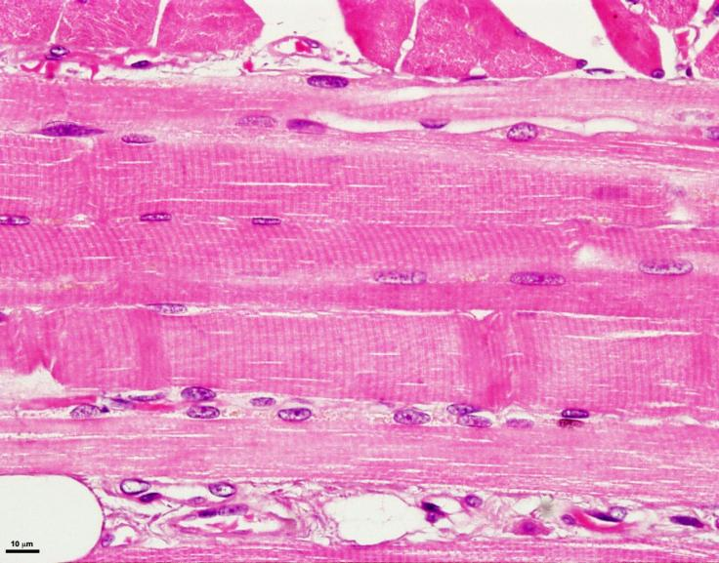
SKELETAL MUSCLE (LONGITUDINAL CROSS-SECTION)
(HIGH MAGNIFICATION)

Slide 4
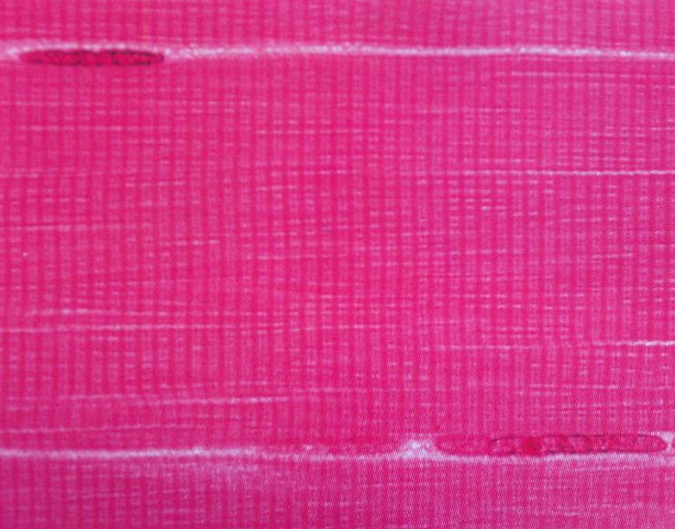
SKELETAL MUSCLE (LONGITUDINAL CROSS-SECTION)
(HIGH MAGNIFICATION)

Slide 5
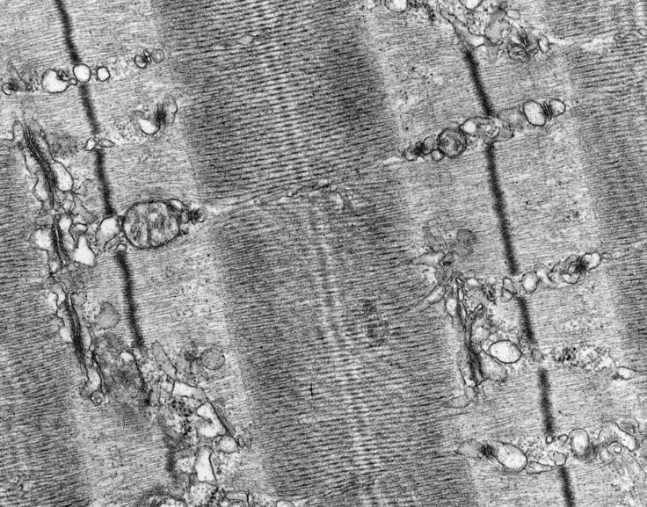
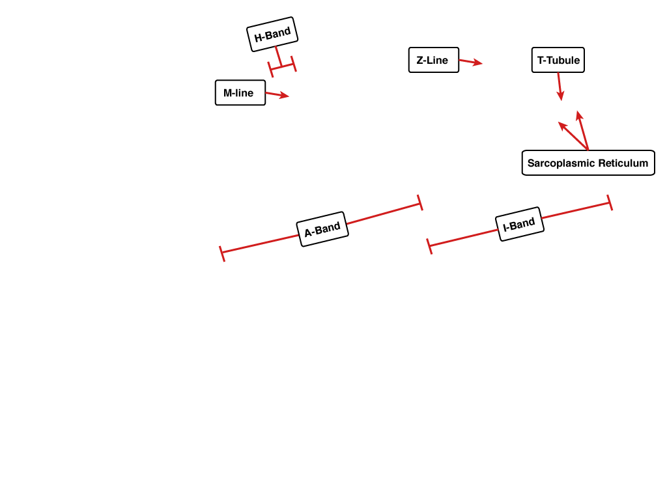
SKELETAL MUSCLE (LONGITUDINAL CROSS-SECTION)
(ELECTRON MAGNIFICATION)

Slide 6
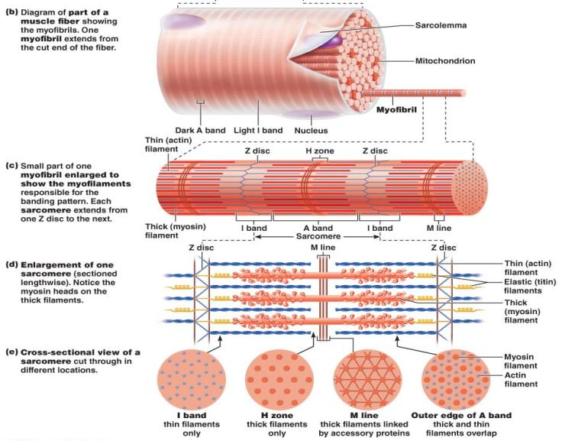
SKELETAL MUSCLE (LONGITUDINAL CROSS-SECTION)
(ILLUSTRATION)

Slide 7
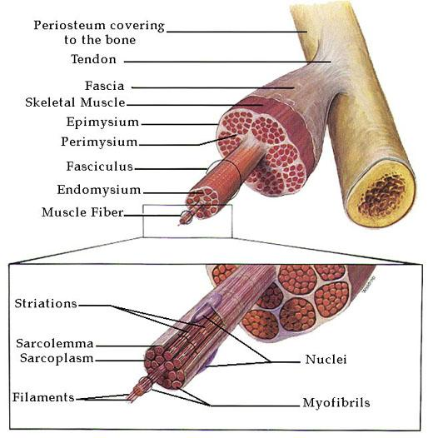
SKELETAL MUSCLE (LONGITUDINAL CROSS-SECTION)
(ILLUSTRATION)

Slide 8
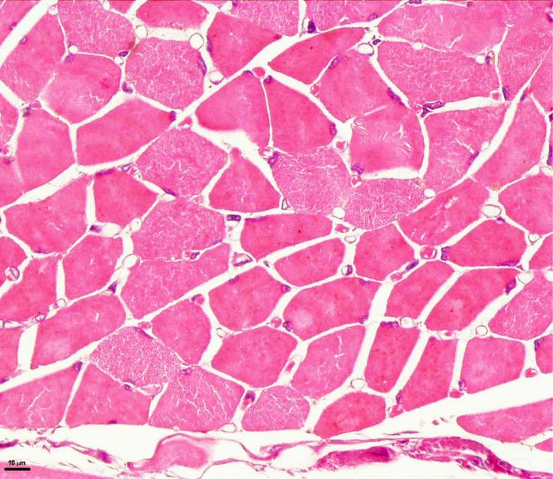
SKELETAL MUSCLE (VERTICAL CROSS-SECTION)
(LOW MAGNIFICATION)

Slide 9
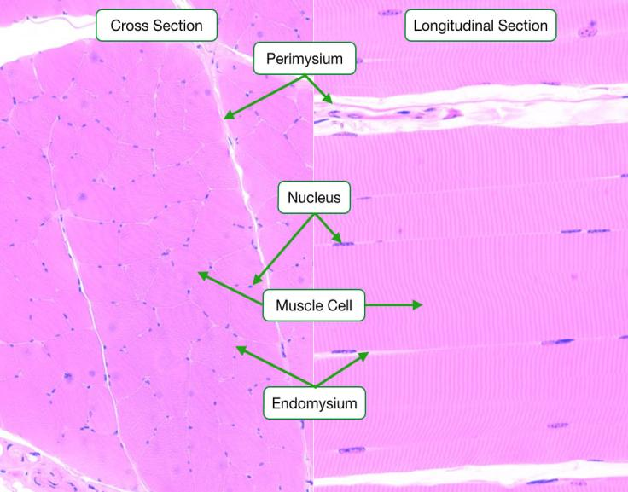
SKELETAL MUSCLE (LONGITUDINAL VS VERTICAL CROSS-SECTION)
(LOW MAGNIFICATION)

Slide 10
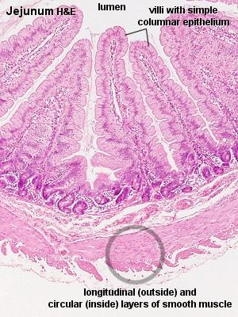
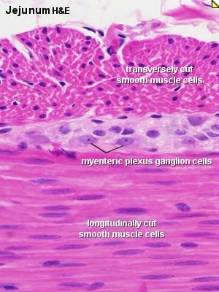
SMOOTH MUSCLE (CROSS-SECTION)
(LOW MAGNIFICATION)

Slide 11
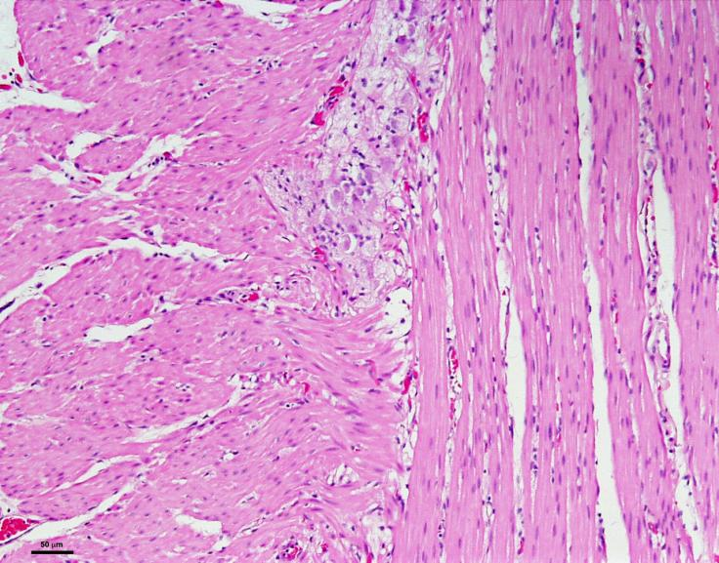
SMOOTH MUSCLE (CROSS-SECTION)
(HIGH MAGNIFICATION)

Slide 12
SMOOTH MUSCLE (CROSS-SECTION)

Slide 13
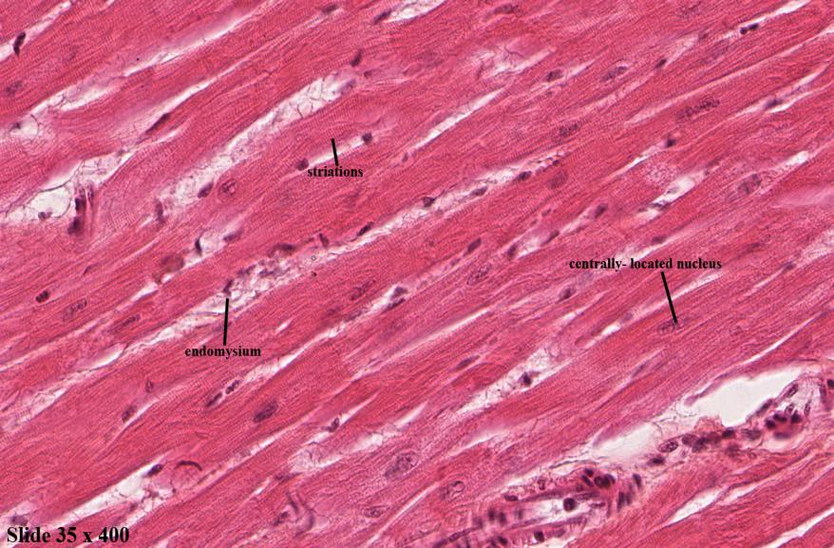
CARDIAC MUSCLE (LONGITUDINAL CROSS-SECTION)
(LOW MAGNIFICATION)

Slide 14
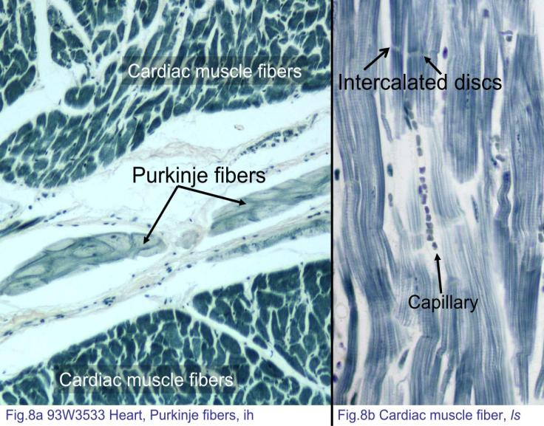
CARDIAC MUSCLE (PURKINJE CELLS)
(LOW MAGNIFICATION)

