Slide 1
LYMPHATIC SYSTEM
HISTOLOGY LABORATORY DEPARTMENT
MEDICAL & HEALTH SCIENCE FACULTY
MUHAMMADIYAH YOGYAKARTA UNIVERSITY

Slide 2
LYMPH NODES

Slide 3
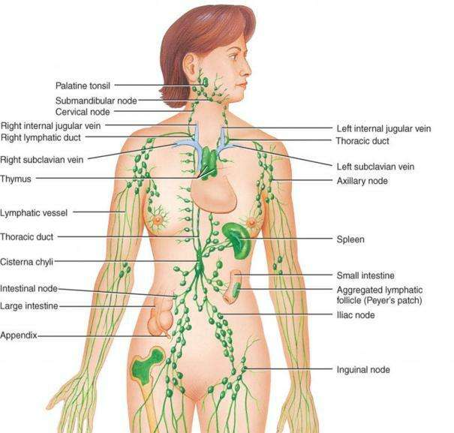
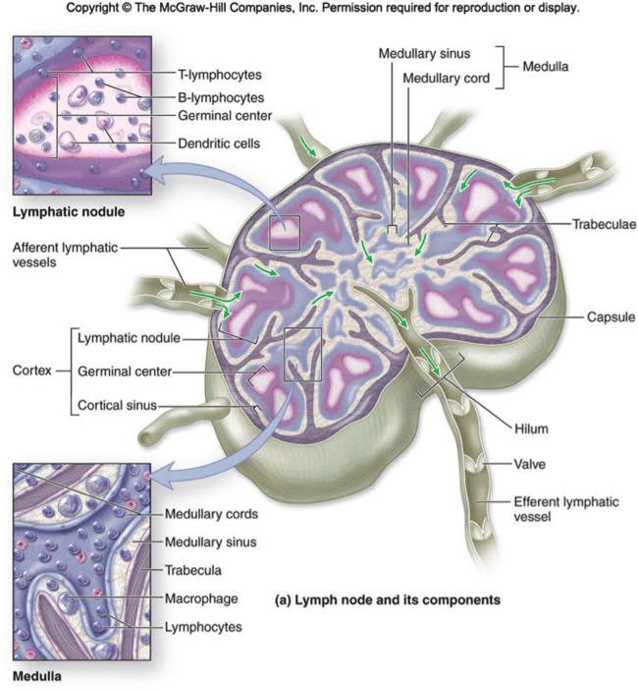

Slide 4
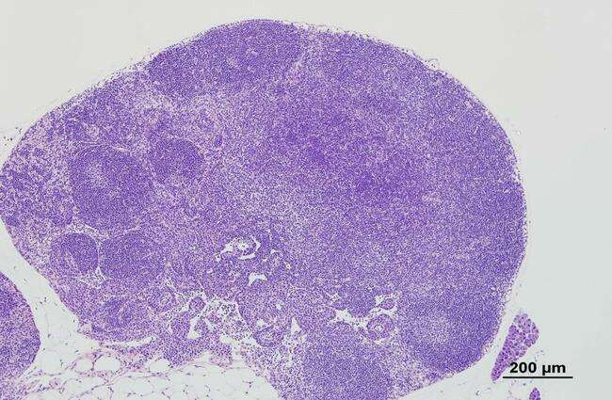

Slide 5
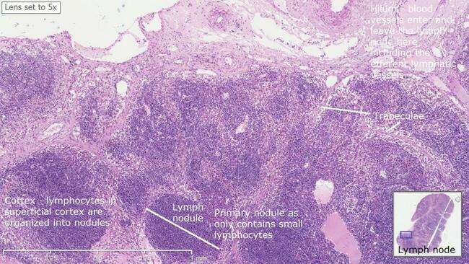

Slide 6
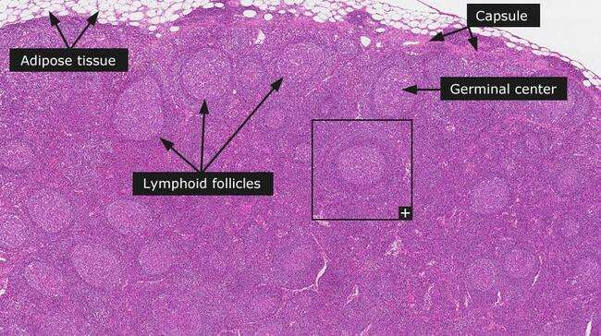

Slide 7
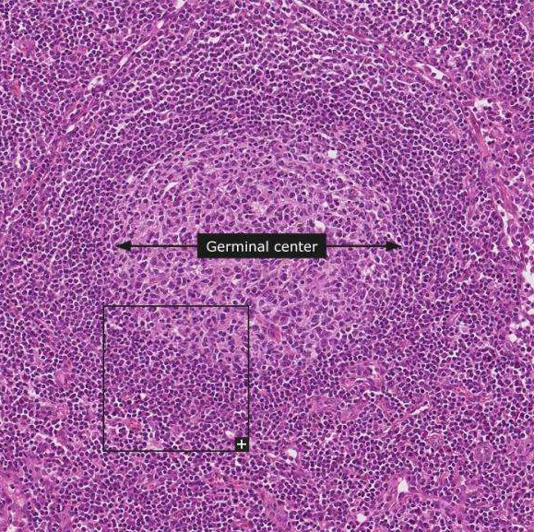
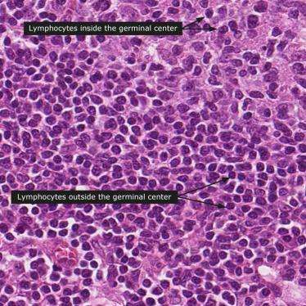

Slide 8
SPLEEN

Slide 9
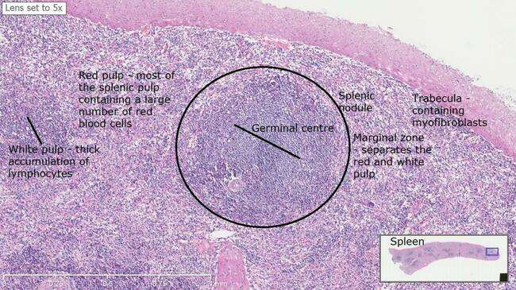

Slide 10
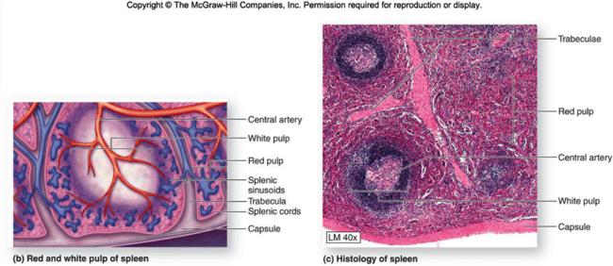

Slide 11
THYMUS

Slide 12
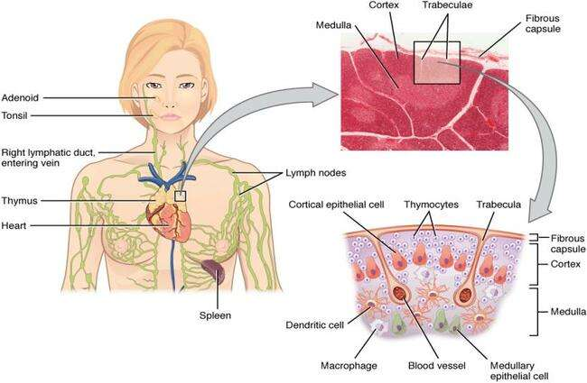

Slide 13
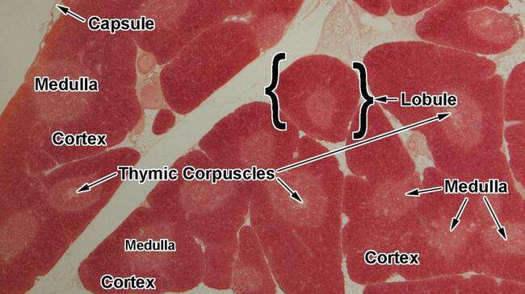

Slide 14
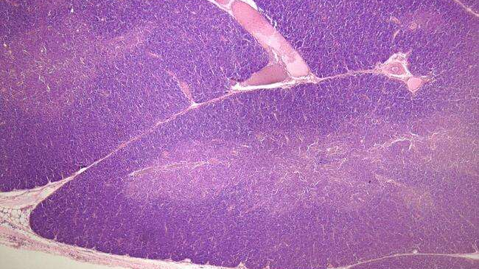

Slide 15
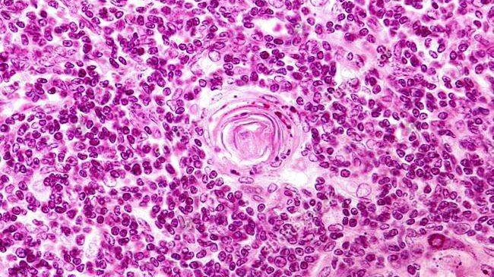

Slide 16
PALATINE TONSIL

Slide 17
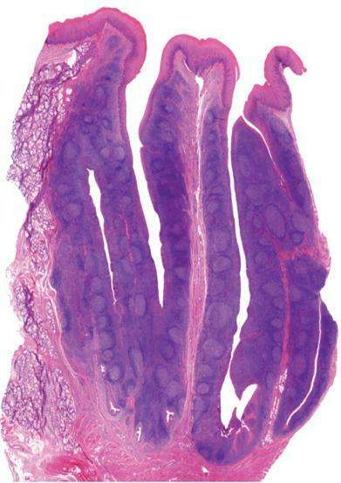

Slide 18
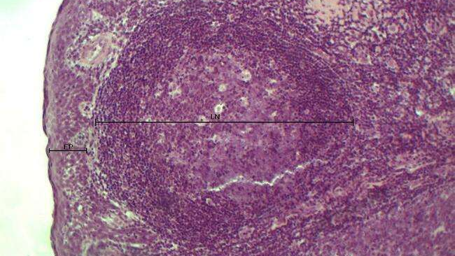

Slide 19
PLAQUE PEYER ILEUM SMALL BOWEL (ILEUM) | USUS HALUS (ILEUM)

Slide 20
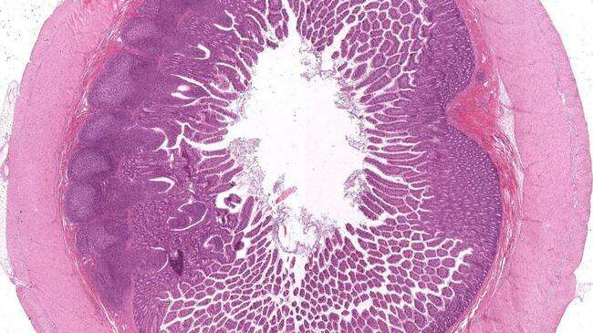

Slide 21
