Slide 1
Endodontic Outcome and Prognosis
Blok 21 Pre Clinic Comprehensive
Tahun Ajaran 2020/2021
Angkatan 2017

Slide 2
Types of Disease and Their Treatment
Vital pulp therapy (indirect pulp therapy, direct pulp capping, pulpotomy, regenerative pulp therapy
Nonsurgical root canal treatment
Nonsurgical root canal retreatment
Surgical retreatment

Slide 3
Types of Outcome Measures
The first dimension is physical/physiologic and related to presence or absence of pulpal/periapical health/disease, pain, and function.
The second dimension assesses longevity or tooth survival.
The third dimension relates to economics and assesses direct and indirect costs.
the fourth dimension examines psychologic aspects involving perceptions of oral health–related quality of life (OHRQoL) and aesthetics.

Slide 4
WHAT IS THE PURPOSE OF EVALUATING OUTCOMES? (Effectiveness of Procedures)
The patient must be properly informed as to the risks, benefits, and potential outcomes of the offered treatment)
The treating clinician must assess his or her own personal outcome data and personal expectation of success.
If the clinician is uncertain of a result or feels that the outcome could be enhanced by treatment from another clinician, then referral to someone else more qualified is paramount.

Slide 5
Factors Affecting Outcomes
Evaluation of factors affecting treatment outcomes arguably provides the strongest influence for making changes that will improve the clinical outcomes.
Weighing the relative importance of individual factors should help to identify the key biologic factors at play and how best to manage them from a clinical or technical perspective

Slide 6
Value for Prognostication
Prognostication, which could be defined as the prediction, projection, prophesizing, or foretelling the likely outcome of treatment, is not often well defined in endodontics
The overall prognosis of a tooth depends on the interaction among three individual and often independent variables, including endodontic, periodontal, and restorative prognoses

Slide 7
Vital Pulp Therapy
The techniques used to maintain the vitality and health of pulps in teeth with extensive caries or those with traumatic/ mechanical exposures include
indirect pulp capping with one-step or stepwise caries excavation
direct pulp capping of exposed pulps
partial/full pulpotomy procedures for more extensively involved pulps.

Slide 8
Outcome measures of Vital Therapy
clinical success (pulp sensitivity to cold test and absence of pain, soft-tissue swelling, sinus tract, periradicular radiolucency, or pathologic root resorption)
patient satisfaction,
adverse events (pain, swelling, tooth fracture), and
tooth extraction

Slide 9
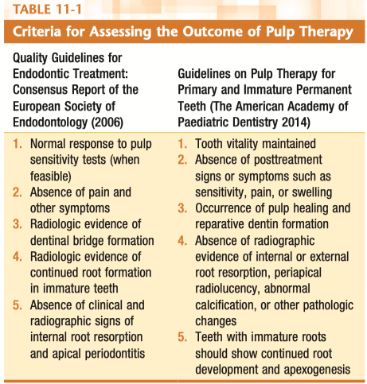
Criteria for Assessing the Outcome of Pulp Therapy

Slide 10
the presence or absence of tenderness to palpation of adjacent soft tissues, tenderness to pressure and percussion of the tooth, signs of radiographic pulpal, and periapical changes, and responses to pulp tests.
The accuracy of pulp tests may be limited in pulpotomized teeth because of the distance of the remaining pulp tissue from the tooth’s surface.
In the case of pulp capping and pulpotomy, additional tests include radiographic verification of the presence of the calcific barrier

Slide 11
Outcome Measures for Nonsurgical Root Canal Treatment and Retreatment
Root canal treatment may be employed either to prevent or resolve periapical disease
periapical lesions develop as a result of interaction between bacteria (and their by-products) and the host defenses
Incomplete removal of the infection will reduce but not eliminate the periradicular inflammatory reaction, and in fact this is generally what happens.
residual infection in the apical anatomy is typical following completion of root canal treatment and that an ongoing interaction continues between the residual infection, root filling material, and host defenses, which plays a definitive role in determining the final healing outcome.

Slide 12
Outcome Measures for Nonsurgical Root Canal Treatment and Retreatment
The term functional retention was coined by Friedman in 2004 to mean retention of the tooth in the absence of signs and symptoms regardless of the radiographic presence of a lesion.
The term functionality should further and more specifically cover the functional utility of the tooth—that is, some patients may complain that despite the absence of specific signs and symptoms of infection or inflammation, they find it impossible to use the tooth because it “feels” weak.
Many studies consider the treatment successful only when both radiographic and clinical criteria are satisfied.

Slide 13
STRINDBERG CRITERIA
Success |  | Failure |  | Uncertain
Clinical | radiographic | Clinical | Radiographic | Clinical | Radiographic
No symptom | Contours and width of periodontal ligament are norma | Symptoms present | Unchanged periradicular rarefaction | Symptoms present | Ambiguous or technically unsatisfactory radiograph that could not be interpreted with certainty
 | Periodontal ligament contours are widened mainly around excess root filling |  | Decrease in periradicular rarefaction but no resolution |  | Periradicular rarefaction less than 1 mm and disrupted lamina dura
 | Lamina dura is intact |  | Appearance of new rarefaction or an increase in the size of initial rarefaction |  | Tooth extracted prior to recall due to reasons not related to endodontic outcome
 |  |  | Discontinuous or poorly defined lamina dura

Slide 14
STRINDBERG CRITERIA
Radiographic Findings
Clinical Findings
Success (
Failure
Uncertain
Success
Failure
Uncertain

Slide 15
PAI
5-point ordinal scale :
Normal periapical structures
Small changes in bone structure with no dimineralization
Changes in bone structure with some diffuse demineralization
Apical periodontitis with well-defined radiolucent area
Severe apical periodontitis, with exacerbating features

Slide 16
The CBCT-PAI
Intact periapical bone structures
Diameter of periapical radiolucency 0.5 mm to 1 mm
Diameter of periapical radiolucency 1 mm to 2 mm 3
Diameter of periapical radiolucency 2 mm to 4 mm 4
Diameter of periapical radiolucency 4 mm to 8 mm 5
Diameter of periapical radiolucency 8 mm
E: Expansion of periapical cortical bone
D: Destruction of periapical cortical bone
CBCT is more sensitive than conventional periapical radiography for detection of apical radiolucencies

Slide 17
Assessment
The assessment of outcome was based on the PAI and categorized outcomes as “healed” when the PAI score is less than 3 or “disease” for PAI scores greater than or equal to 3.

Slide 18
THE AMERICAN ASSOCIATION OF ENDODONTISTS–APPROVED DEFINITIONS OF ENDODONTIC OUTCOMES
Healed — functional*, asymptomatic teeth with no or minimal radiographic periradicular pathosis
Nonhealed — nonfunctional, symptomatic teeth with or without radiographic periradicular pathosis
Healing — teeth with periradicular pathosis, which are asymptomatic and functional, or teeth with or without radiographic periradicular pathosis, which are symptomatic but whose intended function is not altered
Functional — a treated tooth or root that is serving its intended purpose in the dentition

Slide 19
VITAL PULP THERAPY
Many factors may affect the outcome of vital pulp therapy, such as
age of patients,
stage of tooth development,
severity of pulp damage,
regenerative potential of the pulp, and
microleakage of the capping materials.
Control of infection

Slide 20
OUTCOME ASSESSMENT OF VITAL PULP THERAPY
Success |  | Failure |  | Uncertain
Clinical | Radiographic | Clinical | Radiographic | Clinical | Radiographic
Regression of clinical symptoms | Progressive root growth in length | Persistence or recurrence of clinical symptoms | Cessation of root growth
Maintenance of pulp vitality | Maturation of the apex | Loss of pulp vitality | Cessation of maturation of the apex
 | Thickening of the root canal walls |  | Lack of thickening of root canal walls

Slide 21
OUTCOME RATES FOR VITAL PULP THERAPY
review of vital pulp therapy in permanent teeth with carious pulp exposure showed that the success rates after 3-year follow-up were 72.9% for direct pulp capping and up to 99.4% for pulpotomy
immature teeth seem to have better treatment outcomes than mature teeth presumably due to a greater immunologic and reparative response provided from an open apex

Slide 22
The periapical index (PAI)
a structured scoring system for categorization of radiographic features of apical periodontitis.
It is based on a visual scale of periapical periodontitis severity and was built on a classic study of histologic-radiologic correlations.

Slide 23
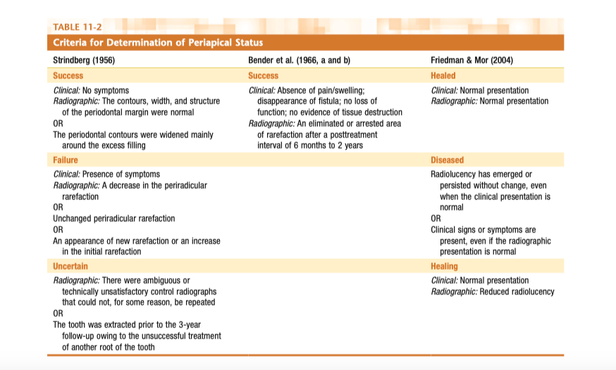
Periapical Status Criteria

