Slide 1
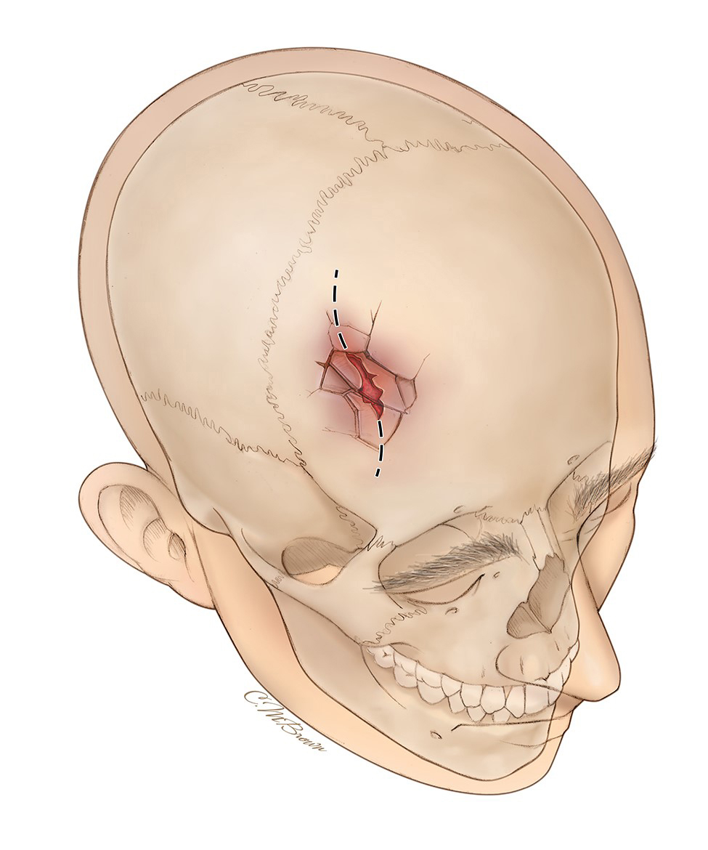
Clinical Anatomy for Trauma of Head, Neck and Vertebrata
Dr.dr.Sagiran,Sp. B (K)KL.,M.Kes.,FICS

Slide 3
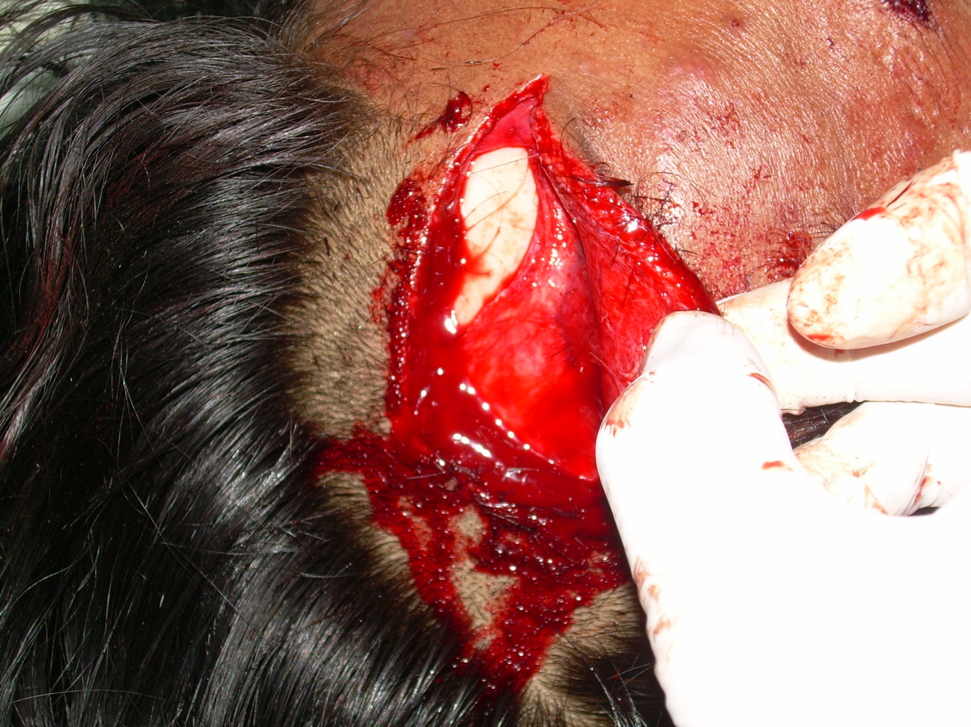

Slide 4
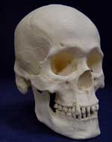
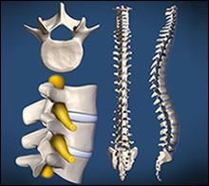

Slide 5
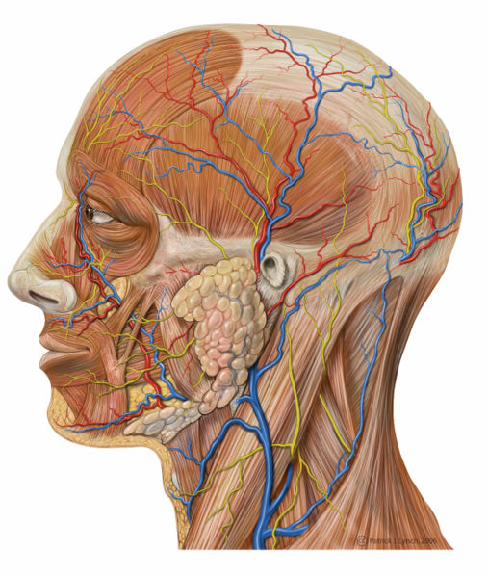
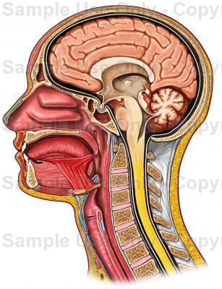

Slide 6
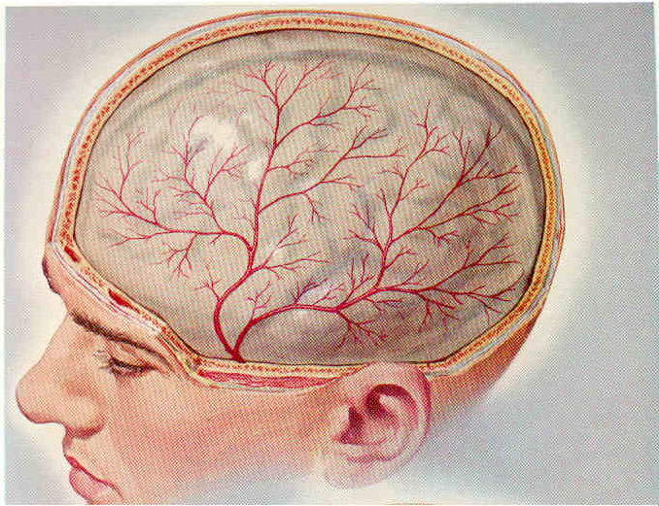

Slide 7
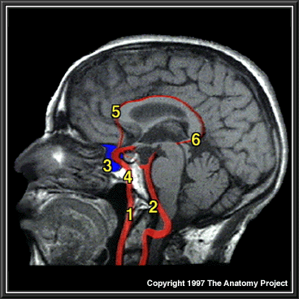
MRI, Brain & Spinal Cord, Sagittal Section
Internal carotid artery
Vertebral artery
Cavernous sinus
Carotid canal
Anterior cerebral artery
Posterior cerebral artery

Slide 8
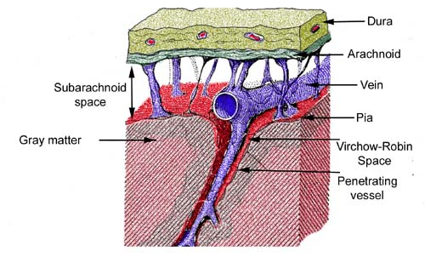

Slide 9
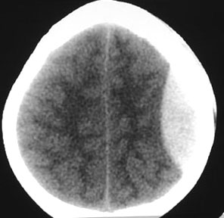
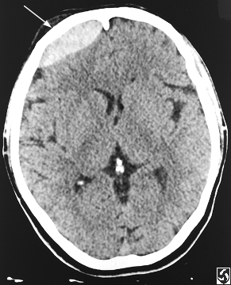

Slide 10
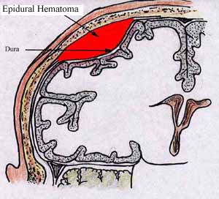
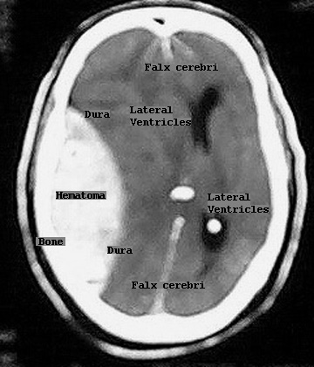

Slide 11
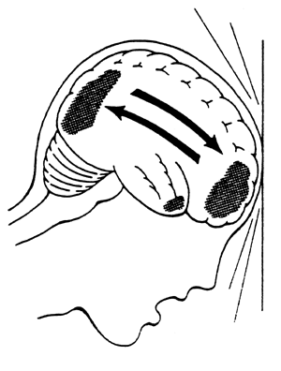
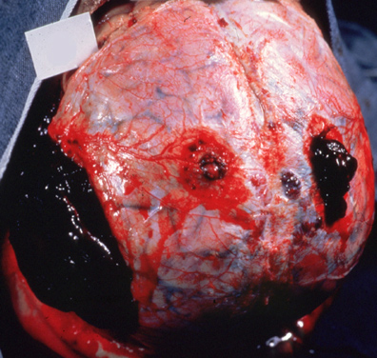

Slide 12
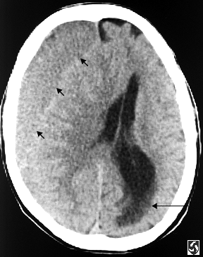
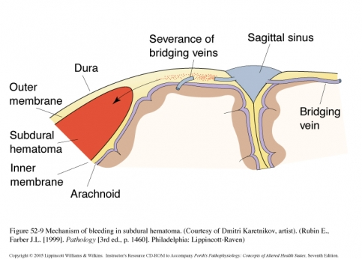

Slide 13
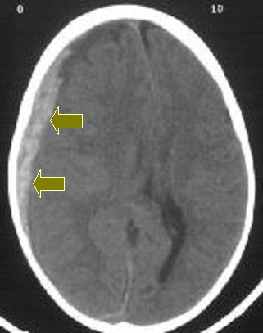
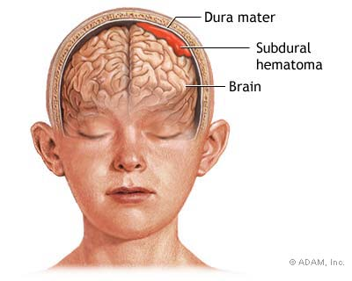

Slide 14
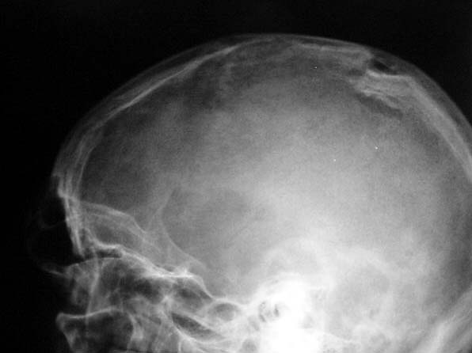

Slide 15
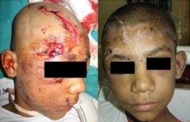
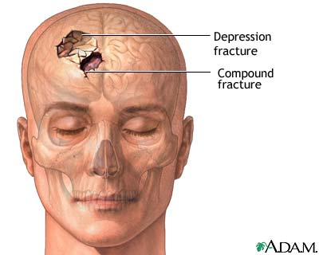

Slide 16
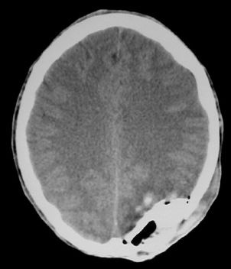
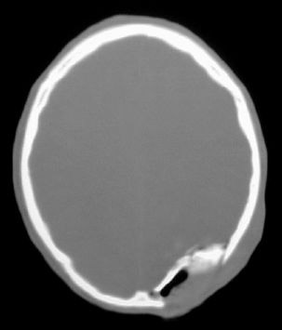

Slide 17
Pharynx and Larynx

Slide 18
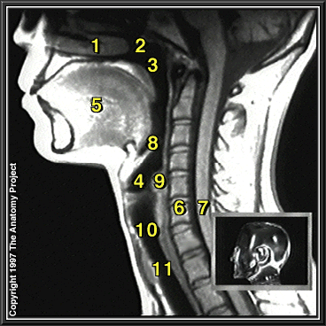
MRI, Head And Neck, Sagittal Section
Nasal cavity
Nasopharynx
Pharynx
Larynx
Tongue
Spinal column
Spinal cord
Epiglottis
Cricoid cartilage
Cricotracheal membrane
Trachea

Slide 19
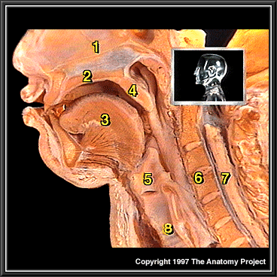
Head And Neck, Sagittal Section
Nasal Cavity
Hard Palate
Tongue
Soft Palate
Larynx
Spinal Column
Spinal Cord
Trachea

Slide 20
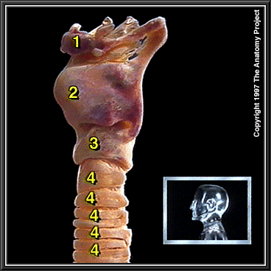
Larynx And Trachea, Lateral View
Hyoid Bone
Thyroid Cartilage
Cricoid Cartilage
Tracheal Cartilages

Slide 21
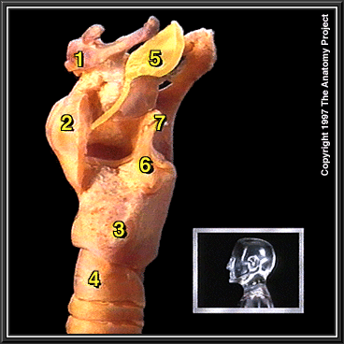
Larynx, Nearest Thyroid Lamina Removed, Lateral View
Hyoid Bone
Thyroid Cartilage
Cricoid Cartilage
Tracheal Cartilage
Epiglottis
Arytenoid Cartilage
Corniculate Cartilage

Slide 22
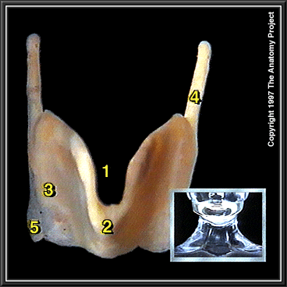
Thyroid Cartilage, Anterior View
Thyroid Incisure Or Notch
Thyroid Prominence
Thyroid Lamina
Superior Cornu
Inferior Cornu

Slide 23
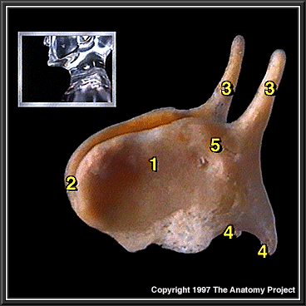
Thyroid Cartilage, Lateral View
Thyroid Lamina
Thyroid Prominence
Superior Cornu
Inferior Cornu
Oblique Line

Slide 24
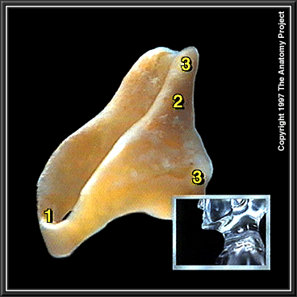
Cricoid Cartilage, Lateral View
Anterior Arch
Posterior Lamina
Articular Facet

Slide 25
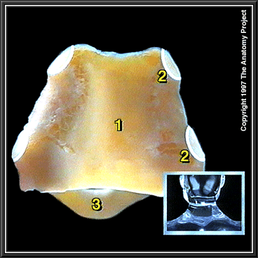
Cricoid Cartilage, Posterior View
Posterior Lamina
Articular Facet
Anterior Arch

Slide 26
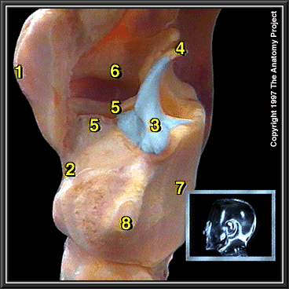
Larynx, Nearest Thyroid Lamina Removed, Lateral View
Thyroid Prominence
Cricothyroid Ligament
Arytenoid Cartilage
Corniculate Cartilage
Vocal Ligament
Vestibular Fold
Cricoid Cartilage
Articular Facet For Inferior Cornu Of Thyroid Cartilage

Slide 27
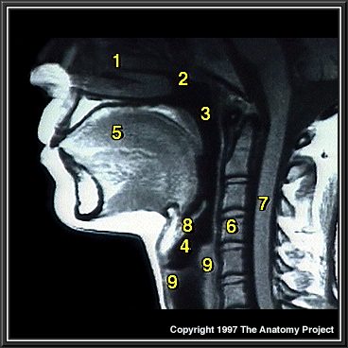
MRI, Head And Neck, Sagittal Section
Nasal Cavity
Nasopharynx
Pharynx
Larynx
Tongue
Spinal Column
Spinal Cord
Epiglottis
Cricoid Cartilage

Slide 28
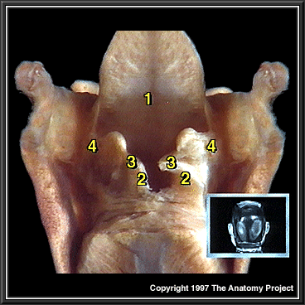
Larynx, Posterior View
Epiglottis
Arytenoid Cartilage
Corniculate Cartilage
Aryepiglottic Fold

Slide 29
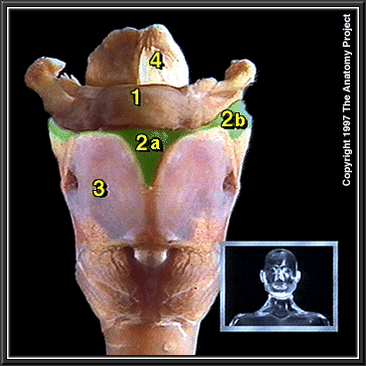
Larynx, Anterior View
Hyoid Bone
Thyrohyoid Membrane 2a. Median Thyrohyoid Ligament 2b. Lateral Thyrohyoid Ligament
Thyroid Cartilage
Epiglottis

Slide 30
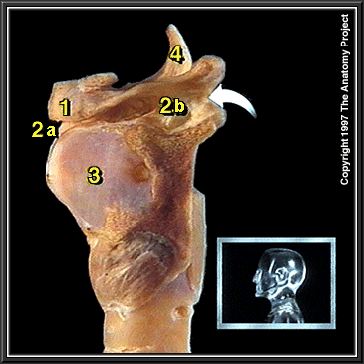
Larynx, Lateral View
Hyoid Bone
Thyrohyoid Membrane 2a. Median Thyrohyoid Ligament 2b. Lateral Thyrohyoid Ligament
Thyroid Cartilage
Epiglottis

Slide 31
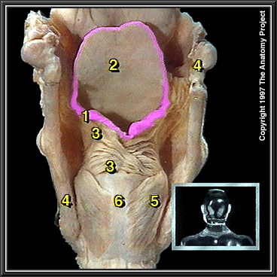
Larynx, Posterior View
Inlet Of The Larynx
Epiglottis
Oblique Arytenoid And Aryepiglottici Muscles
Cornua Of Thyroid Cartilage
Posterior Cricoarytenoid Muscle
Cricoid Cartilage

Slide 32
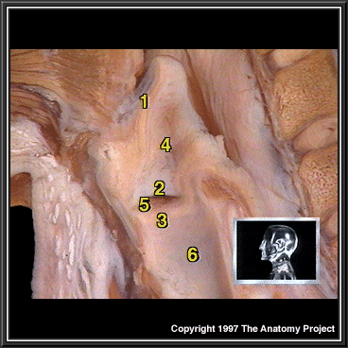
Larynx, Lateral View
Epiglottis
Vestibular Fold
Vocal Fold
Vestibule Of Larynx
Middle Part Of Larynx
Lower Part Of Larynx

Slide 33
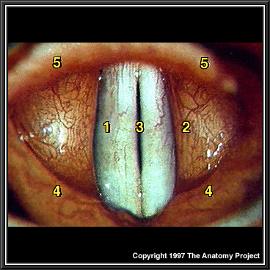
Larynx, Laryngoscopic View
Vocal Fold
Vestibular Fold
Glottis
Aryepiglottic Folds
Epiglottis

Slide 34
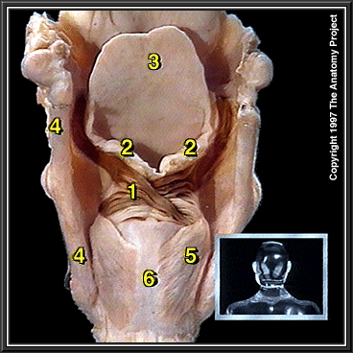
Larynx, Posterior View Muscles Which Narrow The Laryngeal Inlet
Oblique Arytenoid And Aryepiglottici Muscles
Inlet Of The Larynx
Epiglottis
Cornua Of Thyroid Cartilage
Posterior Cricoarytenoid Muscle
Cricoid Cartilage

Slide 35
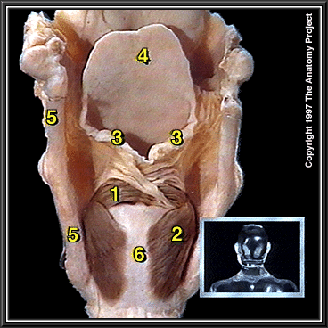
Larynx, Posterior View Muscles Which Close The Glottis
Transverse Arytenoid Muscle
Posterior Cricoarytenoid Muscle
Inlet Of The Larynx
Epiglottis
Cornua Of Thyroid Cartilage
Cricoid Cartilage

Slide 36
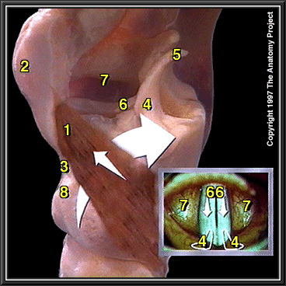
Larynx, Lateral View, Nearest Thyroid Lamina Removed Muscles Which Tense The Vocal Cords
Cricothyroid Muscle
Thyroid Prominence
Cricothyroid Ligament
Arytenoid Cartilage
Corniculate Cartilage
Vocal Ligament
Vestibular Fold
Cricoid Cartilage

Slide 37
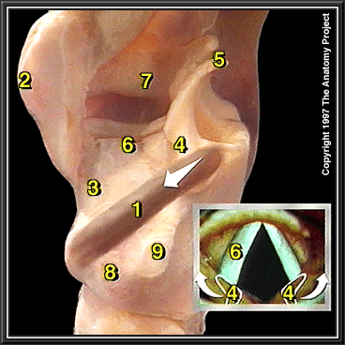
Larynx, Lateral View, Nearest Thyroid Lamina Removed Muscles Which Close The Glottis
Lateral Cricoarytenoid Muscle
Thyroid Prominence
Cricothyroid Ligament
Arytenoid Cartilage
Corniculate Cartilage
Vocal Ligament
Vestibular Fold
Cricoid Cartilage
Articular Facet For Thyroid Cartilage

Slide 38
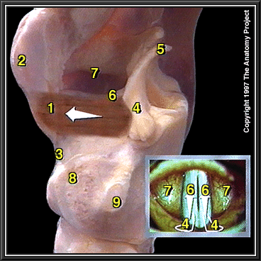
Larynx, Lateral View, Nearest Thyroid Lamina Removed Muscles Which Relax The Vocal Cords
Thyroarytenoid Muscle
Thyroid Prominence
Cricothyroid Ligament
Arytenoid Cartilage
Corniculate Cartilage
Vocal Ligament
Vestibular Fold
Cricoid Cartilage
Articular Facet For Thyroid Cartilage

Slide 39
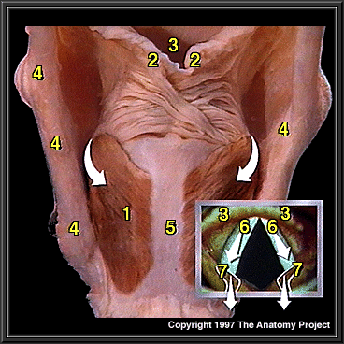
Larynx, Posterior View Muscles Which Abduct The Vocal Cords
Posterior Cricoarytenoid Muscle
Inlet Of The Larynx
Epiglottis
Cornua Of Thyroid Cartilage
Cricoid Cartilage
Vocal Cord
Arytenoid Cartilage

Slide 40
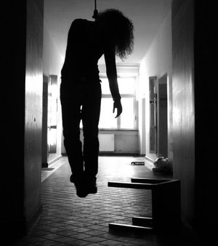
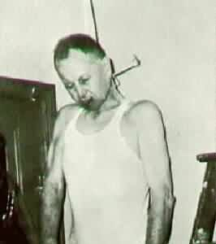

Slide 41
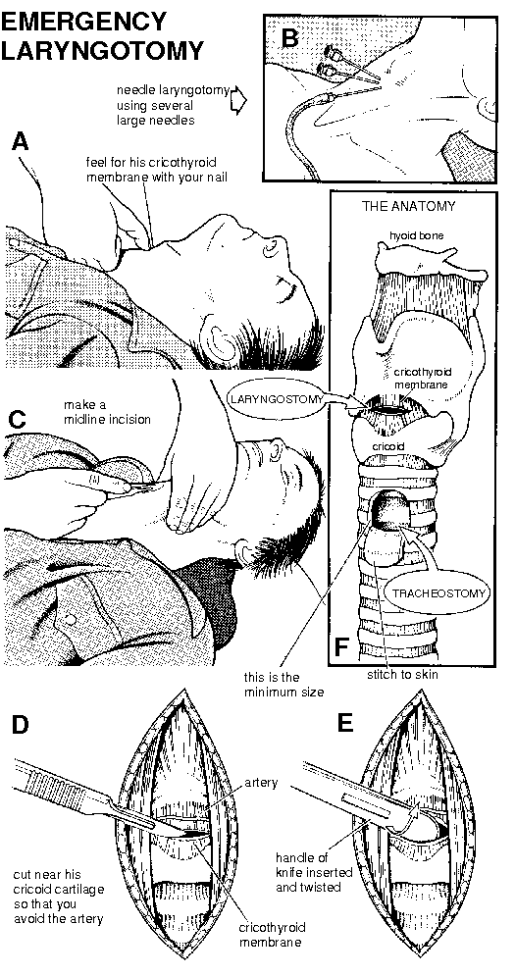

Slide 42
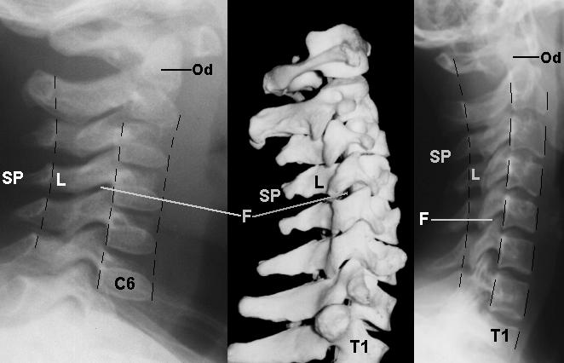
The contour lines of alignment are shown. Identify the following areas on the radiographs: F - facet joint SP - spinous process L - lamina Od - odontoid

Slide 45
The hangman's fracture is an unstable fracture of the C2 pedicles, with forward displacement of C1 and the body of C2 on C3. This traumatic spondylolisthesis of C2 is the result of hyperextension of the head relative to the neck.

Slide 46
Ruptur carotis

Slide 47
HNP
Herniated lumbar disk is a condition in which part or all of the soft, gelatinous central portion of an intervertebral disk (the nucleus pulposus) is forced through a weakened part of the disk, resulting in back pain and nerve root irritation.

Slide 51
WEDGE FRACTURE

Slide 54
Abdomen
Trauma (dinding):
Tajam (senjata tajam, tembak)
Tumpul
Organ:
Padat
Berrongga
Resiko:
Perdarahan → shock
Peritonitis → sepsis

Slide 57
Penetrating abdominal trauma.

Slide 62
Doa Penutup Majelis سُبْحَانَكَ اللَّهُمَّ وَبِحَمْدِكَ، أَشْهَدُ أَنْ لاَ إِلَـٰهَ إِلاَّ أَنْتَ، أَسْتَغْفِرُكَ، وَأَتُوْبُ إِلَيْكَ "Maha Suci Engkau ya Allah, aku memuji-Mu. Aku bersaksi bahwa tidak ada sesembahan yang berhak disembah kecuali Engkau, aku minta ampun dan bertaubat kepada-Mu.” "

