Slide 1
Mechanism, Early Management For Sepsis
Nova Maryani

Slide 2
General and Specific Instructional Objectives
Students are able to know, understand, and explain the mechanism, definition, and early management of sepsis.
Students are able to recognize critical patients, especially patients with sepsis.

Slide 3
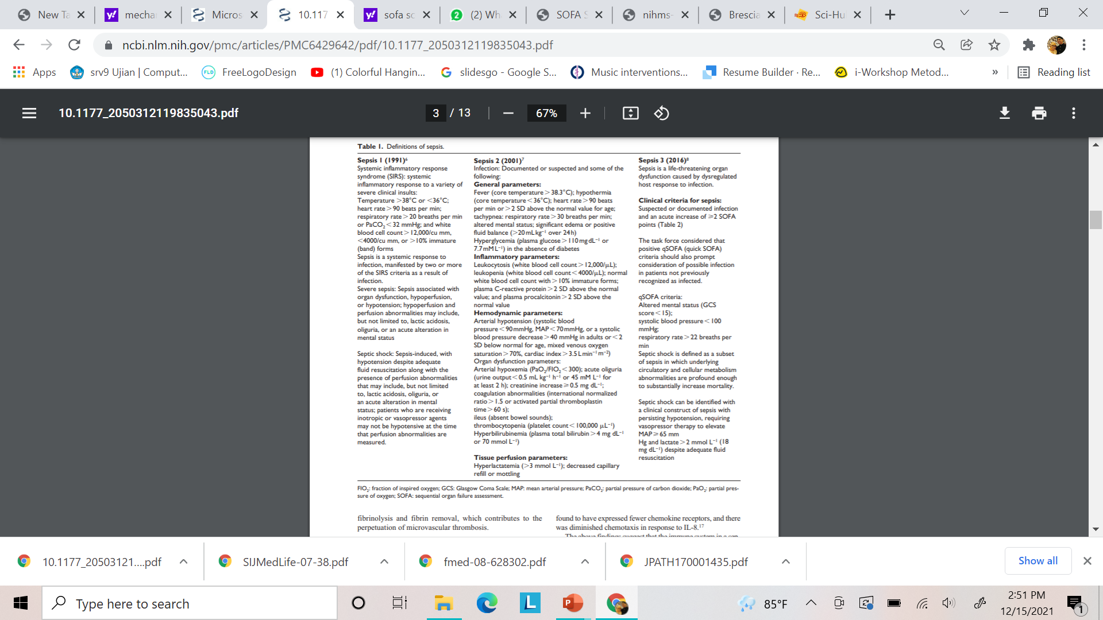
Review Definition

Slide 4
SEPSIS
Definition (3rd International Consensus Definitions for Sepsis and Septic Shock)
“life threatening organ disfunction caused by a dysregulated host response to infection”
Organ Dysfunction: ≥ 2 point in SOFA score (Sequential Organ Failure Assessment).
Infection: Invasion of organism in normal steril tissue→infectious pathology.

Slide 5
MILESTONE
qSOFA + EWS +MEWS
Surviving Sepsis Campaign
2020
Revision (1 hour)
The Surviving Sepsis campaign launched in 2004, is aimed at improving diagnosis, management and survival of patients with sepsis. Care bundles are a group of best evidence based interventions which when instituted together, gives maximum outcome benefit.
2018
Revision of 6 hours item (hemodynamic monitoring)
2016
2014
Revision of 6 hours item (CVC)
2012
3-6 hours
Year
2004
2 Phase
6-24 hours
1992

Slide 6
Mechanism

Slide 7
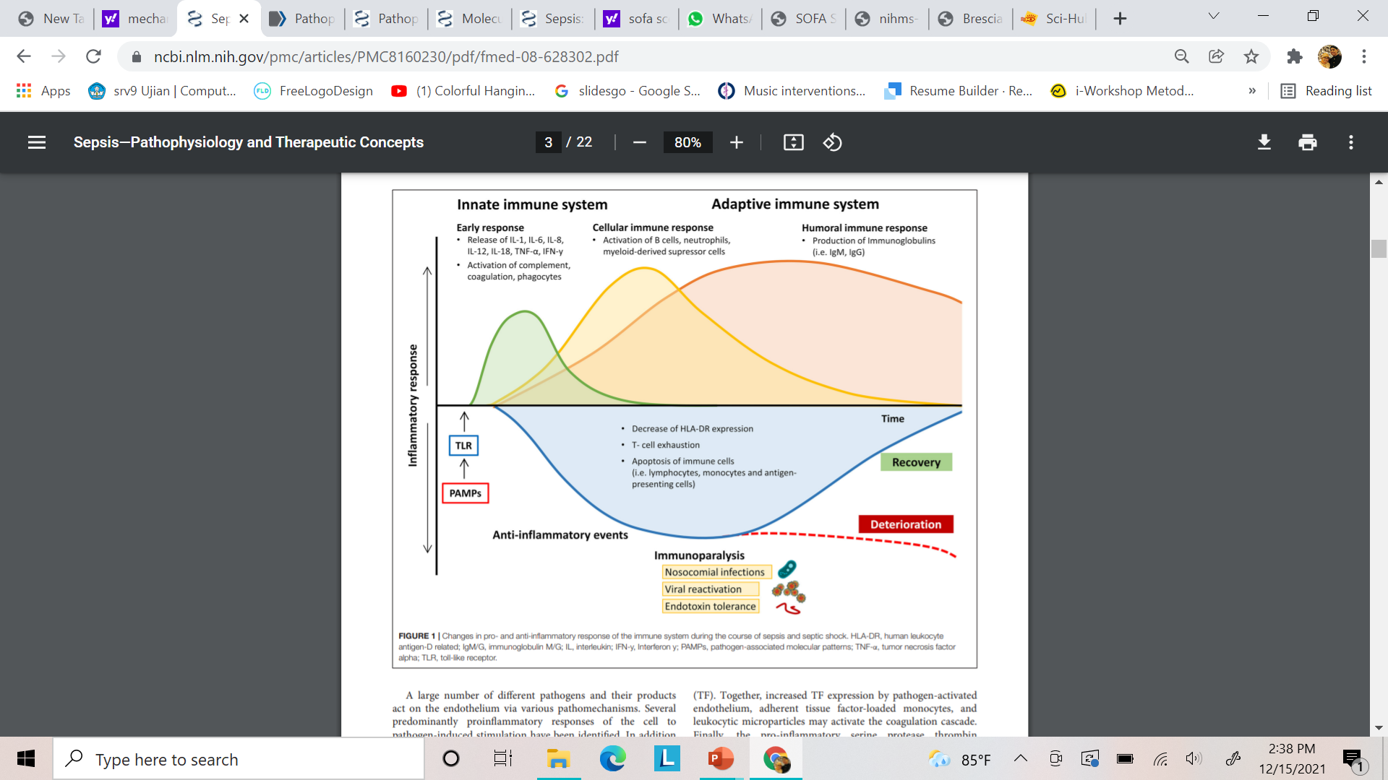
Pathogenesis of Sepsis
Notes:
In contrast to an uncomplicated and localized infection, sepsis is a multifaceted disruption of the finely tuned immunological balance of inflammation and anti-inflammation. The upregulation of pro- and anti-inflammatory pathways leads to a system-wide release of cytokines, mediators, and pathogen related molecules, resulting in activation of coagulation, and complement cascades (5).
Recognition of pathogen-derived molecular patterns (PAMPs, e.g., endo- and exotoxins, lipids, or DNA sequences) or endogenous host-derived danger signals (damage-associated molecular patterns; DAMPs) is the starting signal. These molecules activate specific receptors (toll-like receptors, TLR) on the surface of antigen-presenting cells (APCs) and monocytes, thereby initiating the clinical syndrome of sepsis via transcription of genes involved in inflammation, cell metabolism, and adaptive immunity (6). While both pro-inflammatory and anti-inflammatory pathways are upregulated, the resulting inflammation leads to progressive tissue damage, finally causing multi-organ dysfunction. In many patients the concomitant immunosuppression, which is caused by downregulation of activating cell surface molecules, increased apoptosis of immune cells, and T cell exhaustion, leads to “immunoparalysis” in the later stages of the disease course and makes affected patients susceptible to nosocomial infections, opportunistic pathogens, and viral reactivation (Figure 1)

Slide 8
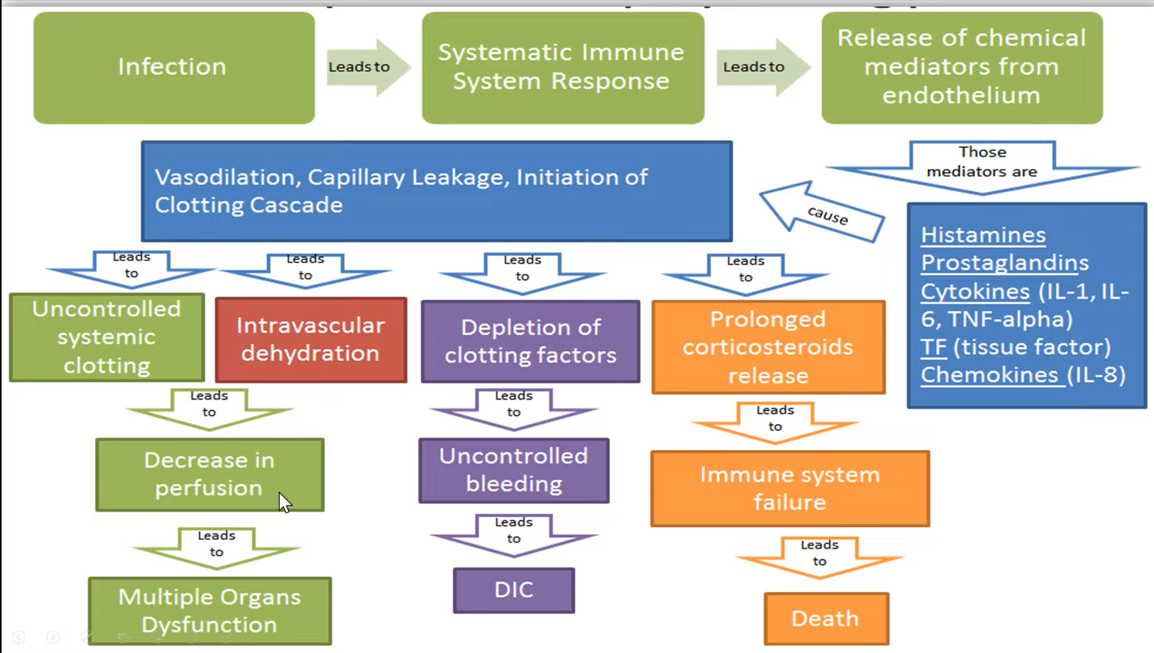

Slide 9
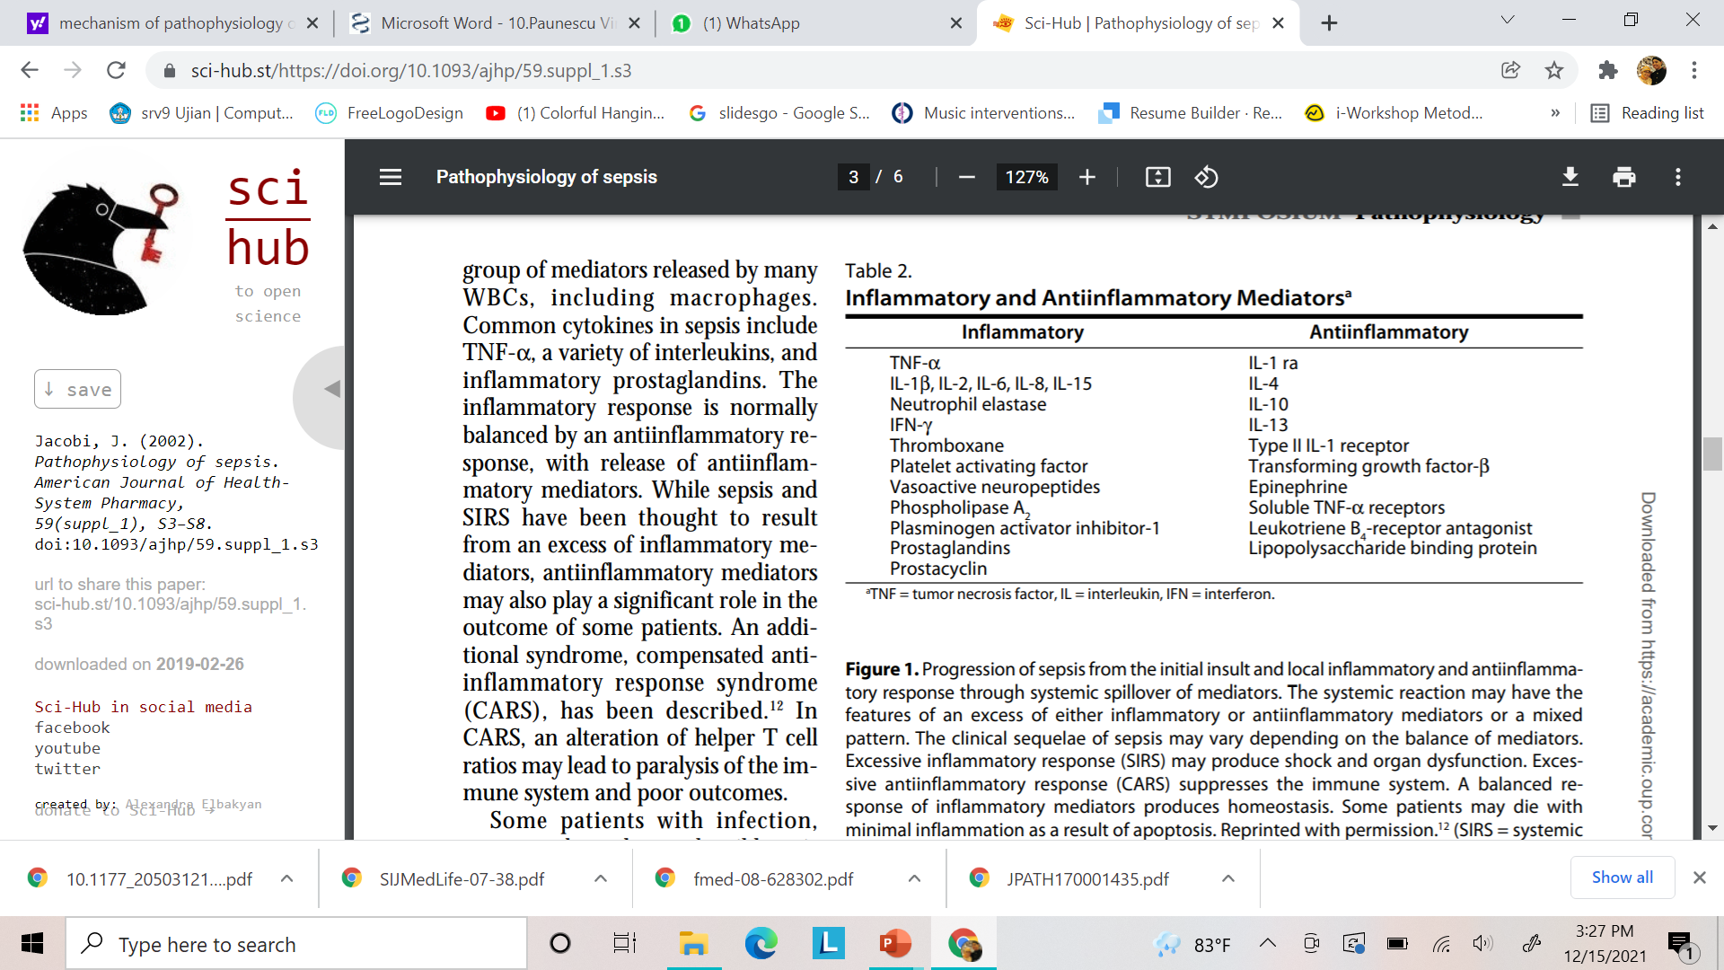

Slide 10
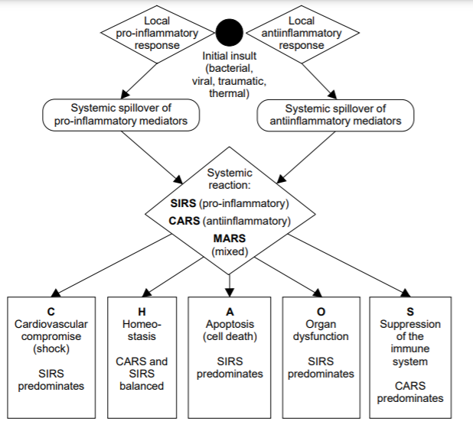

Slide 11
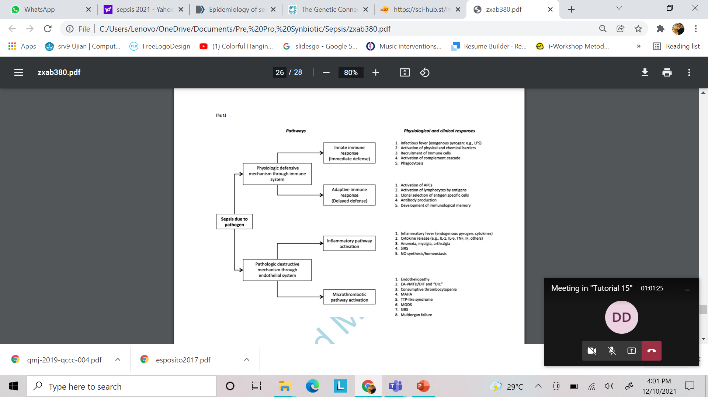
Clinical ResponsePathways

Slide 12
Clinical Manifestations
Organ Dysfunction
Localized Inflamation
(warmth, redness, and swelling)
Severe or generalized infection
systemic response (eg, fever, tachycardia, tachypnea)

Slide 13

ETIOLOGY
Obstructive
EXAMPLETYPE SHOCK
Distributive
Septic Shock
$$:$$
Mediator Vasoactive Release
Cardiogenic
Hypovolemic
Prostacyclin and Nitric Oxide (NO)
Notes:
Shock may develop because of cardiogenic, hypovolemic, obstructive, or distributive/vasodilatory etiologies. Septic shock is the most common form of distributive/vasodilatory shock related to release of vasoactive mediators such as prostacyclin and nitric oxide (NO). These mediators suppress autoregulation of blood flow and perfusion in central, regional, and microcirculatory beds and produce vasodilation and eventually hypotension. The hypotension is exacerbated by inflammatory injury to the vascular endothelium leading to loss of integrity and increased permeability with leakage of fluid and protein into the perivascular tissues and lymphatics (historically known as thirdspacing). Thus, septic shock has elements of hypovolemic shock. Septic shock may also have features of cardiogenic shock because of myocardial depressant effects of a variety of circulating mediators

Slide 14
Early Management

Slide 15
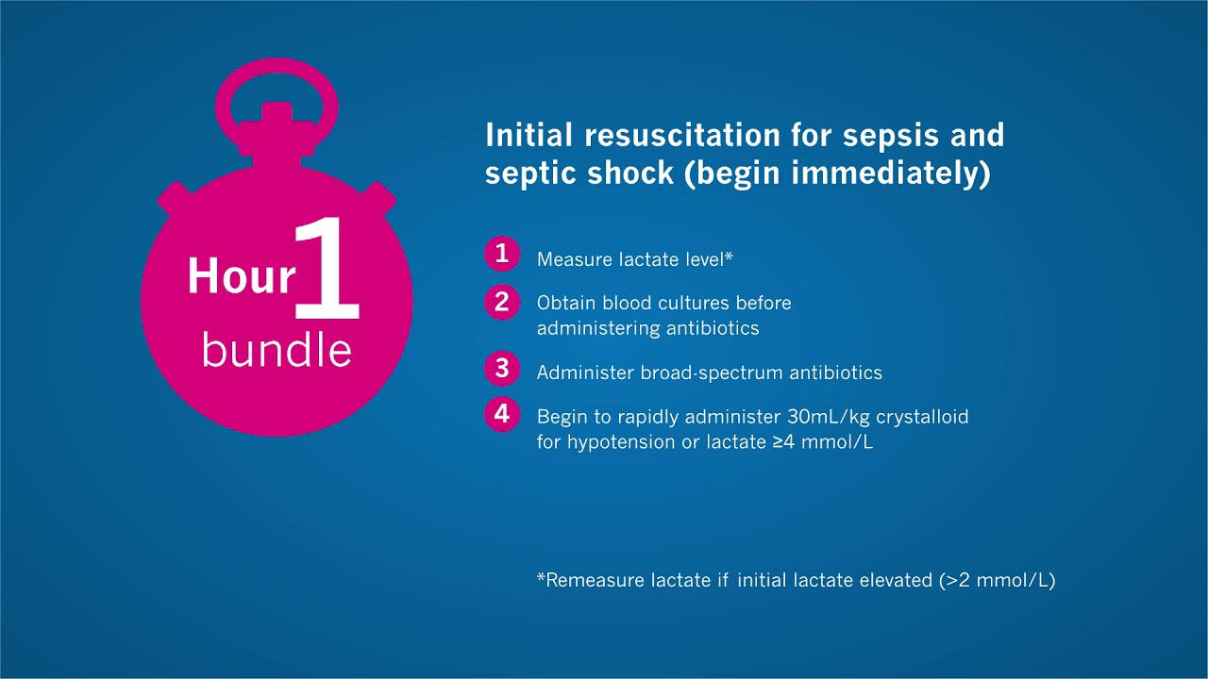
Protokol Kebijakan
Langkah-Langkah Pencegahan Sepsis:
- Hand hygiene,
- Teknik aseptic pada prosedur invasif
- SOP Teknik aseptik
- Hindari peresepan antibiotik yang tidak perlu

Slide 16
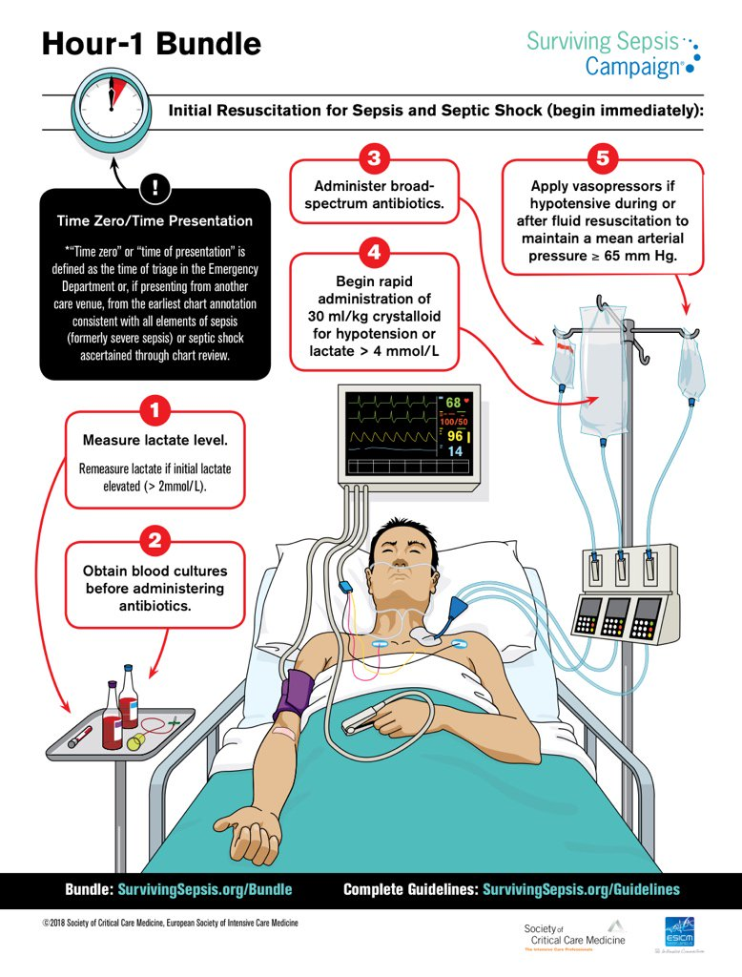


Slide 17
qSOFA SCORE dan SOFA SCORE

Slide 18
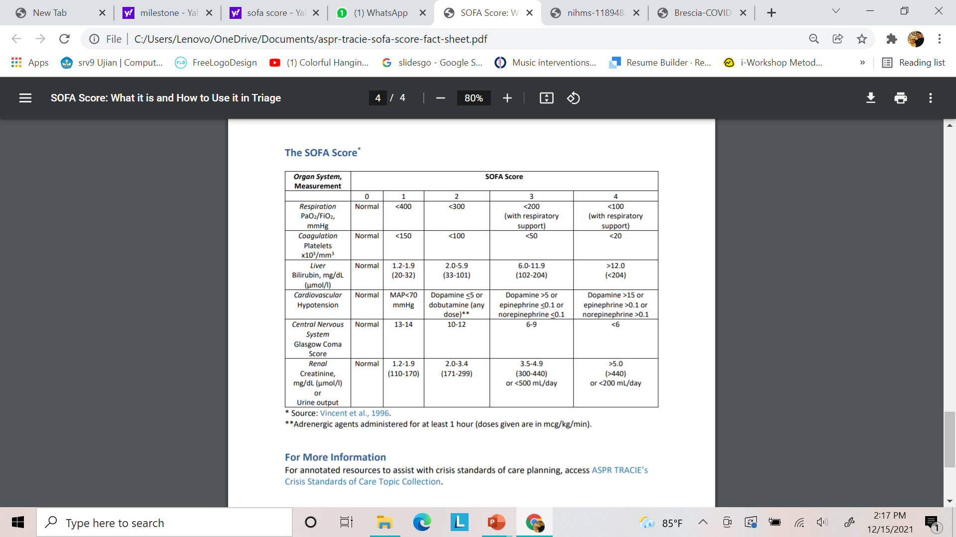
SOFA SCORE

Slide 19
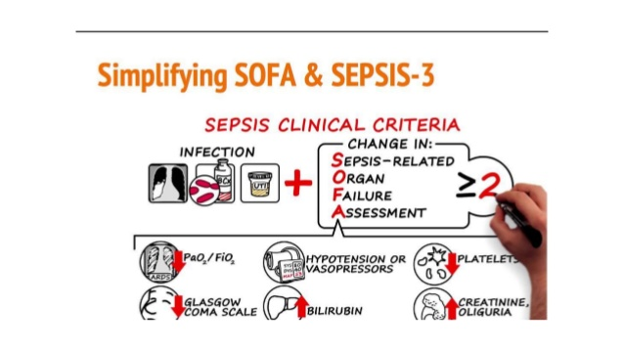

Slide 20

Quick SOFA criteria (qSOFA)
Respiratory rate ≥22/m
Altered Mentation
Systolic blood pressure ≤ 100 mmHg

Slide 21
New Recommendation Guideline Sepsis 2020-2021

Slide 27
INTENSIVE CARE UNIT

Slide 28
General and Specific Instructional Objectives
Students are able to know and understand about Intensive Care Unit
Students are able to recognize which critical patients indicate to ICU

Slide 29
Pengenalan ICU
Permenkes no.1778/MENKES/SK/XII/2010
Definisi:
Suatu bagian dari rumah sakit yang mandiri, dengan staf yang khusus dan perlengkapan yang khusus yang ditujukan untuk observasi, perawatan dan terapi pasien-pasien yang menderita penyakit, cedera atau penyulit-penyulit yang mengancam nyawa atau potensial mengancam nyawa dengan prognosis dubia.
ICU menyediakan kemampuan dan sarana, prasarana serta peralatan khusus untuk menunjang fungsi-fungsi vital dengan menggunakan keterampilan staf medik, perawat dan staf lain yang berpengalaman dalam pengelolaan keadaan-keadaan tersebut.

Slide 30
Ruang lingkup pelayanan ICU
Diagnosis dan penataksanaan spesifik penyakit-penyakit akut yang mengancam nyawa dan dapat menimbulkan kematian dalam beberapa menit sampai beberapa hari
Memberi bantuan dan mengambil alih fungsi vital tubuh sekaligus melakukan pelaksanaan spesifik problem dasar
Pemantauan fungsi vital tubuh dan penatalaksanaan trhadap komplikasi yang ditimbulkan oleh penyakit atau iatrogenic
Memberikan bantuan psikologis pada pasien yang kehidupannya sangat tergantung pada alat/mesin dan orang lain

Slide 31
Bidang Kerja ICU
Pengelolaan pasien langsung
Administrasi unit
Pendidikan, Pelatihan, dan Penelitian

Slide 32
INDIKASI PASIEN MASUK ICU
Pasien yang memerlukan interversi medis segera oleh tim intensive care.
Pasien yang memerlukan pengelolaan fungsi sistem organ tubuh secara terkoordinasi dan berkelanjutan sehingga dapat dilakukan pengawasan yang konstan dan metode terapi titrasi
Pasien sakit kritis yang memerlukan pemantauan kontinyu dan tindakan segera mencegah timbulnya dekompensasi fisiologis

Slide 33
KRITERIA MASUK
Pasien prioritas 1 (pasien sakit kritis, tidak stabil yang memerlukan terapi intensif dan tertitrasi).
Pasien prioritas 2 (pasien yang memerlukan pemantauan canggih, berisiko bila tidak mendapatkan terapi intensif segera)
Pasien prioritas 3 (pasien sakit kritis, tidak stabil, penyakit yang mendasari, kemungkinan smebuh/manfaat terapi di ICU sangat kecil) (no RJP, no intubasi)
Pengecualian

Slide 34
Peran koordinasi dan Integrasi Tim
Sebelum masuk ICU, DPJP (dokter penanggung jawab pasien) melakukan evaluasi pasien sesuai bidangnya dan memberi pandangan atau usulan terapi.
Kepala ICU melakukan evaluasi menyeluruh, mengambil kesimpulan, memberi instruksi terapi dan tindakan secara tertulis dengan mempertimbangkan usulan anggota tim lainnya.
Kepala ICU berkonsultasi pada konsultan lain dengan mempertimbangkan usulan-usulan anggota tim.

Slide 35
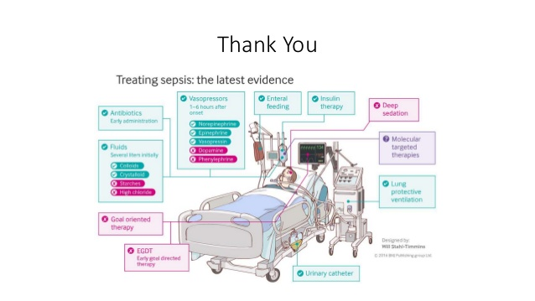


Slide 36
