Slide 1
Gastrointestinal Emergency
Fitria Nurul Hidayah
Department of Internal Medicine
FKIK UMY

Slide 2
The Lectures Topics :
Abdominal Pain
Acute Upper Gastrointestinal Bleeding
Acute Lower Gastrointestinal Bleeding
Acute Hepatic Encephalopathy(Acute Liver Failure)

Slide 3
Abdominal Pain
Possible Causes of Pain by Location
Location of Pain | Associated Diseases
Right upper quadrant (liver, kidney, gallbladder) | Acute cholecystitis, biliary colic, acute hepatitis, duodenal ulcer, right lower lobe pneumonia
Right lower quadrant (ascending colon, appendix, ovary, fallopian tube) | Appendicitis, cecal diverticulitis, ectopic pregnancy, tubo-ovarian abcess, ruptured ovarian cyst, ovarian torsion
Left upper quadrant (pancreas, spleen, kidney) | Gastritis, acute pancreatitis, splenic pathology, left lower lobe pneumonia
Left lower quadrant (sigmoid and descending colon, ovary, fallopian tube) | Diverticulitis, ectopic pregnancy, tubo-ovarian abcess, ruptured ovarian cyst, ovarian torsion
Midline or periumbilical | Appendicitis (early), gastroenteritis, mesenteric lymphadenitis, myocardial ischemia or infarction, pacreatitis
Flank | Abdominal aortic aneurysm, renal colic, pyelonephritis
Front to back | Acute pancreatitis, ruptured abdominal aortic aneurysm, retrocecal appendicitis, posterior duodenal ulcer
Suprapubic or lower abdominal | Ectopic pregnancy, mittelschmerz, ruptured ovarian cyst, pelvic inflammatory disease, endometriosis, urinary tract infection
http://www.emedmag.com/html/pre/cov/covers/011502.asp

Slide 4
Stereotypical Localization of Abdominal Pain
Localization of pain | Organs | Embryonic derivative | Nerves
Epigastrium | • Stomach • First two parts of the duodenum • Liver • Gallbladder • Pancreas | Foregut | • Vagus nerve (parasympathetic) • Greater thoracic splanchnic nerves (sympathetic)
Periumbilical | • Third and fourth parts of duodenum • Jejunum • Ileum • Cecum • Appendix • Ascending colon • First two-thirds of transverse colon | Midgut | • Vagus nerve (parasympathetic) • Greater thoracic splanchnic nerves (sympathetic)
Hypogastrium | • Distal one-third of transverse colon • Descending and sigmoid colon • Rectum and upper portion of anal canal • Reproductive organs (ovaries, fallopian tubes, uterus, seminal vesicles, prostate) • Bladder | Hindgut, genitourinary | • Pelvic splanchnic nerves (parasympathetic) • Lesser thoracic splanchnic nerves (sympathetic)
http://www.emedmag.com/html/pre/cov/covers/011502.asp

Slide 5
Referred Pain
Structure Irritated | Location of Referred Pain
Diaphragmatic | Supraclavicular area (Kehr's sign)
Ureteral | Hypogastrium, groin, inner thigh
Cardiac pain | Epigastrum, jaw, shoulder
Appendix | Periumbilical via T10 nerve
Duodenum | Umbilical region via greater thoracic splanchnic nerve
Hiatal hernia | Epigastrum via T7 and T8 nerves
Pancreas or gallbladder | Epigastrum
Gallbladder and bile duct | Epigastric pain that wraps around to the scapula
http://www.emedmag.com/html/pre/cov/covers/011502.asp

Slide 6
Stereotypes of Pain Onset and Associated Pathology
Sudden onset (full pain in seconds) Perforated ulcer Mesenteric infarction Ruptured abdominal aortic aneurysm Ruptured ectopic pregnancy Ovarian torsion or ruptured cyst Pulmonary embolism Acute myocardial infarction | Rapid onset (initial sensation to full pain over minutes or hours) Strangulated hernia Volvulus Intussusception Acute pancreatitis Biliary colic Diverticulitis Ureteral and renal colic | Gradual onset (hours) Appendicitis Strangulated hernia Chronic pancreatitis Peptic ulcer disease Inflammatory bowel disease Mesenteric lymphadenitis Cystitis and urinary retention Salpingitis and prostatitis
http://www.emedmag.com/html/pre/cov/covers/011502.asp

Slide 7
Important Signs in Patients with Abdominal Pain
Sign | Finding | Association
Cullen's sign | Bluish periumbilical discoloration | Retroperitoneal hemorrhage (hemorrhagic pancreatitis, abdominal aortic aneurysm rupture)
Kehr's sign | Severe left shoulder pain | Splenic rupture Ectopic pregnancy rupture
McBurney's sign | Tenderness located 2/3 distance from anterior iliac spine to umbilicus on right side | Appendicitis
Murphy's sign | Abrupt interruption of inspiration on palpation of right upper quadrant | Acute cholecystitis
Iliopsoas sign | Hyperextension of right hip causing abdominal pain | Appendicitis
Obturator's sign | Internal rotation of flexed right hip causing abdominal pain | Appendicitis
Grey-Turner's sign | Discoloration of the flank | Retroperitoneal hemorrhage (hemorrhagic pancreatitis, abdominal aortic aneurysm rupture)
Chandelier sign | Manipulation of cervix causes patient to lift buttocks off table | Pelvic inflammatory disease
Rovsing's sign | Right lower quadrant pain with palpation of the left lower quadrant | Appendicitis
http://www.emedmag.com/html/pre/cov/covers/011502.asp

Slide 8
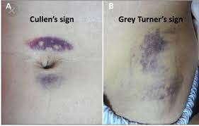

Slide 9
Acute Upper Gastrointestinal Bleeding
Refers to blood loss within the intraluminal gastrointestinal tract
from any location between the upper esophagus to the duodenum at
the ligamentum of Treitz.
By convention, upper GI bleeding has been categorized as either
variceal or nonvariceal in origin
Melena:
Is defined as black,tarry,foul smelling stools
It occurs when hemoglobin is converted to hematin or other
hemochromes by bacterial degradation over a period of at least
14 hours
Usually indicates an upper GI or small bowel site of bleeding,
although can occur from a right colon lesion if motility is slow

Slide 10
Ulcerative,erosive,or inflammatory disease.
Peptic ulcer disease
Stress ulcer
Infectious causes : e.g. Helicobacter pylori
Drug- induced erosions,ulcers or bleeding: e.g.NSAIDs
Trauma.
Mallory-Weiss tear
Foreign body ingestion
Vascular lesions
Varices
Angioma
Dieulafoy’s lesion
Watermelon stomach
Portal hypertensive gastropathy
4. Tumors.
Benign : leiomyoma,lipoma,polyp
Malignant: adenocarcinoma,leiomyosarcoma,lymphoma
Causes of Upper GI Bleeding

Slide 11
Basic Management of Acute Upper GI Bleeding
Prompt patient resuscitation and stabilization
Assessment of the onset and severity of bleeding
Regional localization of the bleeding site
Determination of the likely cause of upper GI bleeding
Preparation for emergent upper endoscopy
Control of active bleeding or treatment of lesions at high risk of
rebleeding with therapeutic endoscopy
Minimization of treatment-related complications
Treatment of rebleeding episodes
Longterm Management of Acute Upper GI Bleeding
Treatment of recurrent bleeding
Preventive mesures for peptic ulcer disease bleeding
Preventive measures for variceal bleeding

Slide 12
Haematemesis/melena
Minor bleeding
Major bleeding
Observation in general ward
Elective endoscopy
Early discharge from hospital
Active rescusitation
Endoscopy
Major stigmata of recent
haemorrhage
varices
No stigmata of recent
haemorrhage
Sclerotherapy
or Endoscopic variceal
ligation
Endoscopic therapy-proton
pump inhibitor infusion
Observation in
general ward
Successful haemostasis
Failure
Stable
Re-bleeding
Surgery
Consider Helico-
Bacter pylori and NSAIDs
Repeat endoscopic
therapy
Success
Failure

Slide 13
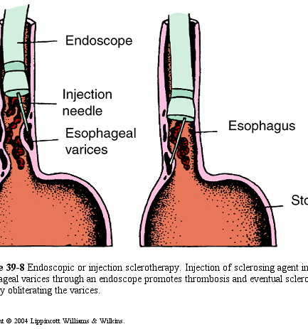
Sclerotherapy of the esophageal varices

Slide 14
Ligator Band adapter
Ligator band adapter on the tip
of scope

Slide 15
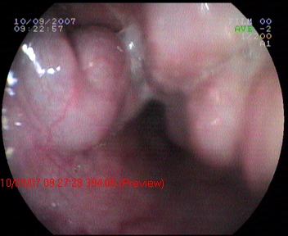
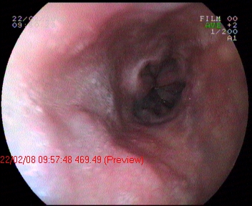
VE F₃ C_{b} RCS(+) L_{m-i}
Setelah LVE 3 kali dengan
jarak antara LVE satu bulan
(evaluasi setelah 3 bulan)

Slide 16
Acute Lower Gastrointestinal Bleeding
Defined as bleeding from below the ligament of Treitz. It is divided into small
bowel bleeding (between the ligament of Treitz and the ileocaecal valve) and
bleeding from the colon.
No site found (6%)
Upper GI
(11%)
Severe (15%)
Small bowel
(9%)
Colon
(74%)
Mild (85%)
Mild

Slide 17
The Clinical Characteristics of Lower Gastrointestinal Bleeding
Hematochaezia
Bright red blood passed per rectum (the most common presentation lower GI bleeding
usually suggest a left colon source of bleeding, although it may occur with brisk upper GI or small bowel bleeding and rapid transit of blood)
Maroon stools
Maroon colored blood mixed with melena
usually indicative of a lower GI source (especially the right colon) or upper GI and small bowel bleeding with rapid transit of blood

Slide 18
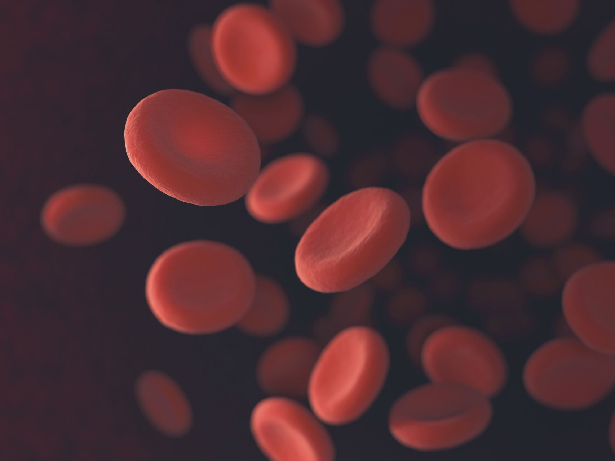
Initial evaluation of patients
Does the blood coat the outside of formed,hard stool (suggesting internal hemorrhoid bleeding) or is it mixed in with the stool
(internal source)? Is there bloody diarrhea or tenesmus (eg,owing to colitis)?
Is this a chronic, intermittent problem, or an acute event ?
Is there a history of GI bleeding

Slide 19
Potential etiologies of hematochaezia from colonic lesions :
Internal hemorrhoids
Angiodysplasia
Diverticula
Cancer
Polyps
Ulcerative colitis
Crohn’s colitis
Infectious colitis
Ischemic colitis
Rectal trauma
Rectal varices
Anal fissures
Anal ulcers
Post polypectomy
External hemorrhoids

Slide 20
Initial assessment and management of suspected lower GI bleeding
Severe bleeding : acute bleeding with either postural hypotension
or a decrease in hematocrit (or both) of at least 8% from baseline after
volume resuscitation (the patient should be hospitalized)
Assess vital signs,particularly for the presence of shock
or orthostatic hypotension.
Palpate the abdomen to assess for tenderness or masses
Evaluate stool color by rectal examination and perform guaiac card test.
Perform anoscopy bto look for active bleeding from internal hemorrhoids
Perform nasogastric tube lavage.

Slide 21
Patient with severe lower GI bleeding
Cannot be stabilized
medically
Urgent surgery
Medically stabilized
Polyethylene glycol
purge over 3-4 hours
Colonoscopy
If lesion
Endoscopic treatment
If negative
Upper endoscopy
If lesion
Endoscopic treatment
If negative
Push enteroscopy
If lesion
Endoscopic treatment
Tc-labelled
red cell scan
If positive
Repeat endoscopy or angiography
or surgery
If ongoing,
Unexplained bleeding
Surgery

Slide 22
Acute Liver Failure
relatively rare but catastrophic illness resulting from sudden marked impairment
of liver function
an acute liver disease which evolves rapidly and is complicated by coagulopathy
and hepatic encephalopathy
most common underlying causes : acute viral hepatitis, drug induced liver injury
Acute liver failure :
Acute liver disease associated with significant coagulopathy, which has been arbitrarily
defined by a prothrombin time or factor V level of less than 50% of normal
Fulminant hepatic failure :
Acute liver failure associated with hepatic encephalopathy developing
within 8 weeks
Subfulminant hepatic failure:
Subgroup of acute liver failure disorder characterized by the development of
encephalopathy 8 weeks to 3 months after the appearance of jaundice

Slide 23
Course of acute liver failure according to cause
Predominantly fulminant hepatic failure
Hepatitis A,B,D, and E
Amanita phalloides
Acetaminophen overdose
Acute fatty liver of pregnancy
Predominantly of subfulminant hepatic failure :
Indeterminate or sporadic
Drug-induced liver injury
Budd-Chiari syndrome
Veno-occlusive disease
Wilson’s disease
Autoimmune hepatitis

Slide 24
Clinical findings
the essential
Jaundice
hepatic encephalopathy
coagulopathy
when severe → multi organ failure, particularly cardiovascular and renal changes, multiple metabolic abnormalities, and an increased incidence of infection
Symptoms and signs :
Non spesific symptoms (malaise,nausea) which are rapidly followed by jaundice and over a variable period of time, changes of mental status

Slide 25
Clinical stages of hepatic encephalopathy
Stage Mental Status Neurologic Signs
1
Mild confusion,euphoria,or
depression;decreased attention;
mental slowness;irritability;
inverted sleep pattern
Incoordination;slight tremor;
poor handwriting
2
Drowsiness;lethargy;deficit in analytic
ability ;personality changes;
inappropriate behaviour;intermittent
disorientation
Asterixis;ataxia;dysarthria
3
Somnolent but arousable;unable to
perform mental tasks;disorientation
with respect to time or place;marked
confusion;amnesia fits of rage incoherent speech.
Hyperreflexia;muscle rigidity;
fasciculation;Babinski’s sign
4
Oculovestibular responses lost;
response to painful stimuli lost;
decerebrate posture
Coma

Slide 26
Complications
Cerebral Edema
Coagulopathy
Renal failure
Cardiovascular abnormality
Hypoglycemia
Infection

Slide 27
Management
Supportive therapy
Liver Transplantation

Slide 28
Terimakasih

