Slide 1
TEXTUS OSSEUS
HISTOLOGY LABORATORY DEPARTMENT
MEDICAL & HEALTH FACULTY
MUHAMMADIYAH YOGYAKARTA UNIVERSITY

Slide 3
DESMAL OSTEOGENESIS

Slide 4
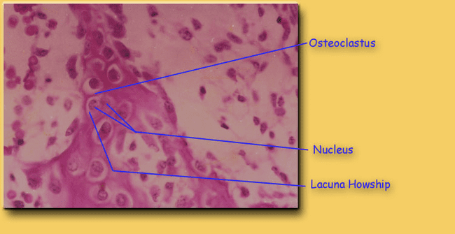
DESMAL OSTEOGENESIS

Slide 5
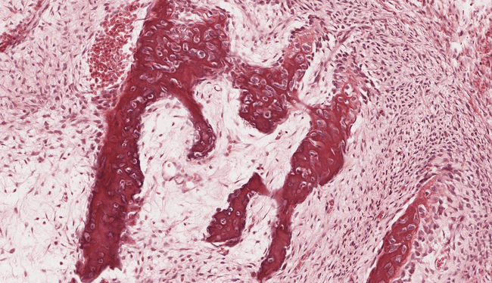
OSTEOGENESIS

Slide 6
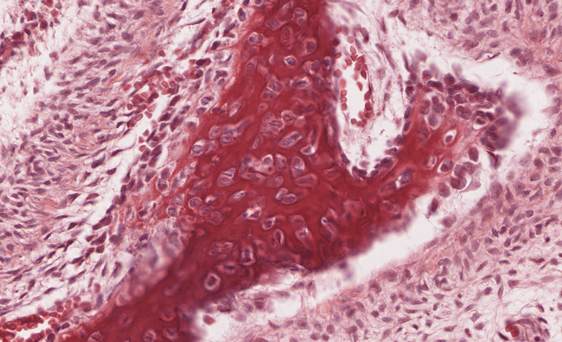
OSTEOBLAST & OSTEOCYTE

Slide 7
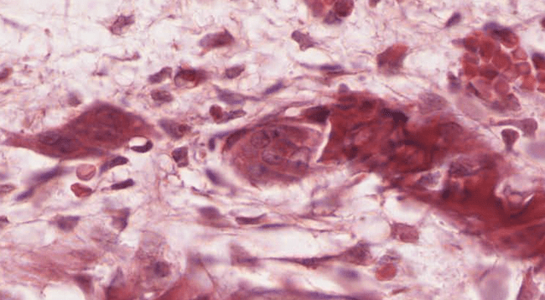
OSTEOCLAST

Slide 8
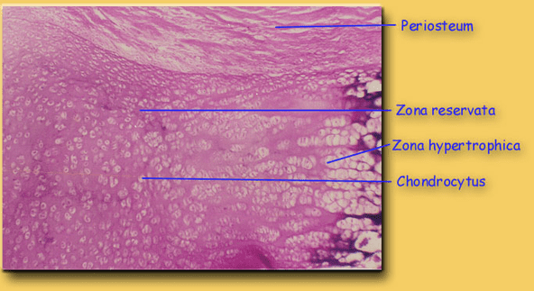
CARTILAGE OSTEOGENESIS

Slide 9
CARTILAGE OSTEOGENESIS

Slide 10
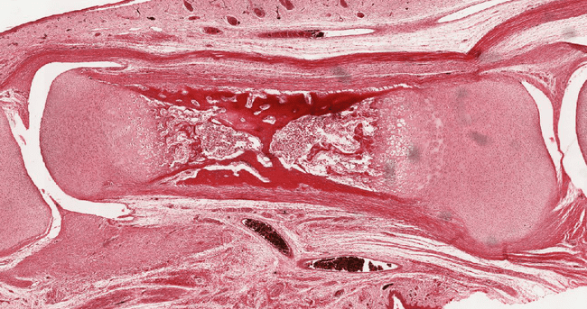
CARTILAGE OSTEOGENESIS

Slide 11
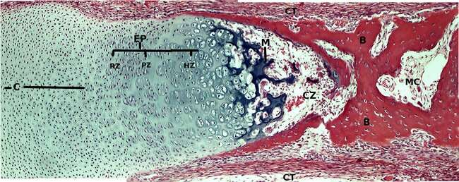
CARTILAGE OSTEOGENESIS

Slide 12
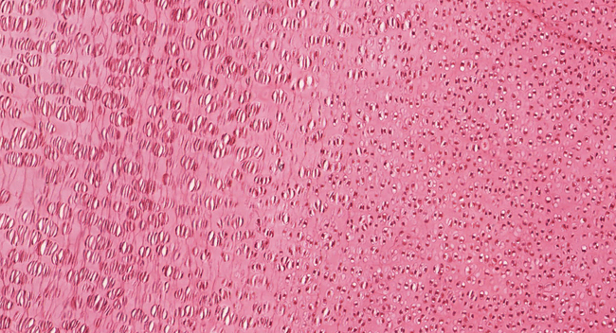
RESERVE ZONE – PROLIFERATE ZONE

Slide 13
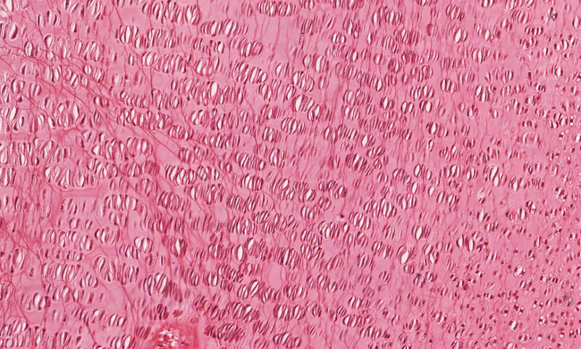
PROLIFERATE ZONE – HYPERTROPHY ZONE

Slide 14
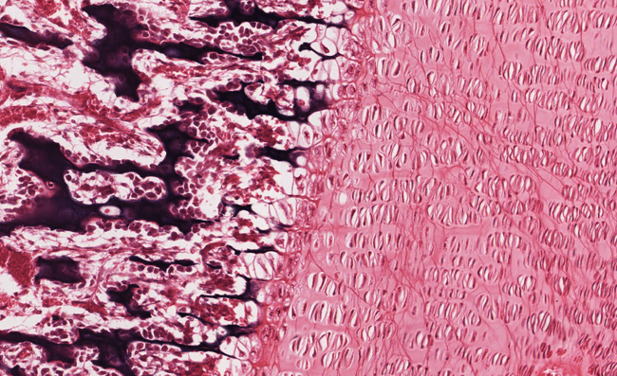
HYPERTROPHY ZONE – RESORBING ZONE

Slide 15
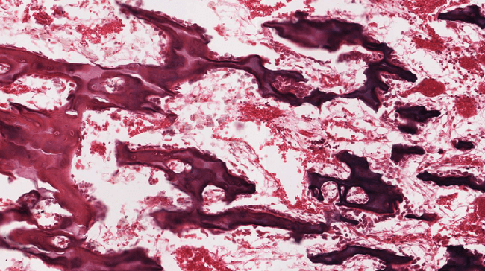
RESORBING ZONE – OSSIFICATION ZONE

Slide 16
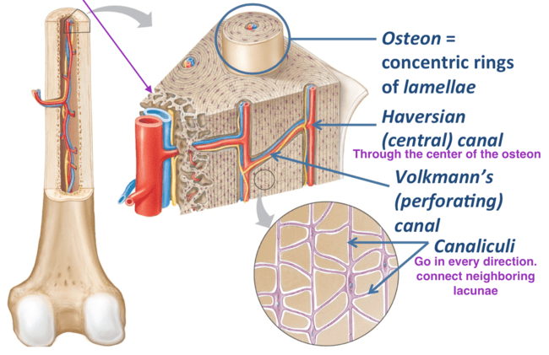
3d illustration of bone’s CROSS-SECTION

Slide 17
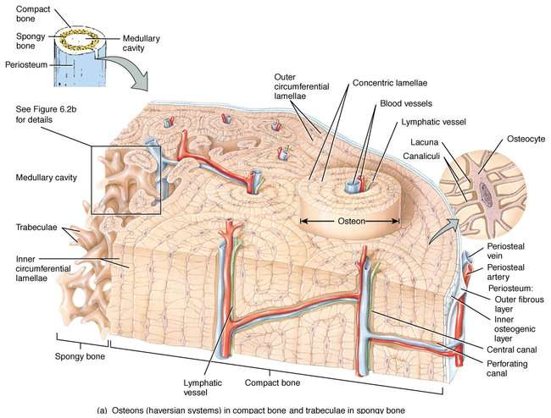
3d illustration of bone’s CROSS-SECTION

Slide 18
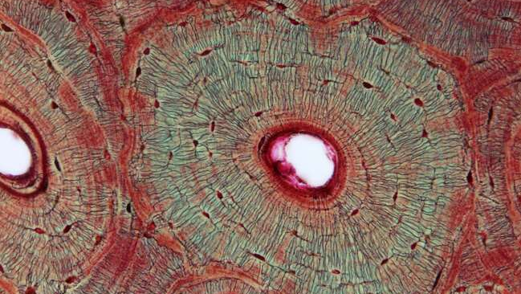
VERTICAL CROSS-SECTION OF BONES

Slide 19
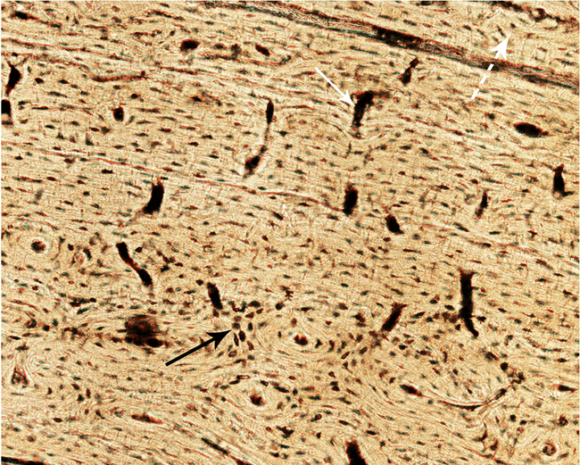
LONGITUDINAL CROSS-SECTION OF BONES

