Slide 1
Gangguan elektrolit
ardi pramono

Slide 2
kalium
Ion terbanyak di intrasel, sedikit di plasma
Diatur oleh pompa seluler Na-K
Perubahan kadar K+ ⇒ pengaruh pada eksitabilitas otot
Eliminasi oleh ginjal:
renal problems causes hyperkalemia
Insulin: causes K+ to move from ECF ⇒ ICF
Acidosis, trauma to cells, and exercise
cause K+ to move from ICF ⇒ ECF:

Slide 3
Hyperkalemia K+ > 5.5 mEq/L
Penyebab utama:
Peningkatan intake K:
Obat penisilin yang mengandung K+
Tranfusi PRC terradiasi
PERPINDAHAN K+ DARI ICF ke ECF
Asidosis, DM tak terkotrol
Sel yg lisis (oleh obat sitotoksik)
Penurunan ekskresi ginjal
Keracunan digitalis, gagal ginjal, penggunaan diuretik hemat K yg berlebihan (spiroaldactone)

Slide 4
Hyperkalemia K+ > 5.5 mEq/L
Management
Eliminasi K+
Diuretik (Lasix)
Dialysis
Kayexalate
Peningkatan cairan
IV insulin
Monitor jantung

Slide 5
Hypokalemia K+ < 3.5 mEq
Penyebab utama
Penurunan asupan atau peningkatan uptake oleh sel
Insulin: promotes K+ uptake by muscle & liver cells
When insulin is given: K+ goes into ICF ⇒ < serum K+ level
Diabetes mellitus tak terkontrol:
Kenaikan Glucose: osmotic diuretic ⇒ ekskresi kalium meningkat oleh eksresi urin
Ketoasidosis diabetes: ⇑ H+ ions in ECF ⇒ exchange across cell membranes ⇒ K+ is first elevated and then K+ stores are excreted via urine

Slide 6
Magnesium (Mg+) 1.5 - 2.5 mEq/L
kation terbanyak kedua di intrasel:
essential for neuromuscular function
changes in serum Mg+ levels effect other electrolytes
Hypermagnesemia: > 2.5mEq/L
muscle weakness, bradycardia, hypotension, nausea & vomiting
Hypomagnesemia:< 1.5mEq/L
increased neuromuscular irritability
Muscle spasms, tetany, seizures

Slide 7
Hypernatremia (Na+ >145 mEq/L)
Etiology
Kehilangan air atau penambahan
Elderly / or comatose patients
Na+ intake > water intake
Diabetes insipidus (excessive fluid loss) ⇒ < production of ADH
Damage to hypothalamic thirst center?
Tumor or CVA?
Manifestasi klinis
Thirst, dry tongue
Restlessness; Coma; Intracranial bleeds
Weight changes

Slide 8
Hypernatremia (Na+ >145 mEq/L)
Treatment (Rx)
Dilute Na+ and promote secretion
Fluids (5% D/W) and diuretics

Slide 9
kalsium
Calcium (8.5 – 10.5 meQ/l)
For: blood coagulation, neuromuscular activity and bone growth
Found: Located in Bones

Slide 10
Hypercalcemia Ca+ > 10.5 mg/dL
Malignancies or hyperparathyroidism
PTH secreting tumor (adenoma)
Skeletal calcium secreted into bloodstream
Metastatic breast cancer & multiple myeloma
Prolonged immobility: loose Ca+ from bone into blood
Osteoporosis: Ca+ is liberated into bloodstream
Manifestations:
lethargy/ weakness/fatigue/constipation
pathogenic fractures ⇒ calcium loss from bone

Slide 11
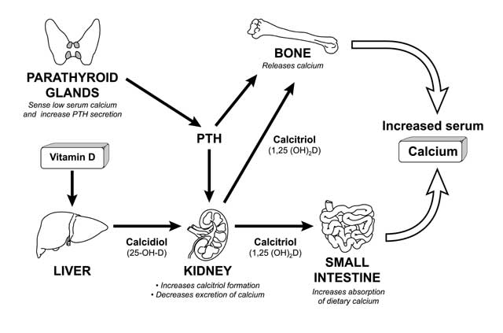
http://lpi.oregonstate.edu/infocenter/minerals/calcium/capth.html

Slide 12
Phosphate (PO4 -) 3.0 - 4.5mg/dL or 1.8 - 2.6 mEq/L
Fungsi: kontraksi otot, nervus, dan sel darah merah
Terlibat pada metabolisme protein, lemak, dan karbohidrat
Hypophosphatemia – Glukosa dan insulin menyebabkan fosfat menuju ke sel
Alcohol withdrawal
Antacid use (acid base imbalance)
S/S – weakness, pain, mental changes, seizures
Hyperphosphatemia – Phosphates shift out of cell (trauma, chemo, malignant tumor), at risk – infants fed cow milk
S/S – numbness, tingling **Around mouth and fingers** muscle spasm, tetany

Slide 13
klorida
Imbalances occur with Na imbalances
Hypochloremia – low Chloride
Causes: sweating, kidney loss, GI tract losses
S/S – twitching, tremors, tetany
Hyperchloremia – high Chloride
Causes: Na retention or high potassium
S/S – tremors, acidosis, weakness, lethargy, arrhythmias, coma
NURSING INTERVENTIONS: Medication, IV Fluids

Slide 14
Alhamdulillah

