Slide 1

CARDIO
VASCULAR SYSTEM
HISTOLOGY LABORATORY DEPARTMENT
MEDICAL & HEALTH SCIENCE FACULTY
MUHAMMADIYAH YOGYAKARTA UNIVERSITY

Slide 2
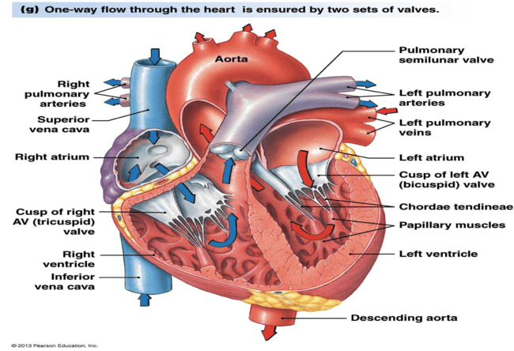

Slide 3
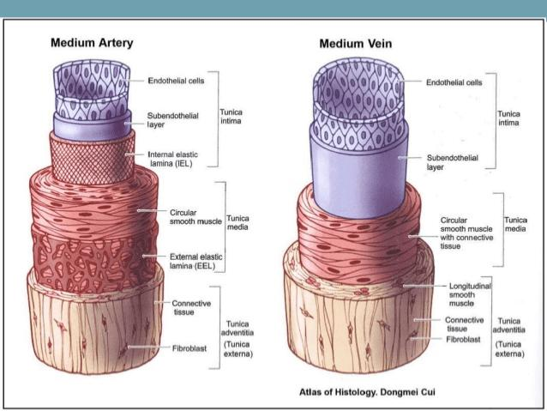
ARTERY & VEIN

Slide 4
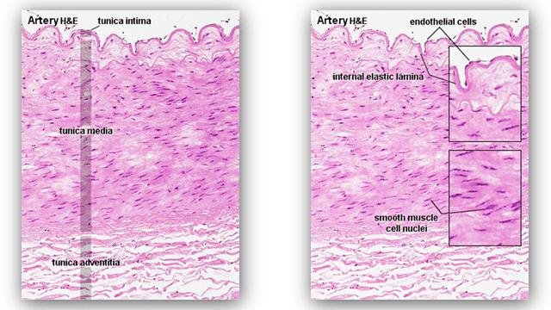

Slide 5
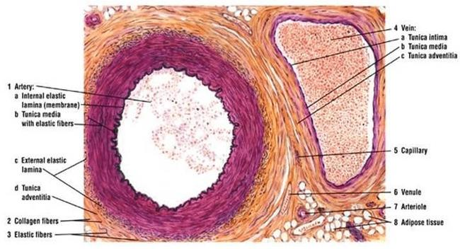

Slide 6
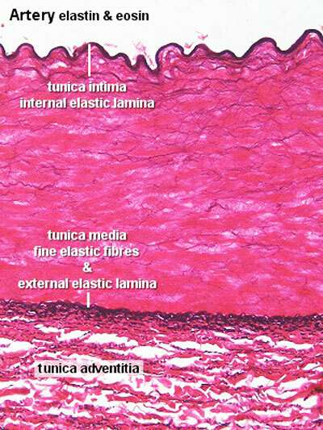
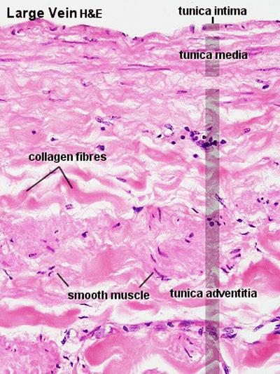

Slide 7
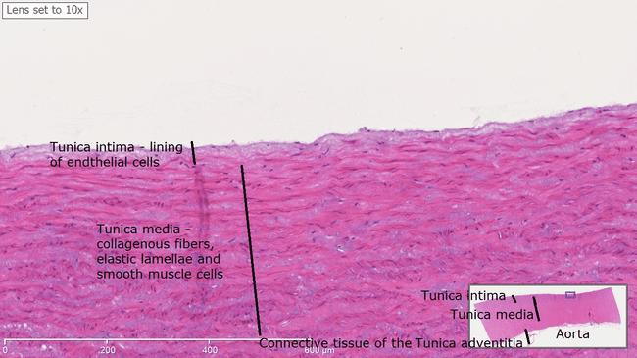
AORTA

Slide 8
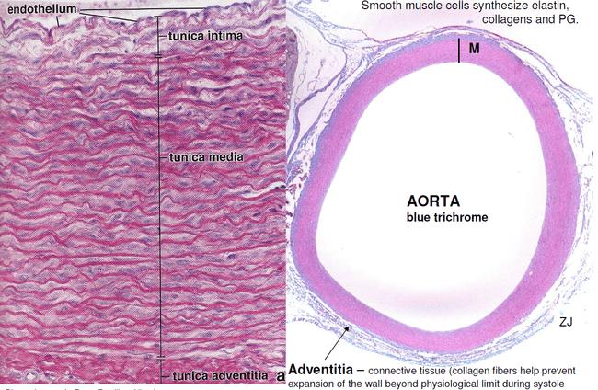

Slide 9
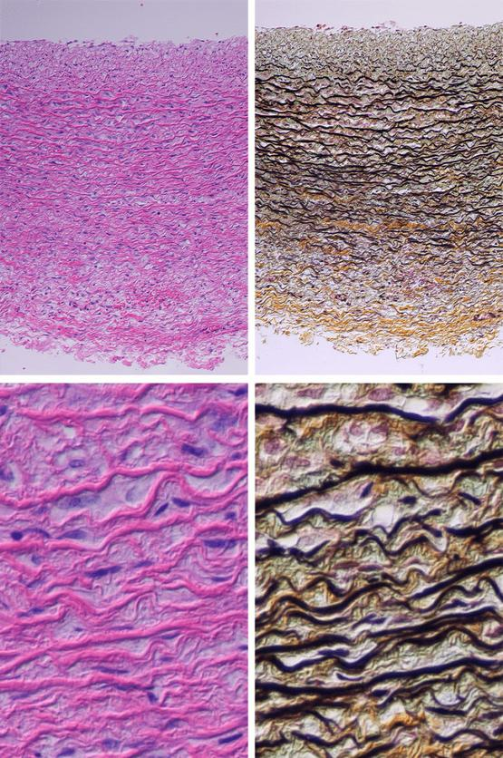

Slide 10
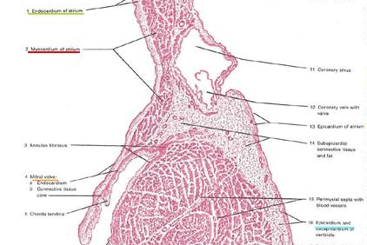
COR (ATRIOVENTRICULAR VALVE)

Slide 11
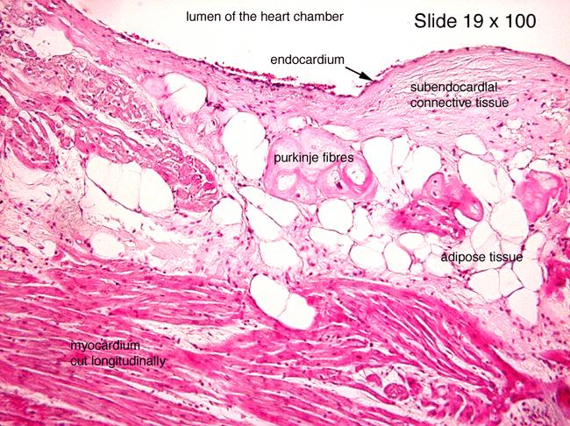
Sub endothelium
endotelium
endocardium

Slide 12
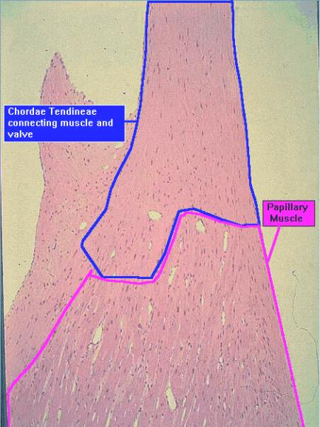
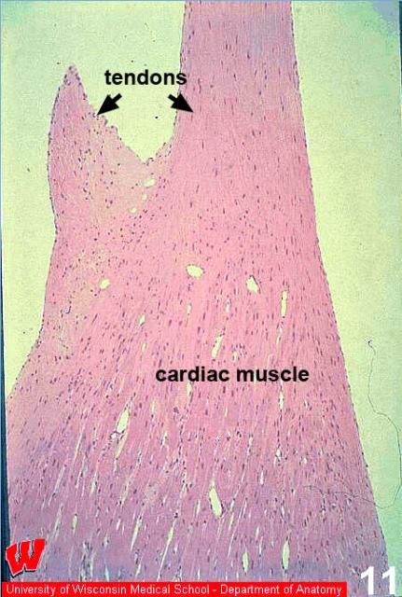
CHORDAE TENDINEAE &
PAPILLARY MUSCLES

