Slide 1
OLFACTORY & GUSTATION
HISTOLOGY LABORATORY
FACULTY OF MEDICINE & HEALTH SCIENCES
UNIVERSITAS MUHAMMADIYAH YOGYAKARTA

Slide 2
CAVUM NASI
NASAL CAVITY / RONGGA HIDUNG

Slide 4
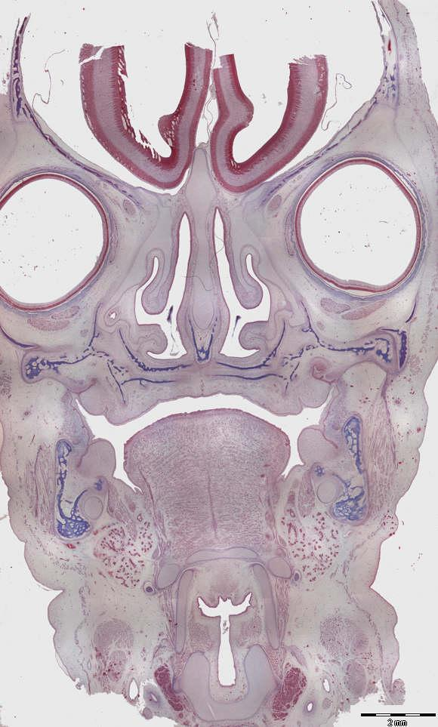

Slide 5
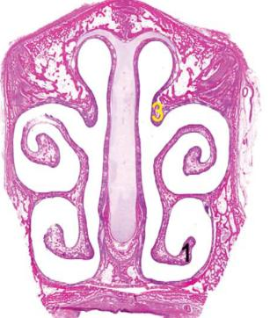
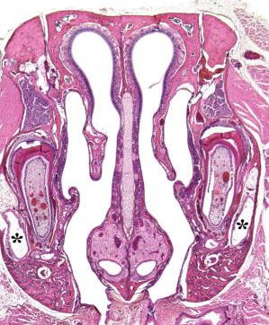
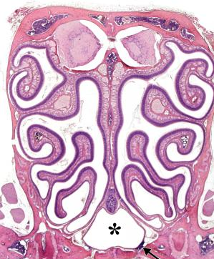

Slide 6
ORGANON OLFACTUS
OLFACTORY ORGAN / ORGAN PENGHIDU

Slide 7
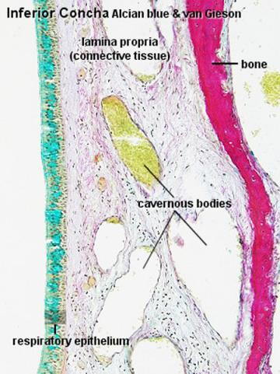
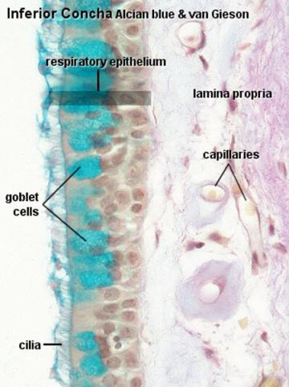

Slide 8
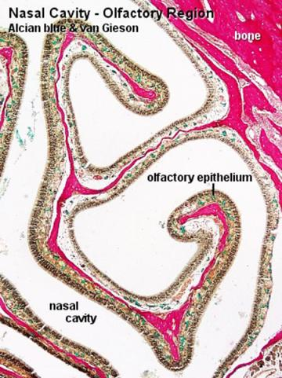
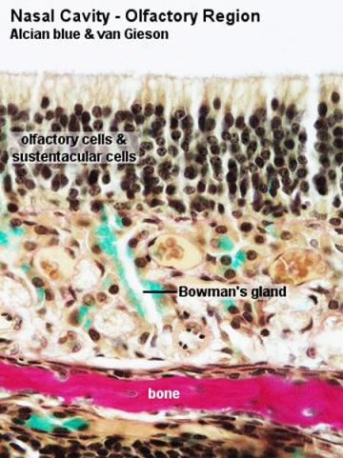

Slide 9
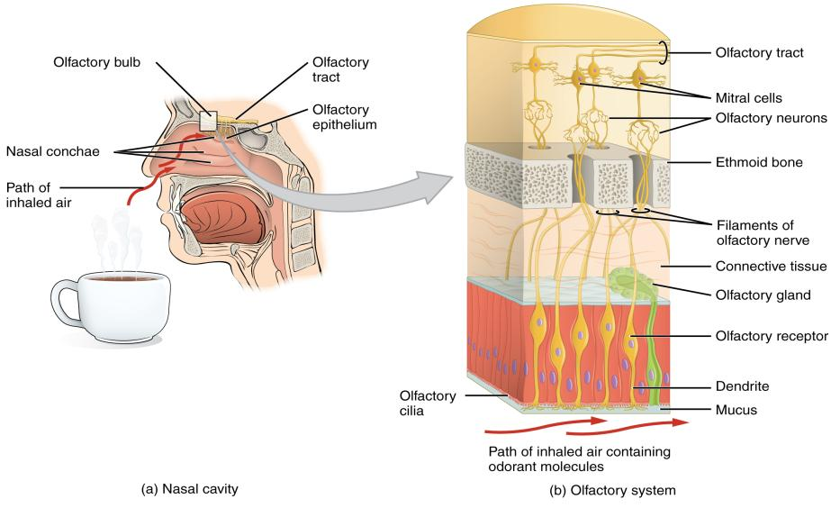

Slide 10
LINGUA
TONGUE / LIDAH

Slide 11
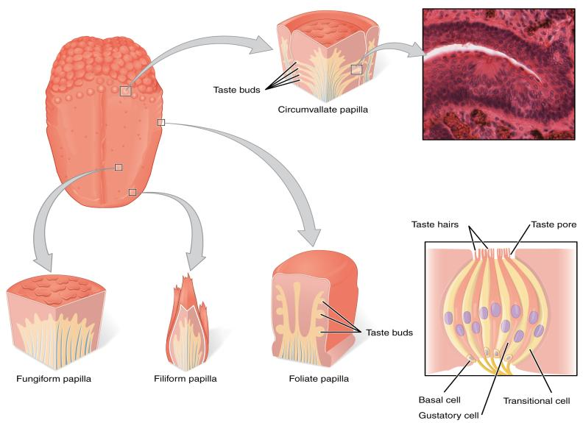

Slide 13
GEMMA GUSTATORIA
TASTE BUDS / TONJOLAN PENGECAP

Slide 14
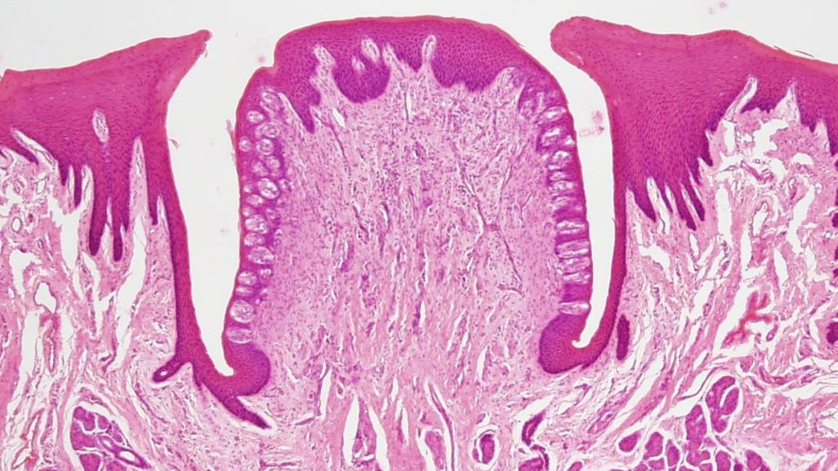

Slide 15
