Slide 1
SOME ASPECTS OF THE FUNCTIONS OF THE SKIN

Slide 2
Introduction
The integumentary system contributes to homeostasis by protecting the body and helping regulate body temperature.
It also allows you to sense pleasurable, painful, and other stimuli in your external environment

Slide 3
Introduction
A system consists of a group of organs working together to perform specific activites.
The integumentary (in-teg-u--MEN-tar-e-; in inward; tegere to cover) system is composed of:
  the skin
  hair
  oil glands
  sweat glands
  nails, and
  sensory receptors.

Slide 4
Goals
To understand the structure of the layers of the skin
To understand the function of the skin, in regards to:
  The melanocytes and melanin
  The skin as a barrier
  Photoconversion of vitamin D
  The skin as a part of the immune system
  Role of the skin in thermoregulation

Slide 5
STRUCTURE OF THE SKIN
The skin (also known as the cutaneous membrane or integument) covers the external surface of the body and is the largest organ of the body in both surface area and weight
In adults, the skin covers an area of about 2 m² and weighs 4.5–5 kg, about 16% of total body weight.
It ranges in thickness from 0.5 mm (0.02 in.) on the eyelids to 4.0 mm (0.16 in.) on the heels. Most of them are1–2 mm (0.04–0.08 in.) thick.

Slide 6
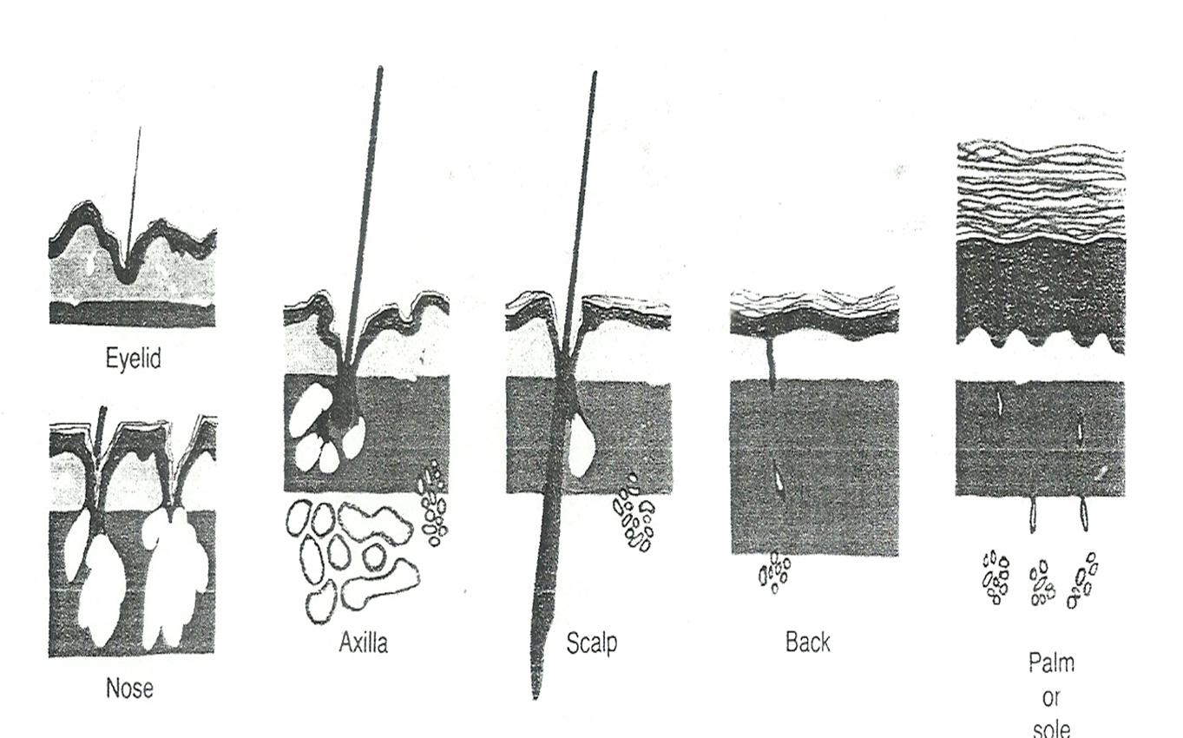

Slide 7
STRUCTURE OF THE SKIN
Structurally, the skin consists of two main parts:
  The superficial, thinner portion which is composed of epithelial tissue, is the epidermis (ep-i-DERM-is; epi- above).
  The deeper, thicker connective tissue portion is the dermis
  Deep to the dermis, but not part of the skin, is the subcutaneous (subQ) layer. Also called the hypodermis (hypo- below), this layer consists of areolar and adipose tissues

Slide 8
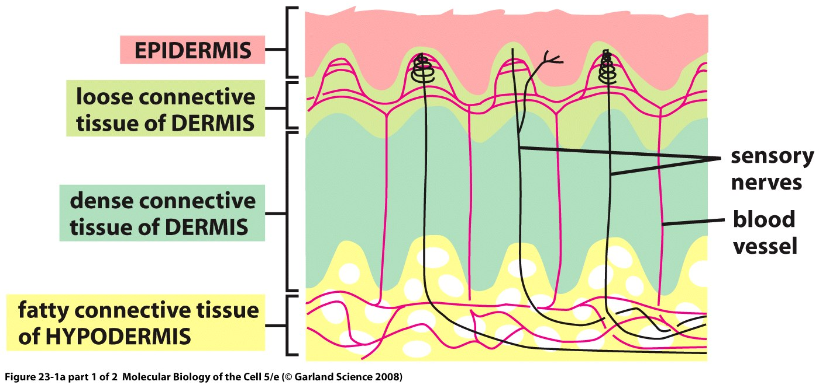

Slide 9
EPIDERMIS
Keratinocytes (ker-a-TIN-o¯-sı¯ts; keratino- hornlike; -cytes cells) produce keratin, a tough, fibrous protein that helps protect the skin and underlying tissues from heat, microbes, and chemicals
Keratinocytes also produce lamellar granules, which release a water-repellent sealant that decreases water entry and loss and inhibits the entry of foreign materials
Several distinct layers of keratinocytes in various stages of development form the epidermis

Slide 10
EPIDERMIS
  In most regions of the body the epidermis has 4 layers:
  stratum basale
  stratum spinosum
  stratum granulosum
  a thin stratum corneum Thin skin
Where exposure to friction is greatest (the fingertips, palms, and soles), the epidermis has 5 layers:
  stratum basale
  stratum spinosum
  stratum granulosum
  stratum lucidum
  a thick stratum corneum Thick skin.

Slide 11
Stratum Basale
Stratum basale (ba-SA-le¯; basal- base), the deepest layer of the epidermis, composed of a single row of cuboidal or columnar keratinocytes.
Some cells in this layer are stem cells that undergo cell division to continually produce new keratinocytes.
The nuclei of keratinocytes in the stratum basale are large, and their cytoplasm contains many ribosomes, a small Golgi complex, a few mitochondria, and some rough endoplasmic reticulum

Slide 12
Stratum Basale
The cytoskeleton within keratinocytes of the stratum basale includes scattered intermediate filaments, called tonofilaments, a kind of protein that will form keratin in more superficial epidermal layers
Tonofilaments attach to:
  Desmosomes, which bind cells of the stratum basale to each other and to the cells of the adjacent stratum spinosum
  Hemidesmosomes, which bind the keratinocytes to the basement membrane positioned between the epidermis and the dermis

Slide 13
Stratum Basale
Therefore, the stratum basale is also known as the stratum germinativum ( jer-mi-na-TE¯ -vum; germ- sprout) to indicate its role in forming new cells
Melanocytes and Merkel cells with their associated Merkel discs are scattered among the keratinocytes of the basal layer

Slide 14
Stratum SPINOSUM
The stratum spinosum (spi-NO¯ -sum; spinos- thornlike), is arranged in 8 to 10 layers of many-sided keratinocytes fitting closely together.
These keratinocytes have the same organelles as cells of the stratum basale.
When cells of the stratum spinosum are prepared for microscopic examination, they shrink and pull apart so that they seem to be covered with thornlike spines

Slide 15
Stratum SPINOSUM
Each spiny projection in a prepared tissue section is a point where bundles of tonofilaments are inserting into a desmosome, tightly joining the cells to one another -- > provides strength and flexibility to the skin
Langerhans cells and projections of melanocytes are also present in this layer

Slide 16
Stratum GRANULOSUM
The stratum granulosum (gran-u¯-LO¯ -sum; granulos- little grains) consists of 3-5 layers of flattened keratinocytes that are undergoing apoptosis
Apoptosis is an orderly, genetically programmed cell death in which the nucleus fragments before the cells die

Slide 17
Stratum GRANULOSUM
The nuclei and other organelles of these cells begin to degenerate, and tonofilaments become more apparent
A distinctive feature of cells in this layer is the presence of darkly staining granules of a protein called keratohyalin(ker-a-to¯-HI¯ -a-lin), which converts the tonofilaments into keratin

Slide 18
Stratum GRANULOSUM
Also present in the keratinocytes are membrane enclosed lamellar granules, which release a lipid-rich secretion
This secretion fills the spaces between cells of the stratum granulosum, stratum lucidum, and stratum corneum
The lipid rich secretion acts as a water-repellent sealant, retarding loss and entry of water and entry of foreign materials

Slide 19
Stratum GRANULOSUM
As their nuclei break down during apoptosis, the keratinocytes of the stratum granulosum can no longer carry on vital metabolic reactions, and they die.
Thus, the stratum granulosum marks the transition between the deeper, metabolically active strata and the dead cells of the more superficial strata

Slide 20
Stratum LUCIDUM
The stratum lucidum (LOO-si-dum; lucid- clear) is present only in the thick skin of areas such as the fingertips, palms, and soles.
It consists of three to five layers of flattened clear, dead keratinocytes that contain large amounts of keratin and thickened plasma membranes

Slide 21
Stratum CORNEUM
The stratum corneum (COR-ne¯-um; corne- horn or horny) consists on average of 25 to 30 layers of flattened dead keratinocytes
These cells are continuously shed and replaced by cells from the deeper strata

Slide 22
Stratum CORNEUM
The interior of the cells contains mostly keratin
Between the cells are lipids from lamellar granules that help make this layer an effective water-repellent barrier
Its multiple layers of dead cells also help to protect deeper layers from injury and microbial invasion
Constant exposure of skin to friction stimulates the formation of a callus, an abnormal thickening of the stratum corneum

Slide 23
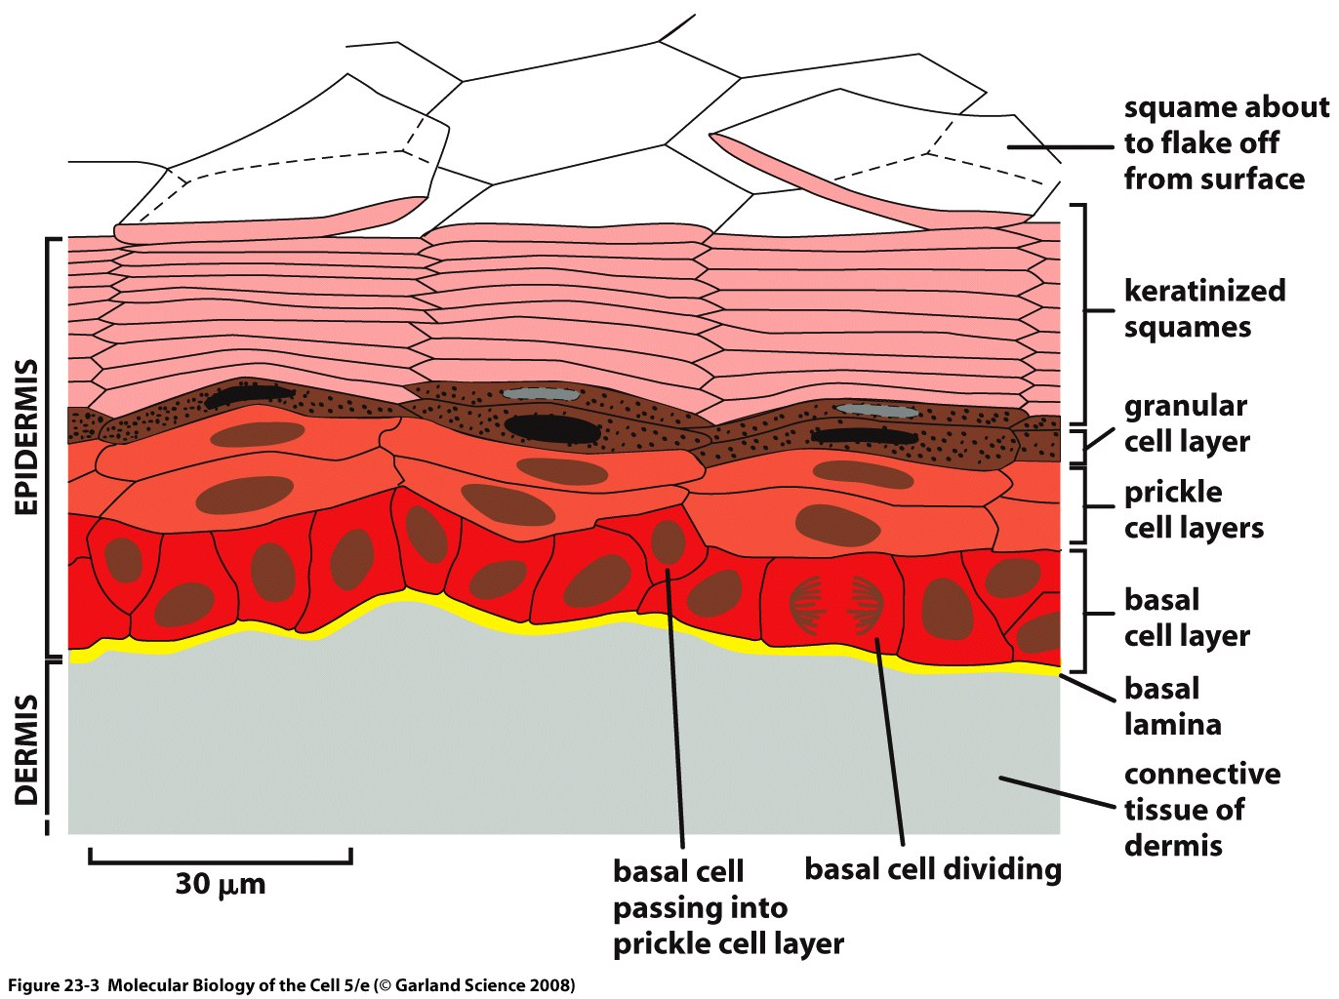

Slide 24
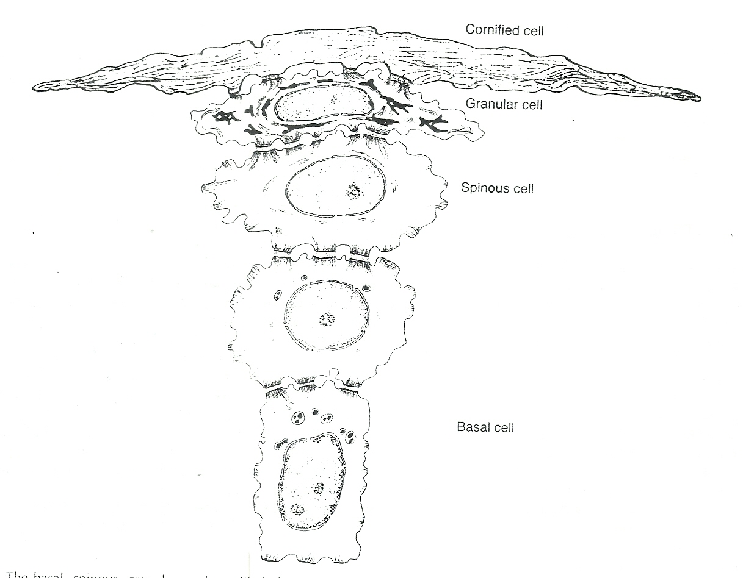

Slide 25
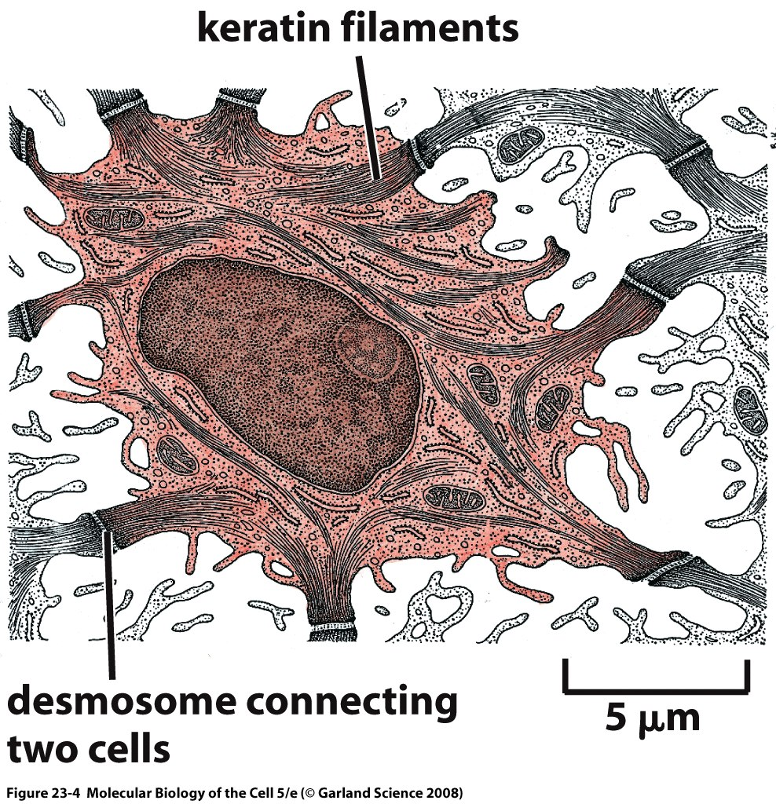

Slide 26
DERMIS
The second, deeper part of the skin, the dermis, is composed of a strong connective tissue containing collagen and elastic fibers
This woven network of fibers has great tensile strength (resists pulling or stretching forces). Therefore, the dermis also has the ability to stretch and recoil easily

Slide 27
DERMIS
The few cells present in the dermis include predominantly fibroblasts, with some macrophages, and a few adipocytes near its boundary with the subcutaneous layer
Blood vessels, nerves, glands, and hair follicles (epithelial invaginations of the epidermis) are embedded in the dermal layer

Slide 28
DERMIS
The dermis is essential to the survival of the epidermis, and these adjacent layers form many important structural and functional relations
Based on its tissue structure, the dermis can be divided into:
  A superficial papillary region
  A deeper reticular region

Slide 29
papillary region
The papillary region makes up about one-fifth of the thickness of the total layer of the dermis
It consists of areolar connective tissue containing thin collagen and fine elastic fibers.
Its surface area is greatly increased by dermal papillae (pa-PILe- nipples), small, fingerlike structures that project into the undersurface of the epidermis

Slide 30
papillary region
Dermal papilae contain
  Capillary loops (blood vessels)
  Tactile receptors called Meissner corpuscles or corpuscles of touch, nerve endings that are sensitive to touch
  free nerve endings, dendrites that lack any apparent structural specialization that responsible to initiate signals that give rise to sensations of warmth, coolness, pain, tickling, and itching

Slide 31
papillary region
The surfaces of the palms, fingers, soles, and toes have a series of ridges and grooves. They appear either as straight lines or as a pattern of loops and whorls, as on the tips of the digits
These epidermal ridges are produced during the third month of fetal development as downward projections of the epidermis into the dermis between the dermal papillae of the papillary region

Slide 32
papillary region
The epidermal ridges increase the surface area of the epidermis and thus increase the grip of the hand or foot by increasing friction
Because the ducts of sweat glands open on the tops of the epidermal ridges as sweat pores, the sweat and ridges form fingerprints (or footprints) upon touching a smooth object.
The epidermal ridge pattern is genetically determined and is unique for each individual

Slide 33
papillary region
The dermal papillae greatly increase the surface contact between the dermis and epidermis. With its extensive network of small blood vessels, it serves as an important source of nutrition for the overlying epidermis
Molecules diffuse from the small blood capillaries in the dermal papilla to the cells of the stratum basale, allowing the basal epithelial stem cells to divide and the keratinocytes to grow and develop. As keratinocytes push toward the surface and away from the dermal blood source, they are no longer able to obtain the nutrition they require, leading to the eventual breakdown of their organelles

Slide 34
papillary region
The dermal papillae fit together with the complementary epidermal ridge to form an extremely strong junction between the two layers. This jigsaw puzzle–like connection strengthens the skin against shearing forces (forces that laterally shift in relation to each other) that attempt to separate the epidermis from the dermis

Slide 35
reticular region
The reticular region (reticul- netlike), which is attached to the subcutaneous layer, consists of dense irregular connective tissue containing fibroblasts, bundles of collagen, and some coarse elastic fibers.
A few adipose cells, hair follicles, nerves, sebaceous (oil) glands, and sudoriferous (sweat) glands occupy the spaces between fibers

Slide 36
reticular region
The combination of collagen and elastic fibers in the reticular region provides the skin with strength, extensibility (ability to stretch), and elasticity (ability to return to original shape after stretching)
The extensibility of skin can be readily seen around joints and in pregnancy and obesity
Extreme stretching may produce small tears in the dermis, causing striae (STRI¯ -e streaks), or stretch marks, visible as red or silvery white streaks on the skin surface

Slide 37
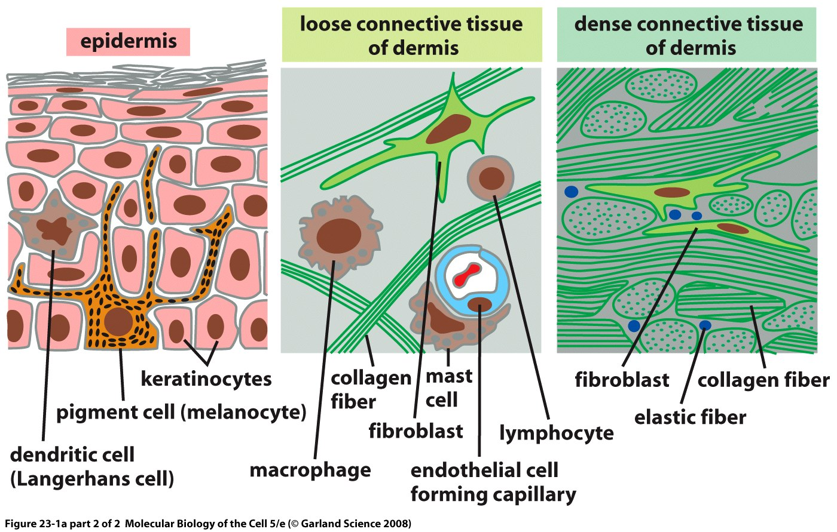

Slide 38
UV Radiation and the skin
Keratinocytes accumulate melanin pigments as they mature
The epidermal melanin functions to block UV penetration into the skin
Although melanin may be found in abundance in epidermal keratinocytes, it is not manufactured in these cells
Rather, melanin synthesis is restricted to melanocytes, which are derived from neural crest and are the second most abundant cell in the epidermis

Slide 39
UV Radiation and the skin
Melanocytes can be found both in the dermis and epidermis
Epidermal melanocytes are generally positioned in the basal layer above the basement membrane
Dermal melanocytes are also found in hair follicles to impart pigment to hair
Dermal melanocytes also can be found in nevi (moles)

Slide 41
UV Radiation and the skin
Through dendritic extensions, melanocytes may be in intimate contact with as many as fifty neighboring keratonocytes in what is known as an “epidermal melanin unit”
Pigment made by melanocytes is transferred to adjacent keratinocytes in cellular organelles termed melanosomes by way of melanocytic dendrites

Slide 42
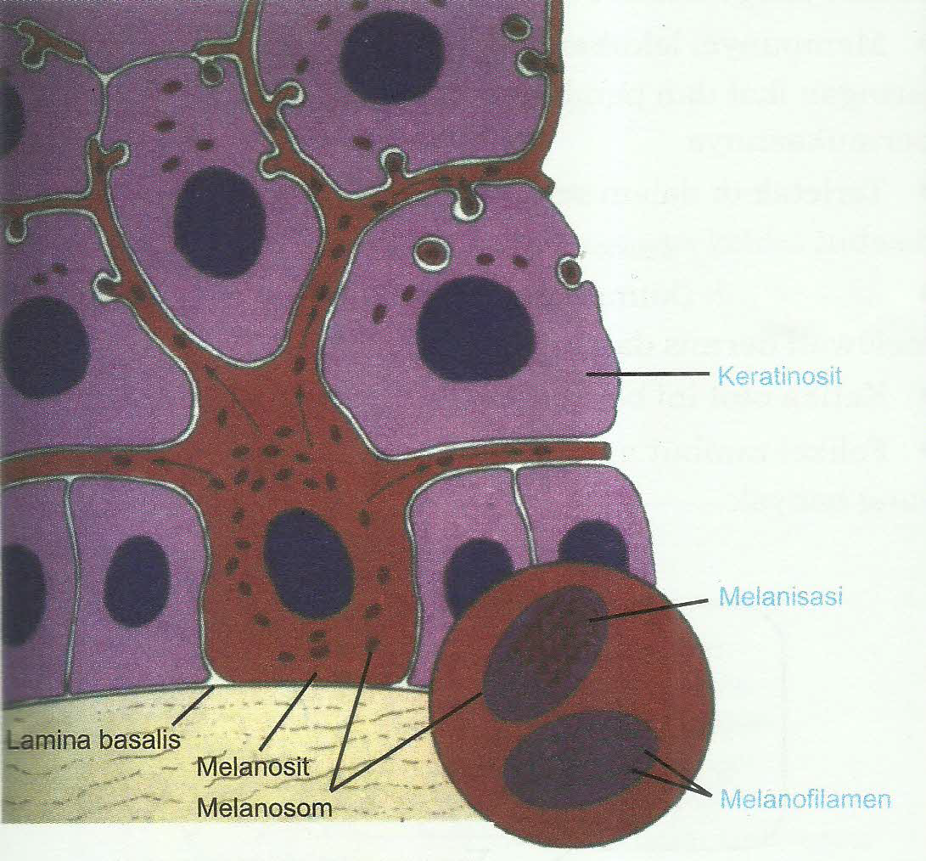

Slide 43
UV Radiation and the skin
Melanin is a large bio-aggregate composed of subunits of different pigment species formed by oxidation and cyclization of the amino acid tyrosine
Melanin exists in two main chemical forms:
(1) eumelanin, a dark pigment expressed abundantly in the skin of heavily pigmented individuals
(2) pheomelanin, a light-colored sulfated pigment resulting from incorporation of cysteines into melanin precursors

Slide 44
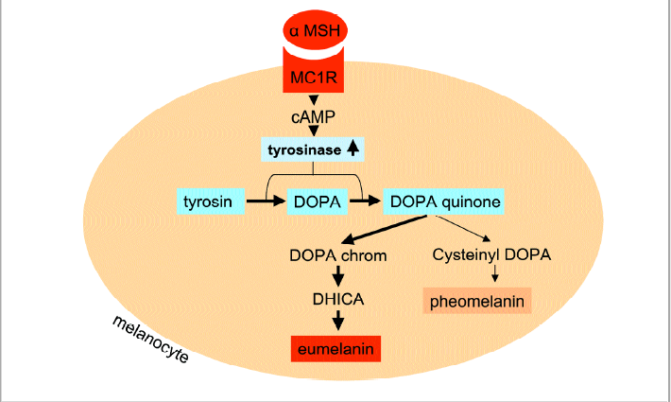

Slide 45
UV Radiation and the skin
Eumelanin is much more efficient at blocking UV photons than pheomelanin, thus the more eumelanin in the skin, the less UV-permeable is the epidermis.
Fair-skinned people have little eumelanin than darker-skinned individuals -- > the fairer the skin, the more damaging UV exposure will be
In fact, pheomelanin levels are similar between dark-skinned and light-skinned individuals, and it is the amount of epidermal eumelanin that determines skin complexion, UV sensitivity and cancer risk

Slide 46
UV Radiation and the skin
Abundant in the environment, UV contributes to a variety of skin maladies including inflammation, degenerative aging and cancer
Humans have been exposed to UV radiation mainly through occupational exposure to sunlight
Recreational UV exposure, however, has increased dramatically in recent years because of outdoor leisure activities and to purposely tan for cosmetic purposes

Slide 47
UV Radiation and the skin
UV energy can be subdivided into UV-A, -B and –C components based on electro physical properties
  UV-C photons having the shortest wavelengths (100-280 nm) and highest energy
  UV-A having the longest (315-400 nm) but least energetic photons
  UV-B falling in between

Slide 48
UV Radiation and the skin
Because of atmospheric ozone that absorbs UVC, ambient sunlight is predominantly UVA (90%–95%) and UVB (5%–10%)
UV penetrates the skin in a wavelength- dependent manner
  Longer wavelength UVA penetrates deeply into the dermis reaching well into the dermis
  In contrast, UVB is almost completely absorbed by the epidermis, with comparatively little reaching the dermis

Slide 49
UV Radiation and the skin
UVA is efficient at generating reactive oxygen species that can damage DNA via indirect photosensitizing reactions
UVB is directly absorbed by DNA which causes molecular rearrangements forming the specific photoproducts such as cyclobutane dimers and 6–4 photoproducts -- > mutations and cancer can result from many of these modifications to DNA

Slide 51
UV Radiation and the skin
Ambient UV exposure varies geographically according to intensity of sunlight in a particular location on Earth
Since UV radiation can be reflected, scattered and dampened by atmospheric particles, ambient UV dose varies according to the amount of atmosphere it must pass through, making UV doses higher:
  nearest the Equator
  at higher altitudes
  in conditions of minimal cloud or particulate cover

Slide 52
UV Radiation and the skin
UV has many effects on skin physiology, with some consequences occurring acutely and others in a delayed manner
One of the most obvious acute effects of UV on the skin is the induction of inflammation
UVB induces a cascade of cytokines, vasoactive and neuroactive mediators in the skin that together result in an inflammatory response and causes sunburn

Slide 53
UV Radiation and the skin
If the dose of UV exceeds a threshold damage response, keratinocytes activate apoptotic pathways and die
Such apoptotic keratinocytes can be identified by their pyknotic nuclei and are known as sunburn cells
UV also leads to an increase in epidermal thickness, termed hyperkeratosis

Slide 54
UV Radiation and the skin
By causing cell injury, UV induces damage response pathways in keratinocytes. Damage signals such as p53 activation profoundly alter keratinocyte physiology, mediating cell cycle arrest, activating DNA repair and inducing apoptosis if the damage is sufficiently great
Several h after UV exposure, however, and damage response signals abate, epidermal keratinocytes proliferate robustly, mediated by a variety of epidermal growth factors

Slide 55
UV Radiation and the skin
Increased keratinocyte cell division after UV exposure leads to accumulation of epidermal keratinocytes which increases epidermal thickness
Epidermal hyperplasia protects the skin better against UV penetration

Slide 56
UV Radiation and the skin
Coupled with epidermal hyperkeratosis is adaptive melanization of the skin, also known as tanning
UV up-regulates production and epidermal accumulation of melanin pigment in the skin
This important physiologic response protects the skin against subsequent UV damage, and defects in this pathway are linked with cancer susceptibility

Slide 59
UV Radiation and the skin
UV-mediated skin darkening is actually biphasic, with initial skin darkening occurring from redistribution and/or molecular changes to existing epidermal melanin pigments
Delayed increases in skin darkening, mediated by actual up-regulation in melanin synthesis and transfer to keratinocytes, begin several h to days after UV exposure

Slide 60
UV Radiation and the skin
Mechanisms of the physiologic tanning response:
DNA and cellular damage in keratinocytes up-regulates transcription of the pro-opiomelanocortin (POMC) gene which encodes production and secretion of melanocyte stimulating hormone (α-MSH)
α-MSH binding to melanocortin 1 receptor (MC1R) on melanocytes in the basal epidermis generates the second messenger cAMP via interactions between MC1R and adenylyl cyclase, and leads to activation of protein kinase A and the cAMP responsive binding element (CREB) and microphthalmia (Mitf) transcription factors

Slide 61
UV Radiation and the skin
CREB and Mitf directly enhance melanin production by raising levels of tyrosinase and other melanin biosynthetic enzymes
Thus, MSH-MC1R signaling leads to enhanced pigment synthesis by melanocytes and accumulation of melanin by epidermal keratinocytes
By this mechanism, the skin is better protected against UV insults

Slide 63
UV Radiation and the skin
Besides blocking UV penetration into the skin, melanin may have many other important physiologic effects including:
  regulatory influences over epidermal homeostasis
  free radical scavenging to protect against oxidative injury
  antimicrobial activity

Slide 65
THE SKIN AS A BARRIER
The epidermis comprises:
  the physical barrier
  the chemical ⁄ biochemical barrier
  the adaptive immunological barriers

Slide 67
THE SKIN AS A BARRIER
The skin barrier protects against extensive water loss in one direction (inside-outside barrier) and against the invasion of harmful substances from the environment (outside-inside barrier)
TEWL is a marker for the inside-outside barrier only

Slide 68
THE SKIN AS A BARRIER
The physical barrier consists mainly of the stratum corneum (SC) and also the cell–cell junctions and associated cytoskeletal proteins
The chemical ⁄ biochemical (antimicrobial, innate immunity) barrier consists of lipids, acids, hydrolytic enzymes, antimicrobial peptides and macrophages
The (adaptive) immunological barrier is composed of humoral and cellular constituents of the immune system

Slide 69
Components of the physical epidermal barrier
Stratum corneum
The SC serves as the principal barrier against the percutaneous penetration of chemicals and microbes and is capable of withstanding mechanical forces
It is further involved in the regulation of water release from the organism and into the atmosphere, known as transepidermal water loss (TEWL)

Slide 70
Components of the physical epidermal barrier
The SC forms a continuous sheet of protein-enriched cells (corneocytes) connected by corneodesmosomes and embedded in an intercellular matrix enriched in non-polar lipids and organized as lamellar lipid layers

Slide 71
Components of the physical epidermal barrier
The final steps in keratinocyte differentiation are associated with their transformation into the flat and anucleated corneocytes of the SC, which are loaded with keratin filaments and surrounded by a cell envelope composed of cross-linked proteins (cornified envelope proteins) as well as a covalently bound lipid envelope
Extracellular non-polar lipids surround the corneocytes to form a hydrophobic matrix

Slide 72
STRATUM CORNEUM AS
A PHYSICAL BARRIER

Slide 74
Components of the physical epidermal barrier
Nucleated epidermis
Although the SC is recognized as the most important physical barrier, the nucleated epidermal layers are also significant in barrier function
A low to moderate increase in TEWL occurs after removal of the SC by tape-stripping, whereas loss of the entire epidermis leads to a severe disturbance in barrier function

Slide 75
Components of the physical epidermal barrier
Loss of the SC and parts of the granular layers in staphylococcal scalded skin syndrome are not life-threatening.
In contrast, suprabasal and subepidermal blistering diseases like pemphigus vulgaris, toxic epidermal necrolysis (Lyell syndrome) and severe burns (intra as well as subepidermal blistering) are lifethreatening when large areas of the body are involved.
Patients die because of extensive water loss or sepsis induced by external bacteria infection

Slide 77
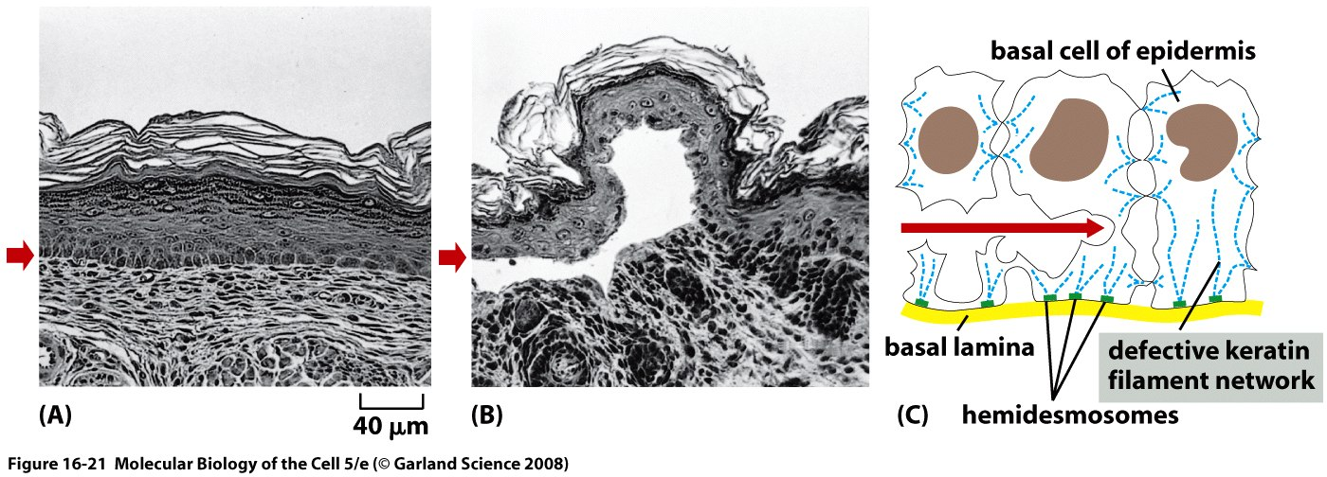

Slide 78
  PHOTOCONVERSION OF VITAMIN D
Vitamin D (represents either D2 or D3) is essential for maintaining healthy bone
The major source of vitamin D for most humans comes from the exposure of the skin to sunlight
During exposure to sunlight, 7-dehydrocholesterol (provitamin D3) in the skin absorbs high-energy solar ultraviolet B photons (UVB; 290–315 nm) and is photolyzed to previtamin D3 and then thermoisomerized to vitamin D3 in the bilayer of the plasma membrane

Slide 79
PHOTOCONVERSION OF VITAMIN D

Slide 80
  PHOTOCONVERSION OF VITAMIN D
After vitamin D is made in the skin or ingested in the diet, it is transported to the liver where it is hydroxylated on C-25 to form 25-hydroxyvitamin D [25(OH)D], the major circulating form of vitamin D that has been used as an index to determine vitamin D nutritional status
To become active, 25(OH)D is further hydroxylated in the kidney to 1α,25-dihydroxyvitamin D [1,25(OH)2D]

Slide 81
  PHOTOCONVERSION OF VITAMIN D
One of the major functions of vitamin D is the stimulation of the small intestine to increase its absorption of dietary calcium and phosphorus to maintain normal levels of calcium and phosphorus in the circulation
When dietary calcium is inadequate to satisfy the body’s calcium requirement, 1,25(OH)2D, in concert with parathyroid hormone (PTH), mobilizes monocytic stem cells in the bone marrow to become mature osteoclasts -- > to enhance the removal of calcium from the bone into the circulation to maintain normal serum calcium levels

Slide 82
  PHOTOCONVERSION OF VITAMIN D
1,25(OH)2D has other biologic actions in many tissues or cells that possess the 1,25(OH)2D receptor, such as:
  enhancement of cellular differentiation
  inhibition of cellular proliferation
  maintenance of normal neuromuscular, immunomodulatory, and cardiovascular function

Slide 83
  PHOTOCONVERSION OF VITAMIN D
Interestingly, it has been shown that epidermal keratinocytes and various other cell types contain the enzymatic machinery needed to produce 1,25(OH)2D3
The vitamin D3 pathway in human skin is complex and characterized by photochemical activation of 7-dehydrocholesterol (7-DHC), formation of previtamin D3, isomerization to vitamin D3, enzymatic production of 25OHD3, enzymatic generation of 1,25(OH)2D3, and finally, catabolic degradation of 1,25(OH)2D3

Slide 84
(Reichrat, 2007)

Slide 85
  THE SKIN AS A PART OF THE IMMUNE SYSTEM
Briefly, the two strands of the immune response are represented by the basic effector:
INNATE RESPONSE - mediated by phagocytes, namely macrophages, dendritic cells, polymorphonuclear, Langerhans cells, the Antigen Presenting Cells [APC], cytokines such as interferons [INF], the tumor necrosis factors [TNF], and a series of interleukins [IL- 1, IL-2, IL-4, IL-6, IL-10, IL-12]. Also, a series of interrelated proteins named Complement System, among them the C1a, C1q, C2, C4, C3a, C3b, C5a, C5b… C9, are essential against pathogens and tumor progression

Slide 86
  THE SKIN AS A PART OF THE IMMUNE SYSTEM
ACQUIRED RESPONSE – Memory, is the main characteristic. B cells, cytotoxic T cells [CTL] and its products. The helper T lymphocytes [TH] TH1-type produce IL-2 and INF-γ that increase cell-mediated responses, activate macrophages, recruit other lymphocytes that recognize bacterial antigens, and stimulate the clonal expansion of other antigen-specific T cells, and cooperate with B lymphocytes to differentiate, producing and secreting antibodies of distinct classes

Slide 87
  THE SKIN AS A PART OF THE IMMUNE SYSTEM
DC recognise whether to initiate an immunogenic immune response (to pathogenic antigens) or tolerogenic immune response (to self antigen or commensal microbiota) via antigen recognition involving PAMP recognitions by PRRs and presence of cytokines or other inflammatory/non-inflammatory mediators
There are three subsets of human skin DC in the steady state; Langerhans’ cells (LC), dermal DC (dDC) and plasmacytoid DC

Slide 88
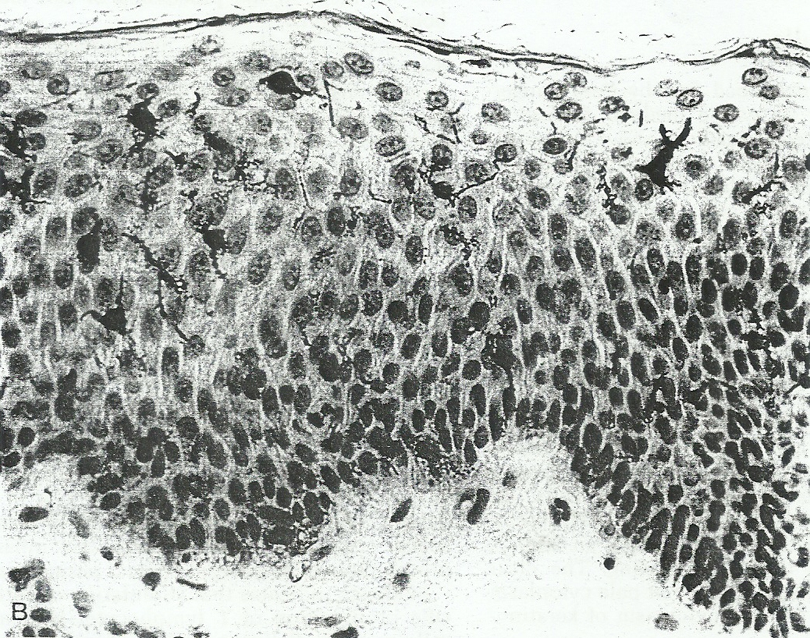
Langerhans cells

Slide 89
  THE SKIN AS A PART OF THE IMMUNE SYSTEM
IMMUNOLOGIC PROPERTIES OF LANGERHANS CELLS
Langerhans cells were shown to express receptors for the Fc fragment of antibody molecules and the Complement fragment C3b
In humans, these cells bear B cell alloantigens on their surface,
In guinea pig and mouse, they express the histocompatibility Class II genes products [Ia antigens]

Slide 90
  THE SKIN AS A PART OF THE IMMUNE SYSTEM
IMMUNOLOGIC PROPERTIES OF LANGERHANS CELLS
It was demonstrated that contact allergens applied to skin accumulate preferentially within Langerhans cells --> T cells exposed to antigen-pulsed Langerhans-cell-enriched epidermal cell preparations are induced to proliferate
Increased numbers of Langerhans cells were observed in dermal lymphatic and in draining lymph nodes at sites sustaining contact hypersensitivity

Slide 91
  THE SKIN AS A PART OF THE IMMUNE SYSTEM
Keratinocytes produce antimicrobial peptides (AMPs) in response to infection, including human β-defensins, cathelicidins and RNases, which can be found in the corneal layer
Beneath the corneal layer of the epidermis are the granular, spinous and basal layers, that consist of keratinocytes expressing pattern recognition receptors (PRRs) which can detect invading microorganisms via pathogen-associated molecular patterns (PAMPs) expressed on the invading microorganism cell surface; this interaction initiates early immune responses in the skin

Slide 92
  THE SKIN AS A PART OF THE IMMUNE SYSTEM
EVIDENCES FOR SKIN-ASSOCIATED LYMPHOID TISSUES [SALT]
In analogy with the mucosa-associated lymphoid tissue [MALT], SALT would work as a specific sentinel for invading pathogens. In this context, skin would play not only a barrier role but also be a component of the lymphatic system. Therefore, SALT should be constituted by lymphoid follicles, vessels, antigen presenting cells [APC], and lymphocytes

Slide 93
Regulation of body temperature
Balance between heat production and heat loss
  Heat production → chemical reaction → chemical heat regulation
  Heat loss → physical in nature → physical heat regulation

Slide 94
Modes of heat loss
Radiation
Conduction
Convection
Evaporation

Slide 95
Radiation
  Heat passes from the body by invisible infrared rays
  It occurs when temperature of surrounding objects (walls, furniture, etc.) is lower than temperature of the body
  When many people are in the same room, they irradiate each other, their body temperature rises, and discomfort is felt

Slide 96
Convection
The removal of heat from the body by convection air
  The heat is conducted to the air first, the warm air becomes lighter and rises, thus replaced by cold air
  The current of air

Slide 97
Conduction
Conduction to solid objects
  Heat loss after the skin contacts directly with cold objects
Conduction to the air
Conduction to the water

Slide 98
Evaporation
Insensible perspiration
  600 – 700 ml/ day
  occurred in:
    The skin
    The lungs (respiratory tract) → water vapor
Sweating

Slide 99
Channels of heat loss
Skin (85%)
  Perspiration insensibilis
  Changes in cutaneous blood flow
  Sweating
Lungs
  Water vapor
Excreta
  Gastrointestinal tract
  Genitourinary tract

Slide 100
Body’s heat loss at moderate environmental temperature
(at a 25⁰ C)
Modes of Heat Losses | Contribution (%)
Radiation & Convection | 70 – 75 (55 + 15)
Evaporation | 21.5
Heating foods | 1.5
Heating air in the lungs | 1.3
Heat loss from urine & feces | 0.7

Slide 101
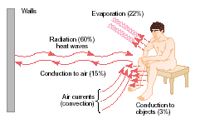
Modes of heat loss in low to moderate environmental temperature

Slide 102
Heat loss by convection and radiation
Vasodilatation
Behavioral changes

Slide 103
Vasodilatation
The skin and subcutaneous fatty tissue are heat isolators
Blood is good heat conductors
Heat loss by convection is determined by the amount of blood flow through cutaneous blood vessels

Slide 104
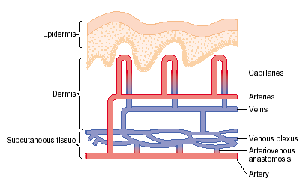
Cutaneous blood vessels

Slide 105
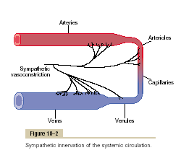
Sympathetic Innervations of
Blood Vessels

Slide 106
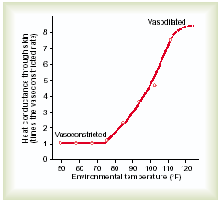
The effect of vasodilatation and vasoconstriction of cutaneous blood vessels to heat conductance

Slide 107
Mechanism of vasodilatation
There is a need for heat loss
Decrease of sympathetic activity
Decrease of norepinephrine release
Vasodilatation of cutaneous vessels
Increase of blood flow Heat loss ↑

Slide 108
Body’s heat loss at high environmental temperature
There is increased sweating and followed hopefully by increased evaporation by which the body losses heat.
Human sweats very little at low & moderate temperatures, but it sharply increases at high t⁰

Slide 109
Body’s heat loss at high environmental temperature
Modes of Heat Losses
Radiation & Convection
Evaporation
Heating foods
Heating air in the lungs
Heat loss from urine & feces

Slide 110
Body’s heat loss at high environmental temperature
Evaporation does not increase noticeably in environmental temperature < 30⁰C
At temperature > 30⁰C, there is a sudden increase in sweat secretion
At t 35⁰C, nearly all the heat is eliminated by evaporation
At 37⁰C, heat is absolutely dissipated by evaporation

Slide 111
Body’s heat loss at high environmental temperature
Evaporation of sweat from the surface of human skin relates to the function of sweat glands, which are innervated by sympathetic nerves secreted acetylcholine → serabut saraf simpatetik kolinergik .

Slide 112
Sweat gland
Innervation: cholinergic sympathetic nerve fibers
Also has adrenergic receptors → can be stimulated by adrenalin and noradrenalin (hormones) in the blood → important during exercise

Slide 113
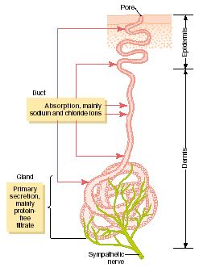
Sweat gland

Slide 114
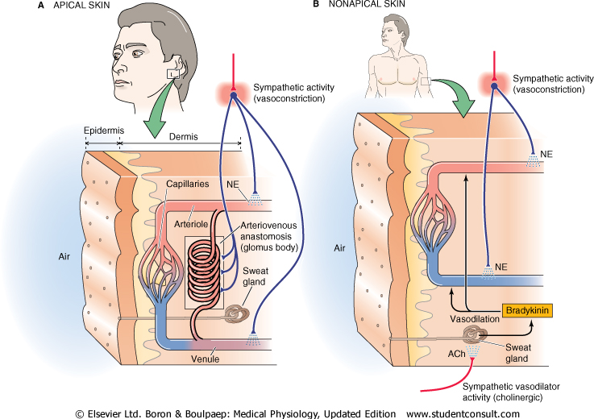

Slide 115
Sweat gland
Sweat glands have acetylcholine receptors
Acetylcholine and pilocarpine are agonist of acetylcholine receptors at sweat glands → stimulate secretion of sweat → sweating
Atropine is antagonist → inhibits → is not sweating

Slide 116
Mechanism of sweating
Mechanism of sweat secretion at rest: sweat glands are stimulated slightly → primary secretion passes the ducts slowly → extensive Na⁺ and Cl⁻ reabsorbtion thorough the ducts → hypo-osmotic of the sweat → passive reabsorbtion of water → the sweat is very concentrated and small loss of NaCl (5 mEq/ L)

Slide 117
Unacclimatization
High environmental temperature or during exercise: sweat glands are stimulated strongly → primary secretion passes the ducts fast → slightly Na⁺ and Cl⁻ reabsorbtion thorough the ducts → passive reabsorbtion of water is little → the result: the sweat is not very concentrated and large loss of Na⁺ (50 – 60 mEq/ L) → happened in an unacclimatized subject

Slide 118
Acclimatization
Person who familiarized with hot environmental temperature for 1 – 6 weeks will:
produce profuse sweating 2 – 3 L/ day
  Increased 10 times cooling effect of evaporation to body
Decreased NaCl content in the sweat → better conservation of body salt
  Roles of aldosteron to increase NaCl reabsorbtion from the ducts

Slide 119
Sweat secretion is stimulated by…
Increase environmental temperature
Physical exercise
Psychic factors
Stimulation of nerve center (such as asphyxia)
Sleep
Reflexes

Slide 120
In cold environment
Radiation and convection is decreased → heat loss is decreased → heat conservation
Modes of decreased radiation & convection
  Vasoconstriction
  Horripilation
  Behavioral changes

Slide 121
Mechanism of vasoconstriction
There is a need for heat conservation
Increase of sympathetic activity
Release of norepinephrine
Vasoconstricion of cutaneous vessels
Decrease of blood flow Heat loss ↓

Slide 122
Horripilation
Contraction of smooth muscles of the skin (mm. arrectores pilorum)
Air trap in the fur
Heat isolator
Body’s heat loss ↓

Slide 123
Thermoreceptors
Peripheral thermoreceptors: in the skin (skin thermoreceptors)
Central thermoreceptor: in the preoptic area of the hypothalamus
(anterior hypothalamus)

Slide 124
Skin thermoreceptors
Warmth receptors
Stimulated by increased environmental temperature, up to 44 -46⁰C
Cold receptors
is stimulated as local temperature decreases from 40⁰C to 24 – 28⁰C
  Cold receptors are much more abundant & important than warmth receptors

Slide 125
Skin thermoreceptors
Skin thermoreceptors provide:
  information about skin/ environmental temperature to hypothalamic thermoregulatory center
  conscious perception of environmental temperature & estimation of thermal comfort via thalamic pathways to cerebral cortex

Slide 126
Central thermoreceptors
At this anterior part of hypothalamus, warmth receptors greatly outnumber cold receptors
Around 10% of hypothalamic neurons show a positive temperature coefficient when local temperature (i.e. blood flow to hypothalamus) is cycled over a range of 2 – 4⁰C about the mean -- Thermostat

Slide 127
Central thermoreceptors
Hypothalamic thermoreceptors are important during exercise, in which body’s heat production & dissipation can differ dramatically, leading to rapid changes in body core temperature

Slide 128
Thermoregulatory center
The posterior hypothalamus summates the central and peripheral temperature sensory signals

Slide 129
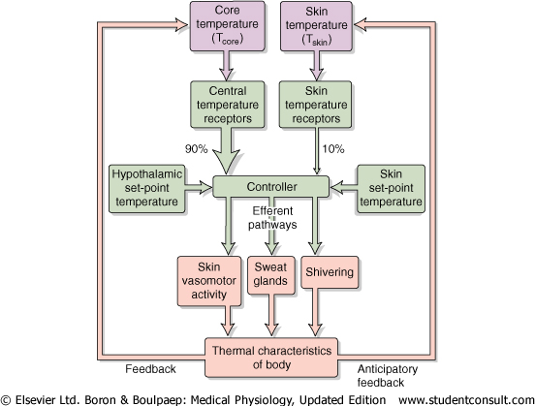
Heat regulation

Slide 130
The response exerted by the thermoregulatory center when the body is too hot
Increase heat loss
  Cutaneous vasodilatation
  Sweating
  Increased respiration
Decrease heat production
  Anorexia
  Apathy & inertia
  Shivering is inhibited

Slide 131
The response exerted by the thermoregulatory center when the body is too cold
Increase heat production
  Shivering
  Feeding
  Increased thyroxin and catecholamine secretion
Decrease heat loss
  Cutaneous vasoconstriction
  Horripilate

