Slide 1


The future starts today, not tomorrow.
Kuliah Blok 5
Sistem Penghidu
& Pengecap
www.umy.ac.id
Ikhlas Muhammad Jenie
Bagian Fisiologi

Slide 2
Tujuan Instruksional Umum
Mahasiswa mampu menjelaskan fungsi alat dan sistem penghidu dan pengecap dalam keadaan fisiologis dan patologis tertentu agar kemudian dapat digunakan sebagai pola pikir untuk membantu menegakkan diagnosis dan melakukan tindakan pengobatan penderita penyakit-penyakit tertentu.

Slide 3
Tujuan Instruksional Khusus
(Learning Outcomes)
Mahasiswa mampu menjelaskan reseptor olfaktorius dan mekanisme transduksinya.
Mahasiswa mampu menjelaskan jaras olfaktorius.
Mahasiswa mampu menjelaskan reseptor pengecap dan mekanisme transduksinya.
Mahasiswa mampu menjelaskan jaras pengecapan.
Describe the cutaneous and proprioceptive mechanoreceptors and their function:
Pacinian corpuscles, Meissner’s corpuscles, Ruffini endings, Merkel cell, A-delta and C free
Describe the cutaneous and proprioceptive mechanoreceptors and their function:
nerve endings, Golgi tendon organ, muscle spindle
Pacinian corpuscles, Meissner’s corpuscles, Ruffini endings, Merkel cell, A-delta and C free
nerve endings, Golgi tendon organ, muscle spindle

Slide 4
Chemical Senses: Smell
Smell is a primitive sense not well developed in humans.
Within each nostril, receptor cells are located in the olfactory mucous membrane.
To be detected, substances must be slightly water soluble and somewhat lipophilic.
The receptor proteins are coupled to cytoplasmic G-proteins, allowing the olfactory system to detect substances at a concentration of only one part per billion.

Slide 5
Chemical Senses: Smell
The G-proteins activate adenylate cyclase and the production of cAMP, which opens Na⁺ channels, producing a depolarizing receptor potential.
The receptor potential depolarizes the initial segment of the axon, propagating action potentials.
Receptor cells are true neurons that conduct action potentials to the CNS and are continuously replaced by basal stem cells of the olfactory epithelium.

Slide 6
Chemical Senses: Smell
The axons of the olfactory receptor neurons penetrate the cribriform plate and enter the olfactory bulb.
The three olfactory pathways that lead to the CNS are:
  The pathway to the medial olfactory area anterior to the hypothalamus.
  The pathway to the lateral olfactory area of the pyriform cortex, which is the area of aversion development (eg, smells inducing nausea).
  The pathway to the posterior part of the orbitofrontal cortex, which is an important area for analysis of smells.

Slide 7
Chemical Senses: Smell
The olfactory epithelium is innervated by the trigeminal nerve (CN V), which detects noxious stimuli (eg, menthol).
Because olfactory nerves pass through the cribriform plate on their way to the olfactory bulb, damage to the cribriform plate can lead to a loss of the sense of smell (anosmia).
Olfactory thresholds increase with aging, resulting in a majority of 80 year olds not being able to identify smells.

Slide 9
Olfactory Membrane/ Epithelium
The olfactory membrane/ epithelium lies in the superior part of each nostril, with a surface area of about 2.4 – 3 cm².
  Medially, the olfactory membrane folds downward along the surface of the superior septum;
  Laterally, it folds over the superior turbinate and even over a small portion of the upper surface of the middle turbinate.

Slide 10
Olfactory Membrane/ Epithelium
The olfactory epithelium is composed of three main cellular types:
  the olfactory sensory neurons (also called olfactory cells/ receptors),
  the sustentacular or supporting cells, and
  the basal epithelial or stem cells.

Slide 11
Olfactory Cells.
The receptor cells for the smell sensation are the olfactory cells, which are bipolar nerve cells derived originally from the central nervous system.
There are about 100 million of the olfactory cells in the olfactory epithelium interspersed among sustentacular cells.

Slide 12
Olfactory Cells.
The mucosal end of the olfactory cell forms a knob from which 4-25 olfactory hairs (olfactory cilia) project into the mucus that coats the inner surface of the nasal cavity.
  Olfactory cilia have 0.3 μm in diameter and up to 200 μm in length.
Spaced among the olfactory cells in the olfactory membrane are many small Bowman’s glands that secrete mucus onto the surface of the olfactory membrane.

Slide 13
Olfactory Cells.
Olfactory neurons degenerate with a lifetime (turnover) of 30–40 days.
The dying neuron is replaced by a newly differentiated stem cell, which eventually expresses the same cellular properties in terms of odor sensitivity, odor preference, and axonal projection as the previous neuron.

Slide 14
Stimulation of the Olfactory Cells:
Mechanism of Excitation of the Olfactory Cells.
The odorant substance
contact with the olfactory membrane surface
diffuses into the mucus that covers the cilia
binds with receptor proteins in the membrane of each cilium.

Slide 15
Stimulation of the Olfactory Cells:
Mechanism of Excitation of the Olfactory Cells
Each receptor protein is a long molecule that spans through the membrane about seven times, folding inward and outward.
  The odorant binds with the portion of the receptor protein that folds to the outside.
  The inside of the folding protein is coupled to G-protein, a combination of three subunits.
  Adenylyl cyclase, which is attached to the inside of the ciliary membrane near the receptor cell body.

Slide 16
Mechanism of Excitation of the Olfactory Cells.
The odorant substance excites the receptor protein
An alpha subunit breaks away from the G-protein
An alpha subunit of G-protein activates adenylyl cyclase
The activated cyclase converts many molecules of intracellular adenosine triphosphate into cyclic adenosine monophosphate (cAMP)

Slide 17
Mechanism of Excitation of the Olfactory Cells.
cAMP activates nearby a gated sodium ion channel
Its “gate” opens
Allows large numbers of sodium ions to pour through the membrane into the receptor cell cytoplasm
Sodium ions increase the electrical potential in the positive direction inside the cell membrane

Slide 18
Mechanism of Excitation of the Olfactory Cells.
The olfactory neuron is excited
Action potentials are transmitted into the central nervous system by way of the olfactory nerve

Slide 19
Membrane Potentials and Action Potentials in
Olfactory Cells
The membrane potential inside unstimulated olfactory cells, as measured by microelectrodes, averages about –55 millivolts.
  At this potential, most of the cells generate continuous action potentials at a very slow rate, varying from once every 20 seconds up to two or three per second.
Most odorants cause depolarization of the olfactory cell membrane, decreasing the negative potential in the cell from the normal level of –55 millivolts to –30 millivolts or less; changing the voltage in the positive direction.

Slide 20
Membrane Potentials and Action Potentials in
Olfactory Cells
  Along with this, the number of action potentials increases to 20 to 30 per second, which is a high rate for the minute olfactory nerve fibers.
Over a wide range, the rate of olfactory nerve impulses changes approximately in proportion to the logarithm of the stimulus strength, which demonstrates that the olfactory receptors obey principles of transduction similar to those of other sensory receptors.

Slide 21
Adaptation
Smell sensations adapt almost to extinction within a minute or so after entering a strongly odorous atmosphere.
  The olfactory receptors adapt about 50 per cent in the first second or so after stimulation. Thereafter, they adapt very little and very slowly.
The psychological adaptation is far greater than the degree of adaptation of the receptors themselves -- > most of the adaptation occurs within the central nervous system.
  This seems to be true for the adaptation of taste sensations as well.

Slide 22
Transmission of Smell Signals into the Central Nervous System
The olfactory portions of the brain were among the first brain structures developed in primitive animals.
Part of the brain that originally sub served olfaction later evolved into the basal brain structures that control emotions and other aspects of human behavior (the limbic system).

Slide 23
Transmission of Olfactory Signals into the Olfactory Bulb
The olfactory nerve (the cranial nerve I or the olfactory tract) fibers leading backward from the olfactory bulb.
Both the tract and the bulb are an anterior outgrowth of brain tissue from the base of the brain.
The bulbous enlargement at its end, the olfactory bulb, lies over the cribriform plate, separating the brain cavity from the upper reaches of the nasal cavity.

Slide 24
Transmission of Olfactory Signals into the Olfactory Bulb
The cribriform plate has multiple small perforations through which an equal number of small nerves pass upward from the olfactory membrane in the nasal cavity to enter the olfactory bulb in the cranial cavity.
Short axons from the olfactory cells terminating in multiple globular structures within the olfactory bulb called glomeruli.
Each bulb has several thousand such glomeruli, each of which is the terminus for about 25,000 axons from olfactory cells.
  Different glomeruli respond to different odors.

Slide 25
Transmission of Olfactory Signals into the Olfactory Bulb
Each glomerulus also is the terminus for dendrites from about 25 large mitral cells and about 60 smaller tufted cells, the cell bodies of which lie in the olfactory bulb superior to the glomeruli. These dendrites receive synapses from the olfactory cell neurons.
The mitral and tufted cells send axons through the olfactory tract to transmit olfactory signals to higher levels in the central nervous system.

Slide 26
Transmission of Olfactory Signals into the Olfactory Bulb
Olfactory cells → glomeruli → mitral cells → olfactory tract → CNS
(olfactory bulb)

Slide 27
Olfactory Pathways
The olfactory tract enters the brain at the anterior junction between the mesencephalon and cerebrum.
The tract divides into two pathways:
  The medial olfactory area of the brain stem.
  The lateral olfactory area of the brain stem.
    The medial olfactory area
      A very old olfactory system.
    The lateral olfactory area is the input to:
      A less old olfactory system
      A newer system.

Slide 28
The Medial Olfactory Area:
The Very Old Olfactory System
The medial olfactory area consists of a group of nuclei located in the midbasal portions of the brain immediately anterior to the hypothalamus.
One of them are the septal nuclei, which are midline nuclei that feed into the hypothalamus and other primitive portions of the brain’s limbic system, which are most concerned with basic behavior (primitive responses), such as:
  licking the lips,
  salivation,
  other feeding responses caused by the smell of food or by primitive emotional drive associated with smell.

Slide 29
The Lateral Olfactory Area:
The Less Old Olfactory System
The lateral olfactory area is composed mainly of the prepyriform and pyriform cortex + the cortical portion of the amygdaloid nuclei.
From pyriform cortex and the amygdaloid nuclei, signal pathways pass into almost all portions of the limbic system, especially into less primitive portions such as the hippocampus, which is most important for learning to like/ dislike certain foods depending on one’s experiences with them.
  For instance, when a person develops an absolute aversion to foods that have caused nausea and vomiting.

Slide 30
The Lateral Olfactory Area:
The Less Old Olfactory System
An important feature of the lateral olfactory area is:
  The lateral system deals with the more complicated olfactory conditioned reflexes.
  Many signal pathways from this area also feed directly into an older part of the cerebral cortex (the paleocortex) in the anteromedial portion of the temporal lobe.
    This is the only area of the entire cerebral cortex where sensory signals pass directly to the cortex without passing first through the thalamus.

Slide 31
The Newer Pathway
A newer olfactory pathway has now been found that passes through the thalamus, passing to the dorsomedial thalamic nucleus and then to the lateroposterior quadrant of the orbitofrontale cortex.
Based on studies in monkeys, this newer system probably helps in the conscious analysis of odor.

Slide 32
Summary
A very old olfactory system that subserves the basic olfactory reflexes,
A less old system that provides automatic but partially learned control of food intake and aversion to toxic and unhealthy foods,
A newer system that is comparable to most of the other cortical sensory systems and is used for conscious perception and analysis of olfaction.

Slide 33
ANOSMIA
Anosmia is a loss of the sense of smell.
Possible causes include:
  viral disease;
  trauma (eg, fracture of the cribriform plate);
  congenital hypogonadism due to Kallmann syndrome, a gonadotropin-releasing hormone deficiency;
  smoking; or
  tumor (eg, olfactory meningoma).

Slide 34
COVID-19 and Anosmia
Like its closest relative SARS-CoV1, SARS-CoV2 binds through its receptor-binding domain (RBD) to human angiotensin converting enzyme ACE2 receptor protein, however SARS-CoV2 binds with higher affinity than SARS-CoV1.
ACE2 is ubiquitously expressed in human organs including lung parenchyma, renal and urinary tract, human airway epithelia, lymphoid tissues, reproductive organs, vascular endothelium, and brain while the nasal mucosa or the gastrointestinal tract exhibit particularly high expression levels and may therefore be more vulnerable to viral onslaught.

Slide 35
COVID-19 and Anosmia
There is still debate as to which cells in the nasopharynx express ACE2. Interestingly, olfactory receptor cells do not express ACE2, as well as another gene involved in SARS-CoV2 entry (TMPRSS2) implying that damage to the olfactory receptor cells may be mediated through other cells.
Sustenuclar cells which support olfactory neurons, express ACE2 as well as TMPRSS2 and are infected by SARS-CoV-2. They may therefore represent the viral entry point to the nasopharynx.

Slide 36
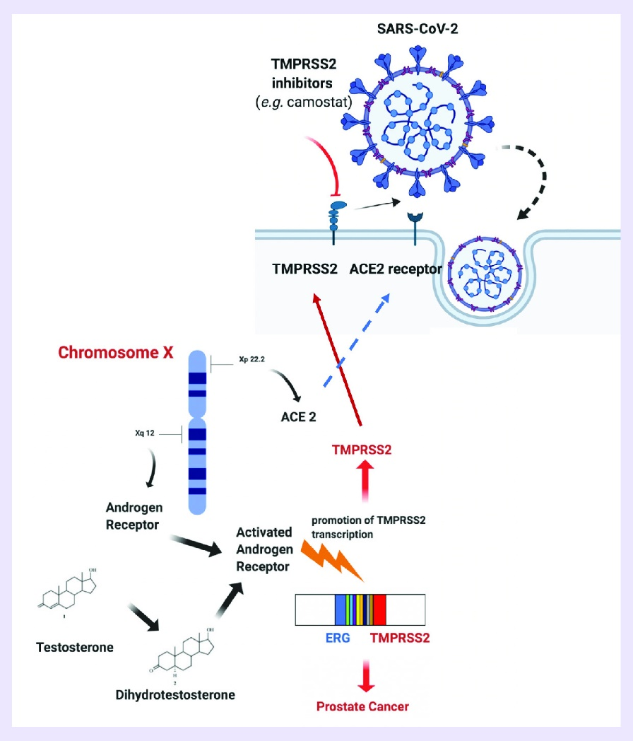
ACE2 Receptors, TMPRSS2 and SARS-CoV-2

Slide 37
COVID-19 and Anosmia
These findings suggest that SARS-CoV-2 infection of non-neuronal cell types, in particular of sustenuclar cells, leads to anosmia and related disturbances in odor perception in COVID-19 patients. Infection of these cells may cause rapid disruption of the epithelium and combined with a possible inflammatory response lead to smell loss.

Slide 38
Chemical Senses: Taste
1. Taste occurs via sensory receptors know as taste buds.
2. Four primary sensations of taste are sour, salty, sweet, and bitter.
3. The receptor cells are covered with microvilli, or taste hairs.
4. Taste buds are found in the walls of the fungiform, folate, and vallate papillae
on the tongue, epiglottis, palate, and pharynx. The filiform papillae that cover
the back of the tongue do not contain taste buds.
5. Fungiform papillae are located on the anterior two-thirds of the tongue and
detect sweet and salty sensations and are innervated by the facial, or chorda
tympani, nerve (CN VII).

Slide 39
Chemical Senses: Taste
6. Vallate and folate papillae are located on the posterior one-third of the tongue
and are innervated by the glossopharyngeal nerve (CN IX).
7. Binding of a taste substance to the specific receptor proteins or the taste hairs
opens Na⁺ channels, creating a receptor potential for that taste, which is
transmitted via the facial, glossopharyngeal, or vagus nerves.
8. The taste fibers unite and ascend the tractus solitarius in the medulla, where
they synapse on second-order neurons.
9. They project to the ventral posteromedial nucleus of the thalamus and are
then relayed to the taste projection area of the cerebral cortex.

Slide 40
Chemical Senses: Taste
10. Although taste cells respond to more than one taste, the response is stronger for one modality than others.
11. Taste plays an important role in food selection and the regulation of some GI secretions.

Slide 41
Primary Sensations of Taste
SOUR
SALTY
SWEET
BITTER
UMAMI

Slide 42
Primary Sensations of Taste
Sour Taste
Salty Taste
The sour taste is caused by acids, that is, by the hydrogen ion concentration.
  The intensity of this taste sensation is approximately proportional to the logarithm of the hydrogen ion concentration.
    The more acidic the food, the stronger the sour sensation becomes.
The salty taste is elicited by ionized salts, mainly by the sodium ion concentration (the cations of the salts, especially sodium cations).
  The quality of the taste varies somewhat from one salt to another, because some salts elicit other taste sensations in addition to saltiness.

Slide 43
Sweet Taste
The sweet taste is not caused by any single class of chemicals.
  Some of the types of chemicals that cause sweet taste are organic chemicals include sugars, glycols, alcohols, aldehydes, ketones, amides, esters, some amino acids, some small proteins, sulfonic acids, halogenated acids, and inorganic salts of lead and beryllium.
  Slight changes in the chemical structure, such as addition of a simple radical, can change the substance from sweet to bitter.

Slide 44
Bitter Taste
The bitter taste is not caused by any single type of chemical agent.
  The substances that give the bitter taste are almost entirely organic substances.
    Two particular classes of substances are especially likely to cause bitter taste sensations:
    Long-chain organic substances that contain nitrogen, and
    Alkaloids: include many of the drugs, such as quinine, caffeine, strychnine, and nicotine.
Some substances that at first taste sweet have a bitter aftertaste, such as saccharin.
The bitter taste, when it occurs in high intensity, usually causes the person or animal to reject the food.
  This is an important function of the bitter taste sensation, because many deadly toxins found in poisonous plants are alkaloids.

Slide 45
Umami Taste
Umami is a Japanese word (meaning “delicious”) designating a pleasant taste sensation.
Umami is the dominant taste of food containing L-glutamate, such as meat extracts and aging cheese.
A taste receptor for L-glutamate may be related to one of the glutamate receptors expressed in neuronal synapses of the brain.

Slide 46
Mechanism of Stimulation of
Taste Buds Receptor Potential
The membrane of the taste cell, like that of most other sensory receptor cells, is negatively charged on the inside with respect to the outside.
Application of a taste substance to the taste hairs causes partial loss of this negative potential—that is the taste cell becomes depolarized. In most instances, the decrease in potential, within a wide range, is approximately proportional to the logarithm of concentration of the stimulating substance.
This change in electrical potential in the taste cell is called the receptor potential for taste.

Slide 47
Mechanism of Stimulation of
Taste Buds Receptor Potential
The mechanism by which most stimulating substances react with the taste villi to initiate the receptor potential is by binding of the taste chemical to a protein receptor molecule that lies on the outer surface of the taste receptor cell near to or protruding through a villus membrane.
This, in turn, opens ion channels, which allows positively charged sodium ions or hydrogen ions to enter and depolarize the normal negativity of the cell. Then the taste chemical itself is gradually washed away from the taste villus by the saliva, which removes the stimulus.

Slide 48
Mechanism of Stimulation of
Taste Buds Receptor Potential
The type of receptor protein in each taste villus determines the type of taste that will be perceived.
  For sodium ions and hydrogen ions, which elicit salty and sour taste sensations, respectively, the receptor proteins open specific ion channels in the apical membranes of the taste cells, thereby activating the receptors.
  For the sweet and bitter taste sensations, the portions of the receptor protein molecules that protrude through the apical membranes activate second-messenger transmitter substances inside the taste cells, and these second messengers cause intracellular chemical changes that elicit the taste signals.

Slide 49
Generation of Nerve Impulses by the Taste Bud
On first application of the taste stimulus, the rate of discharge of the nerve fibers from taste buds rises to a peak in a small fraction of a second but then adapts within the next few seconds back to a lower, steady level as long as the taste stimulus remains.
Thus, a strong immediate signal is transmitted by the taste nerve, and a weaker continuous signal is transmitted as long as the taste bud is exposed to the taste stimulus.

Slide 50
Transmission of Taste Signals into the Central Nervous System
Taste impulses from the anterior two thirds of the tongue pass first into the lingual nerve, then through the chorda tympani into the facial nerve, and finally into the tractus solitarius in the brain stem.
Taste sensations from the circumvallate papillae on the back of the tongue and from other posterior regions of the mouth and throat are transmitted through the glossopharyngeal nerve also into the tractus solitarius, but at a slightly more posterior level.
Finally, a few taste signals are transmitted into the tractus solitarius from the base of the tongue and other parts of the pharyngeal region by way of the vagus nerve.

Slide 51
Transmission of Taste Signals into the Central Nervous System
All taste fibers synapse in the posterior brain stem in the nuclei of the tractus solitarius. These nuclei send second-order neurons to a small area of the ventral posterior medial nucleus of the thalamus, located slightly medial to the thalamic terminations of the facial regions of the dorsal column–medial lemniscal system.
From the thalamus, third-order neurons are transmitted to the lower tip of the postcentral gyrus in the parietal cerebral cortex, where it curls deep into the sylvian fissure, and into the adjacent opercular insular area.
This lies slightly lateral, ventral, and rostral to the area for tongue tactile signals in cerebral somatic area I.
From this description of the taste pathways, it is evident that they closely parallel the somatosensory pathways from the tongue.

Slide 52
Taste Reflexes Integrated in the Brain Stem
From the tractus solitarius, many taste signals are transmitted within the brain stem itself directly into the superior and inferior salivatory nuclei, and these areas transmit signals to the submandibular, sublingual, and parotid glands to help control the secretion of saliva during the ingestion and digestion of food.

